Slide 1
Mission and Motivation
New Jersey Conference
Associate Master Guide State Coordinator

Slide 2
Goals of this Course
Understand our mission in terms of the Great Commandments and the Great Commission.
Understand the 7 levels of moral development and how they impact our motivation as individuals, Pathfinders, and Pathfinder staff.
Understand how our spiritual growth (sanctification) affects how we are motivated.

Slide 3
Definition of mission
An important assignment carried out for political, religious, or commercial purposes.
The vocation or calling of a religious organization, especially a Christian one, to go out into the world and spread its faith.

Slide 4
Examples of mission Statement - 1
Apple Company Mission Statement: ”Bringing the best user experience to its customers through innovative hardware, software and services”.
Bank of America Mission Statement: ”We make financial lives better for our clients and our communities through the power of every connection”.

Slide 5
Examples of mission Statement - 2
Baptist Church Mission Statement: ”American Baptist Churches are missional congregations that nurture devoted disciples of Jesus Christ who live their lives in mission and ministry for the healing of the world through the love of God”.
Amish Community Mission Statement: ”WE STAND: for the verbally inspired Word of God, the Trinity, the deity of Christ, His blood atonement, salvation by faith, separation from the world, soul winning and the pre-millennial return of Christ”.

Slide 6
Let's Start With Our Mission
Matthew 22:36-40
³⁶ “Teacher, which is the great commandment in the law?”
³⁷ Jesus said to him, “‘You shall love the Lord your God with all your heart, with all your soul, and with all your mind.’ ³⁸ This is the first and great commandment.
³⁹ And the second is like it: ‘You shall love your neighbor as yourself.’ ⁴⁰ On these two commandments hang all the Law and the Prophets.”

Slide 7
Let’s Start With Our Mission
Love God
Love fellow man
Matthew 28:18-20

Slide 8
Let’s Start With Our Mission
Matthew 28:18-20
¹⁸ And Jesus came and spoke to them, saying, “All authority has been given to Me in heaven and on earth. ¹⁹ Go therefore and make disciples of all the nations, baptizing them in the name of the Father and of the Son and of the Holy Spirit, ²⁰ teaching them to observe all things that I have commanded you; and lo, I am with you always, even to the end of the age.” Amen.

Slide 9
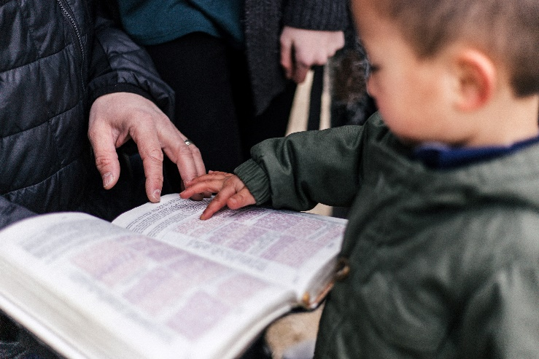
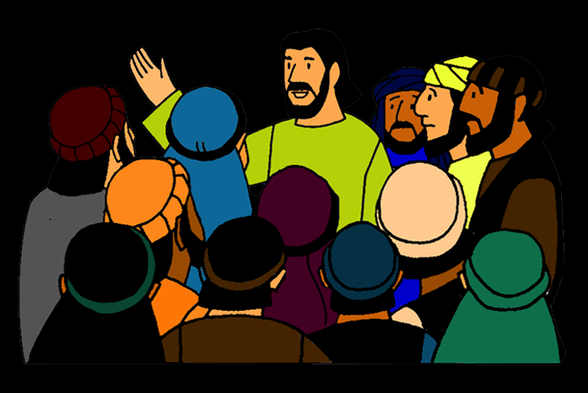
Let’s Start With Our Mission
Love God
Love fellow man
Baptizing
Teaching
Make disciples

Slide 10
Breakout Question #1 (3 min)
How does the Pathfinder program fulfill our Christian mission? (Please be specific in relating parts of the program to the elements of the mission)

Slide 11
Definition of Motivation
the reason or reasons one has for acting or behaving in a particular way.
the general desire or willingness of someone to do something.
The word motivation is derived from the Latin term 'movere', which means 'to move'.

Slide 12
The Seven Levels of Moral Development
7
6
5
4
3
2
1

Slide 13
What is Moral Development ?
Moral development is the process through which humans develop proper attitudes and behaviors toward other people in society.

Slide 14
The Seven Levels of Moral Development
7
6
5
4
3
2
1
Matthew 25:14-30 The Parable of the Talents

Slide 15
The Parable of the Talents
¹⁴ “For the kingdom of heaven is like a man traveling to a far country, who called his own servants and delivered his goods to them.
¹⁵ And to one he gave five talents, to another two, and to another one, to each according to his own ability; and immediately he went on a journey.
¹⁶ Then he who had received the five talents went and traded with them, and made another five talents.
¹⁷ And likewise he who had received two gained two more also.
¹⁸ But he who had received one went and dug in the ground, and hid his lord’s money.
¹⁹ After a long time the lord of those servants came and settled accounts with them.

Slide 16
The Parable of the Talents
²⁰ “So he who had received five talents came and brought five other talents, saying, ‘Lord, you delivered to me five talents; look, I have gained five more talents besides them.’
²¹ His lord said to him, ‘Well done, good and faithful servant; you were faithful over a few things, I will make you ruler over many things. Enter into the joy of your lord.’
²² He also who had received two talents came and said, ‘Lord, you delivered to me two talents; look, I have gained two more talents besides them.’
²³ His lord said to him, ‘Well done, good and faithful servant; you have been faithful over a few things, I will make you ruler over many things. Enter into the joy of your lord.’

Slide 17
The Parable of the Talents
²⁴ “Then he who had received the one talent came and said, ‘Lord, I knew you to be a hard man, reaping where you have not sown, and gathering where you have not scattered seed.
²⁵ And I was afraid, and went and hid your talent in the ground. Look, there you have what is yours.’
²⁶ “But his lord answered and said to him, ‘You wicked and lazy servant, you knew that I reap where I have not sown, and gather where I have not scattered seed.

Slide 18
The Parable of the Talents
²⁷ So you ought to have deposited my money with the bankers, and at my coming I would have received back my own with interest.
²⁸ So take the talent from him, and give it to him who has ten talents.
²⁹ ‘For to everyone who has, more will be given, and he will have abundance; but from him who does not have, even what he has will be taken away.
³⁰ And cast the unprofitable servant into the outer darkness. There will be weeping and gnashing of teeth.’

Slide 19
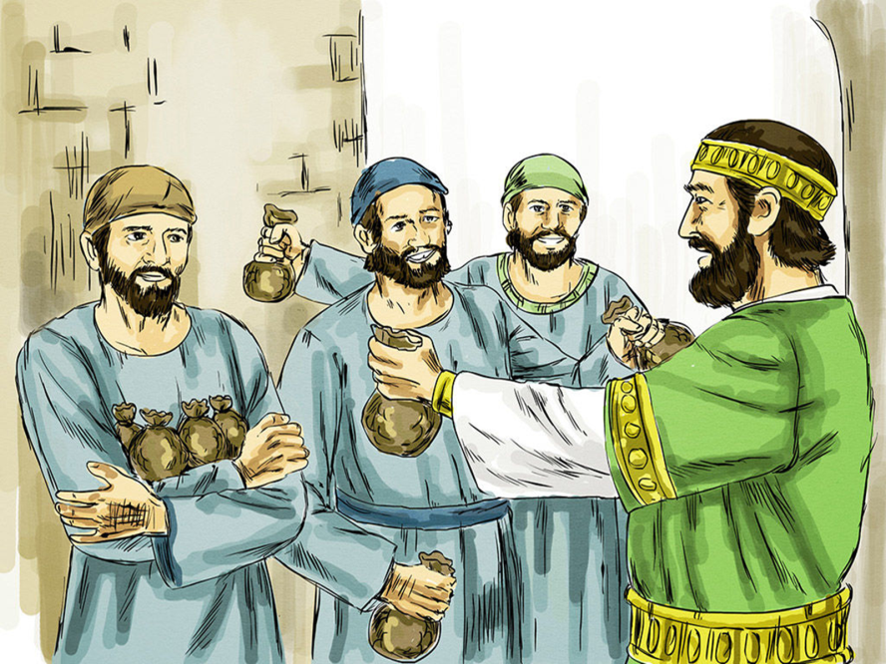
Reward and punishment
Biblical example - Parable of the talents
Pathfinder example – “If you don’t quiet down, there will be no smores at campfire tonight!”
Staff example – “I can’t help you because I will be held accountable if I fail.”
Chief characteristic - fear

Slide 20
The Seven Levels of Moral Development
7
6
5
4
3
2
1
Matthew 19:16-26
Reward and punishment

Slide 21
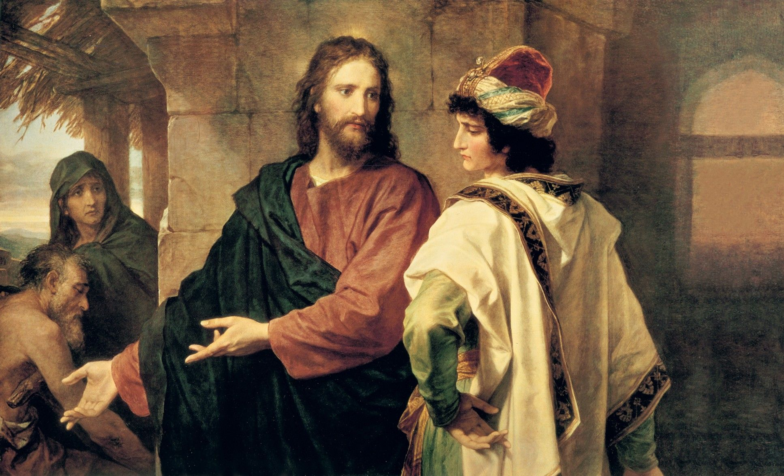
Matthew 19:16-26 - New King James Version
Jesus Counsels the Rich Young Ruler
¹⁶ Now behold, one came and said to Him, “Good Teacher, what good thing shall I do that I may have eternal life?”
¹⁷ So He said to him, “Why do you call Me good? No one is good but One, that is, God. But if you want to enter into life, keep the commandments.”
¹⁸ He said to Him, “Which ones?”
Jesus said, “‘You shall not murder,’ ‘You shall not commit adultery,’ ‘You shall not steal,’ ‘You shall not bear false witness,’ ¹⁹ ‘Honor your father and your mother,’ and, ‘You shall love your neighbor as yourself.’ ”
²⁰ The young man said to Him, “All these things I have kept from my youth. What do I still lack?”
²¹ Jesus said to him, “If you want to be perfect, go, sell what you have and give to the poor, and you will have treasure in heaven; and come, follow Me.”
²² But when the young man heard that saying, he went away sorrowful, for he had great possessions.

Slide 22
Matthew 19:16-26 -- New King James Version
With God All Things Are Possible
²³ Then Jesus said to His disciples, “Assuredly, I say to you that it is hard for a rich man to enter the kingdom of heaven.
²⁴ And again I say to you, it is easier for a camel to go through the eye of a needle than for a rich man to enter the kingdom of God.”
²⁵ When His disciples heard it, they were greatly astonished, saying, “Who then can be saved?”
²⁶ But Jesus looked at them and said to them, “With men this is impossible, but with God all things are possible.”

Slide 23
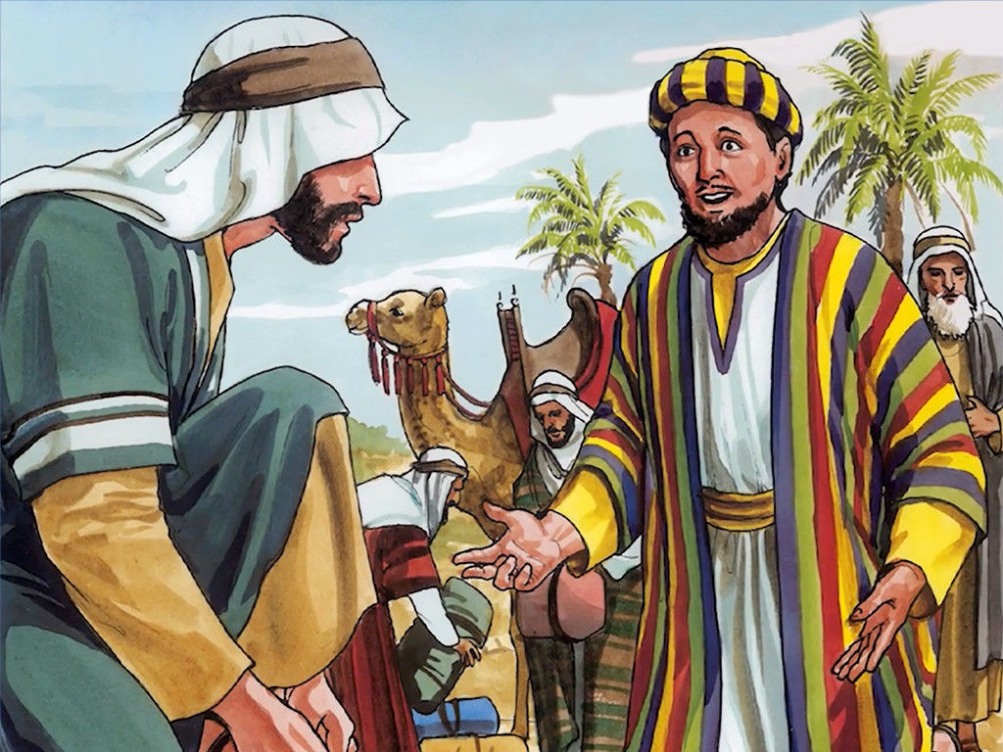
Marketplace exchange
Jesus Counsels the Rich Young Ruler.

Slide 24
Marketplace exchange
Biblical example – The rich young ruler
Pathfinder example – “If you get invested, we will have a pool party at the end of the year.”
Staff example – “I will help out as long as my child is in Pathfinders.”
Chief characteristic – bartering

Slide 25
The Seven Levels of Moral Development
7
6
5
4
3
2
Matthew 6:1-8
1
Marketplace exchange
Reward and punishment

Slide 26
Matthew 6:1-8 New King James Version
Do Good to Please God
6 “Take heed that you do not do your charitable deeds before men, to be seen by them. Otherwise you have no reward from your Father in heaven. ² Therefore, when you do a charitable deed, do not sound a trumpet before you as the hypocrites do in the synagogues and in the streets, that they may have glory from men. Assuredly, I say to you, they have their reward. ³ But when you do a charitable deed, do not let your left hand know what your right hand is doing, ⁴ that your charitable deed may be in secret; and your Father who sees in secret will Himself reward you openly.
The Model Prayer
⁵ “And when you pray, you shall not be like the hypocrites. For they love to pray standing in the synagogues and on the corners of the streets, that they may be seen by men. Assuredly, I say to you, they have their reward. ⁶ But you, when you pray, go into your room, and when you have shut your door, pray to your Father who is in the secret place; and your Father who sees in secret will reward you openly. ⁷ And when you pray, do not use vain repetitions as the heathen do. For they think that they will be heard for their many words.
⁸ “Therefore do not be like them. For your Father knows the things you have need of before you ask Him.

Slide 27
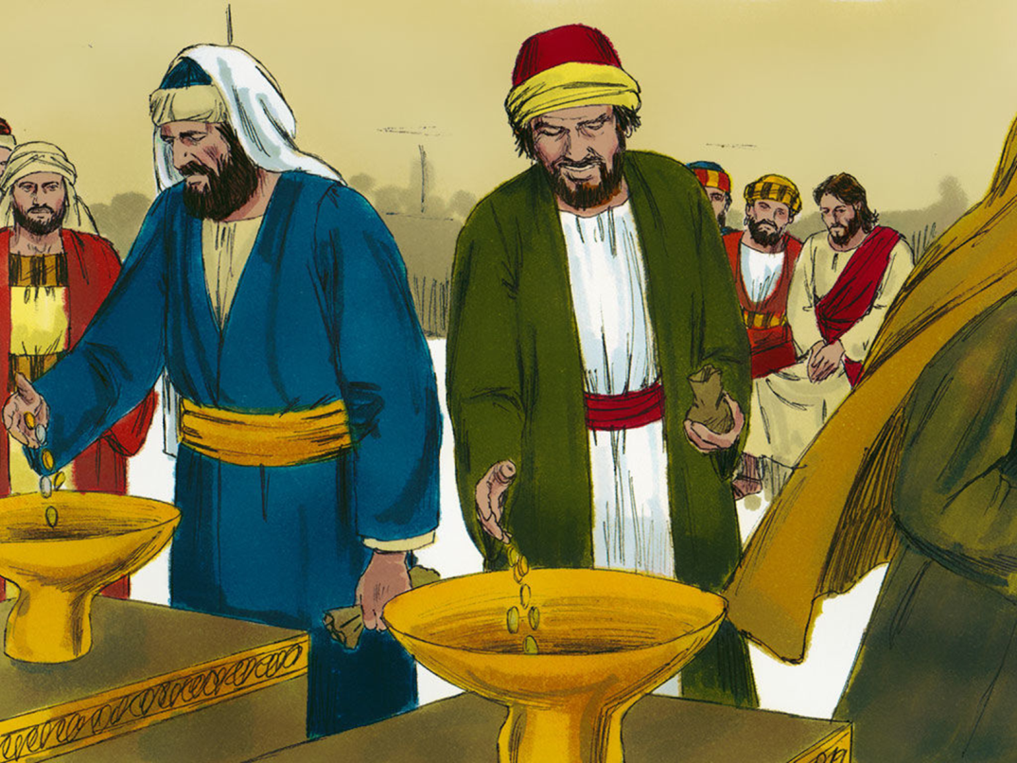
Social conformity
Biblical example – Practicing your righteousness in front of others
Pathfinder example – “You need to practice standing at attention so we don’t look bad at inspection.”
Staff example – “Working with young people will help me look good to my church.”
Chief characteristic – appearances

Slide 28
The Seven Levels of Moral Development
7
6
5
4
3
Matthew 23:23
2
Social conformity
1
Marketplace exchange
Reward and punishment

Slide 29
Matthew 23:23 - New King James Version
²³ “Woe to you, scribes and Pharisees, hypocrites! For you pay tithe of mint and anise and cummin, and have neglected the weightier matters of the law: justice and mercy and faith. These you ought to have done, without leaving the others undone.

Slide 30
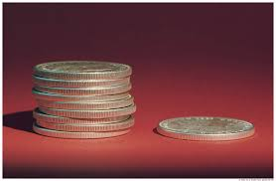
Law and order
Biblical example – Woes pronounced on the Pharisees
Pathfinder example – “If you don’t wear your uniform you can’t collect the offering for Pathfinder Sabbath.”
Staff example – “I need to work with our young people to help instill a sense of discipline in them.”
Chief characteristic – following rules

Slide 31
The Seven Levels of Moral Development
7
6
5
Luke 10:29-37
4
3
Law and order
2
Social conformity
1
Marketplace exchange
Reward and punishment

Slide 32
Luke 10:29-37 New King James Version
²⁹ But he, wanting to justify himself, said to Jesus, “And who is my neighbor?”
³⁰ Then Jesus answered and said: “A certain man went down from Jerusalem to Jericho, and fell among thieves, who stripped him of his clothing, wounded him, and departed, leaving him half dead. ³¹ Now by chance a certain priest came down that road. And when he saw him, he passed by on the other side. ³² Likewise a Levite, when he arrived at the place, came and looked, and passed by on the other side. ³³ But a certain Samaritan, as he journeyed, came where he was. And when he saw him, he had compassion. ³⁴ So he went to him and bandaged his wounds, pouring on oil and wine; and he set him on his own animal, brought him to an inn, and took care of him. ³⁵ On the next day, when he departed, he took out two denarii, gave them to the innkeeper, and said to him, ‘Take care of him; and whatever more you spend, when I come again, I will repay you.’ ³⁶ So which of these three do you think was neighbor to him who fell among the thieves?”
³⁷ And he said, “He who showed mercy on him.”
Then Jesus said to him, “Go and do likewise.”

Slide 33
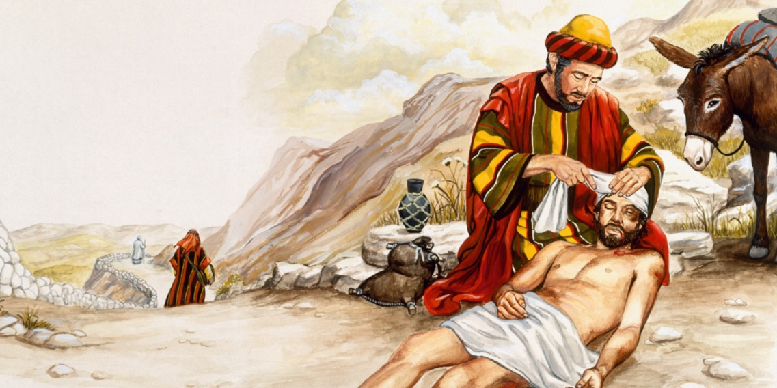
Love for others
Biblical example – The Good Samaritan
Pathfinder example – “We will help feed the homeless to show our love for those less fortunate than us.”
Staff example – “I want to help out because I remember how much I felt loved by my leaders when I was their age and our young people need to experience that.”
Chief characteristic – others focus

Slide 34
The Seven Levels of Moral Development
7
6
1st Samuel 20:14-15
5
Love for others
4
3
Law and order
2
Social conformity
1
Marketplace exchange
Reward and punishment

Slide 35
1 Samuel 20:14-15 New King James Version
¹⁴ And you shall not only show me the kindness of the Lord while I still live, that I may not die; ¹⁵ but you shall not cut off your kindness from my house forever, no, not when the Lord has cut off every one of the enemies of David from the face of the earth.”

Slide 36
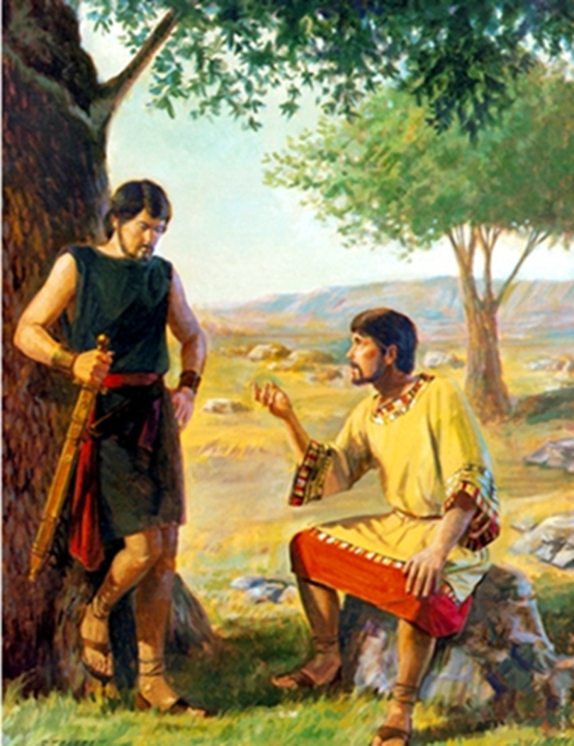
Principle-based living
Biblical example – David and Jonathan
Pathfinder example – “We will clean-up the trash at our campsite because it is the right thing to do”
Staff example – “I have committed to be a Christian and I will follow the great commission by working with our young people.”
Chief characteristic – principle

Slide 37
The Seven Levels of Moral Development
Exodus 32:9-14, 32
7
6
Principle-based living
5
Love for others
4
3
Law and order
2
Social conformity
1
Marketplace exchange
Reward and punishment

Slide 38
Exodus 32:9-14 New King James Version
⁹ And the Lord said to Moses, “I have seen this people, and indeed it is a stiff-necked people! ¹⁰ Now therefore, let Me alone, that My wrath may burn hot against them and I may consume them. And I will make of you a great nation.”
¹¹ Then Moses pleaded with the Lord his God, and said: “Lord, why does Your wrath burn hot against Your people whom You have brought out of the land of Egypt with great power and with a mighty hand? ¹² Why should the Egyptians speak, and say, ‘He brought them out to harm them, to kill them in the mountains, and to consume them from the face of the earth’? Turn from Your fierce wrath, and relent from this harm to Your people. ¹³ Remember Abraham, Isaac, and Israel, Your servants, to whom You swore by Your own self, and said to them, ‘I will multiply your descendants as the stars of heaven; and all this land that I have spoken of I give to your descendants, and they shall inherit it forever.’ ” ¹⁴ So the Lord relented from the harm which He said He would do to His people.

Slide 39
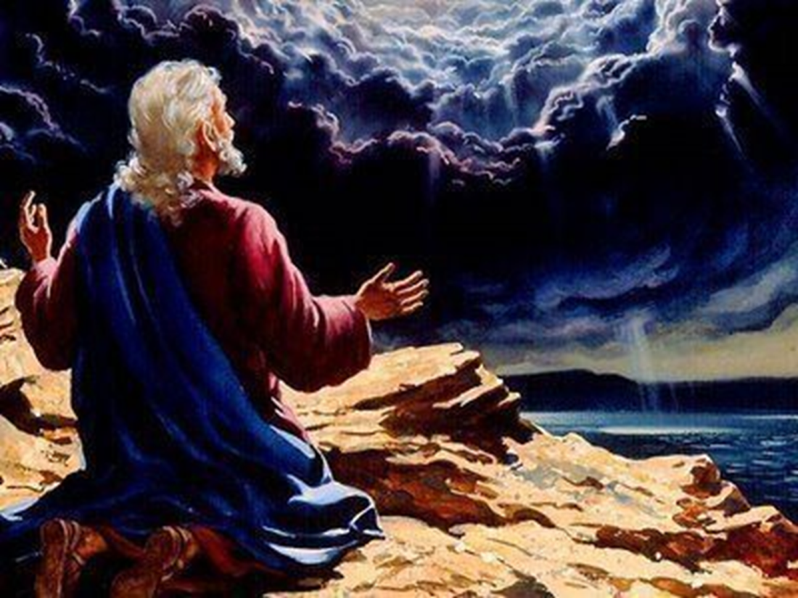
Understanding friend of God
Biblical example – Moses pleads with God
Pathfinder example – “I want to be God’s friend and have a growing relationship with Him”
Staff example – “As a friend of God, I know that leading and discipling His young people into a relationship with God is the greatest thing I can do for Him and them.”
Chief characteristic – relationship

Slide 40
The Seven Levels of Moral Development
7
Understanding friend of God
6
Principle-based living
5
Love for others
4
3
Law and order
2
Social conformity
1
Marketplace exchange
Reward and punishment

Slide 41
The Seven Levels of Moral Development
7
Understanding friend of God
6
God-
focus
Principle-based living
5
Love for others
4
Others-
focus
3
Law and order
2
Social conformity
1
Marketplace exchange
Self-focus
Reward and punishment

Slide 42
Growth and motivation
The different levels of motivation are not necessarily good or bad in themselves but represent different levels of spiritual maturity.
They can become bad when we refuse to grow. We need to grow from the first 4 levels to the last 3 levels.
People can operate at a variety of different levels, depending on the situation.
Remember God meets and deals with us where we are but He never intends to leave us there. (Example: the nation of Israel)
The technical term for this growth is sanctification.

Slide 43
The Seven Levels of Moral Development
7
Understanding friend of God
6
God-
focus
Principle-based living
5
Love for others
4
Others-
focus
3
Law and order
2
Social conformity
1
Marketplace exchange
Self-focus
Reward and punishment

Slide 44
Breakout Question #2 (5 min)
What things can we as leaders do to help both Pathfinders and staff to grow in their levels of motivation?

Slide 45
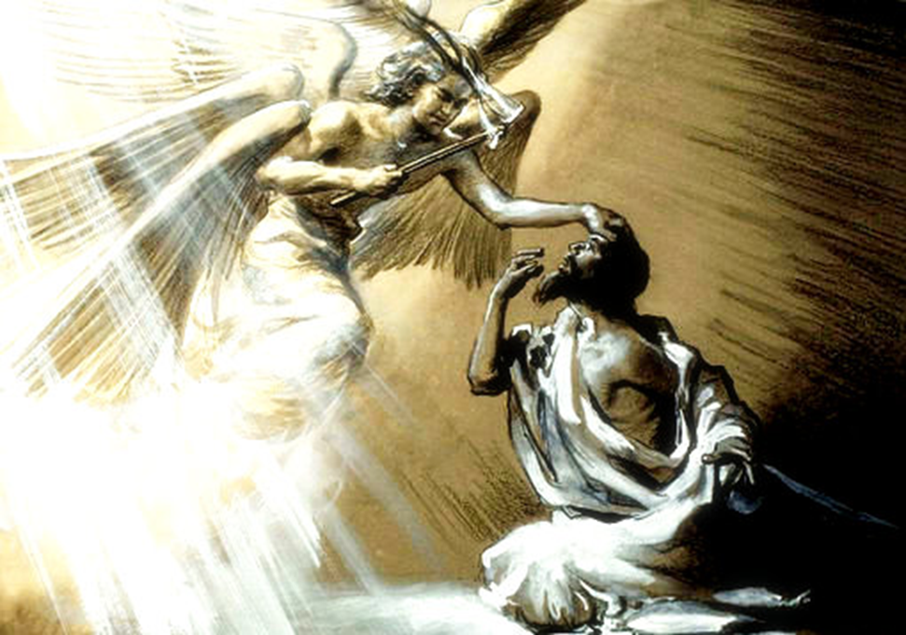
Biblical Example of Growth
Isaiah 6:1-8

Slide 46
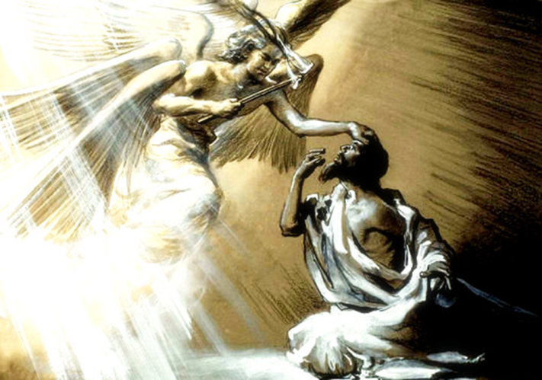
Isaiah 6:1-8 New King James Version
Isaiah Called to Be a Prophet
6 In the year that King Uzziah died, I saw the Lord sitting on a throne, high and lifted up, and the train of His robe filled the temple. ² Above it stood seraphim; each one had six wings: with two he covered his face, with two he covered his feet, and with two he flew. ³ And one cried to another and said:
“Holy, holy, holy is the Lord of hosts; The whole earth is full of His glory!”
⁴ And the posts of the door were shaken by the voice of him who cried out, and the house was filled with smoke.
⁵ So I said:
“Woe is me, for I am undone! Because I am a man of unclean lips, And I dwell in the midst of a people of unclean lips; For my eyes have seen the King The Lord of hosts.”
⁶ Then one of the seraphim flew to me, having in his hand a live coal which he had taken with the tongs from the altar. ⁷ And he touched my mouth with it, and said:
“Behold, this has touched your lips; Your iniquity is taken away, And your sin purged.”
⁸ Also I heard the voice of the Lord, saying:
“Whom shall I send, And who will go for Us ?”
Then I said, “Here am I! Send me.”

Slide 47
Biblical Example of Growth
He is afraid
He acknowledges who he really is, a sinner
He receives the forgiveness of God, symbolized by the coal from the altar touching his lips
He proceeds to do God’s work, “Here am I, send me”

Slide 48
Other Examples of Growth
Abraham
David
Peter
Paul

Slide 49
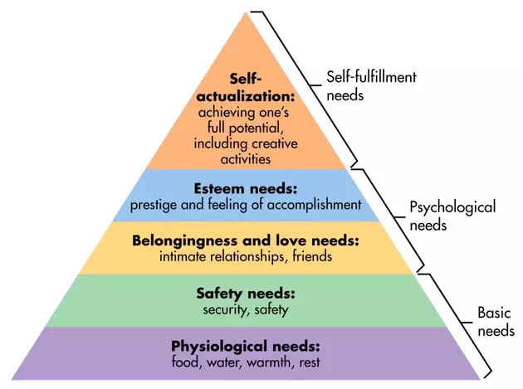
Humanistic View of Motivation: Maslow’s Hierarchy of Needs
Who is Maslow ?

Slide 50
Problems with Humanistic Views of Motivation
They tend to be centered on self

Slide 51
Motivating Staff - Practical Steps
Try to identify what the person’s primary level of motivation is.
Assign a task that best overlaps with their own level of motivation
Challenge them with new tasks that force them to think outside of the preferred level of motivation

Slide 52
Motivating Adolescents - Practical Steps
Enthusiasm
Be a model
Provide them opportunities to take the initiative
Involve them in decision making
Positive peer influence
Safe environment for risk taking
Build relationships

Slide 53
Motivation Final Thoughts
Motivation is accomplished by understanding and meeting the needs of the individual i.e. a relationship

Slide 54
Characteristics of Godly Motives
Humility - they are not done to gather the attention of anyone. They are done quietly, behind the scenes.
It is done for others out of a true sense of love and caring for them.
It is done in a spirit of joy.
It is a result of living the lifestyle of being a new creation in Christ.

Slide 55
Connecting the Dots
True fulfillment of our mission (the Great Commission) cannot happen outside of a relationship with God and with those we are reaching out to.

Slide 56
Motivation Final Thoughts
“The oil of grace gives to men the courage, and supplies to them the motives for doing every day the work that God appoints to them.”
Ellen G. White, Review & Herald, Mar 27, 1894.

Slide 57
Motivation Final Thoughts
”I no longer call you servants, because a servant does not know his master’s business. Instead, I have called you friends, for everything that I learned from my Father I have made known to you.”
John 15:15 (NIV)

Slide 58
Mission and Motivation
Group
Discussion?

