Slide 1
Go and make disciples!
Our role in the world
Matt. 28:16-20
My role as a leader
Eph. 4:11-16
Notes:
----- Meeting Notes (9/6/13 23:31) -----
How do you show you love your young people?

Slide 2
We all are called to Disciple
Matt 28:16-20
16 Then the eleven disciples went to Galilee, to the mountain where Jesus had told them to go.
17 When they saw him, they worshiped him; but some doubted.
18 Then Jesus came to them and said, "All authority in heaven and on earth has been given to me. (NIV)
Notes:
----- Meeting Notes (9/6/13 23:31) -----
When Jesus said go and make disciples, how does this relate to young people?

Slide 3
We all are called to Disciple
Matt 28:16-20
19 Therefore go and make disciples of all nations, baptizing them in the name of the Father and of the Son and of the Holy Spirit,
20 and teaching them to obey everything I have commanded you. And surely I am with you always, to the very end of the age." (NIV)
Notes:
----- Meeting Notes (9/6/13 23:31) -----
When Jesus said go and make disciples, how does this relate to young people?

Slide 4
What is a disciple ?
Karate Kid Story
Martin Luther King Story
Explain the difference of discipleship and evangelism
Following the Master
Notes:
----- Meeting Notes (9/6/13 23:31) -----
Karate Kid - Master and a disciple good and bad
MLK - have you read his speechs, what did he believe in.

Slide 5
The Discipleship Funnel

Slide 6
The Funnel of Disciple-ship
Come Level – they come for the fun, girls, friends
Grow level - they tolerate spiritual things as they have fun
Disciple Level – take the initiative for their spiritual growth
Develop Level - willing to help other people grow
Multiplier Level – become leaders to help others come
Notes:
----- Meeting Notes (9/6/13 23:31) -----
We want ready made Christians! Yet here are the 5 steps.

Slide 7
The Funnel of Disciple-ship
Come Level – Borrowed Faith – Prov. 22:6 –; Eph. 6:4
(Follow the crowd)
Grow level - Reflected Faith (1 Thess. 5:21) (Becoming owned)
Disciple Level – Personalize Faith (Gen 28:20-22) (Owned)
Established Faith (1 Tim 4:11-14) (Organize life to follow)
Develop Level – Reordered Faith (Rom 8:28)
(Emotions & Logic are solidified)
Multiplier Level – Reflective Faith (1 Eph. 9-13)(I am just one story)
Resolute Faith (1 Cor. 15:33,34) (Wisdom & Experience)
Notes:
----- Meeting Notes (9/6/13 23:31) -----
We want ready made Christians! Yet here are the 5 steps.

Slide 8
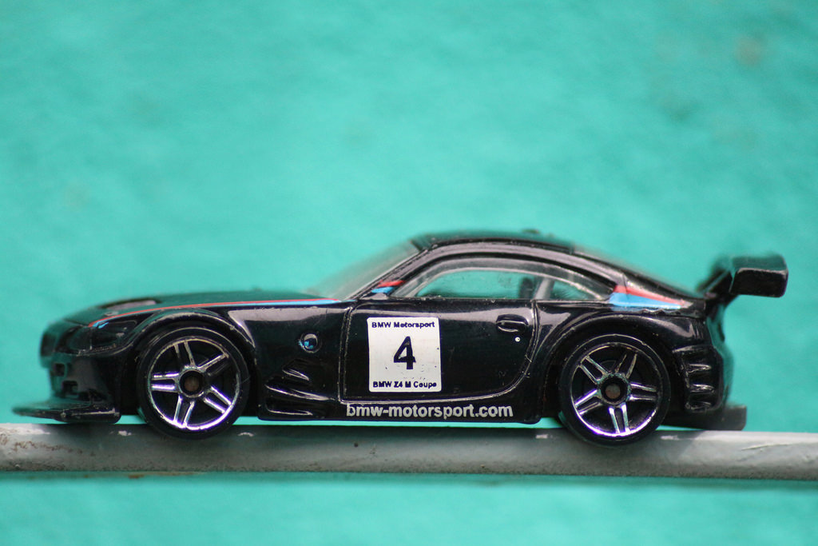
Discipleship is not for wimps
A weakness - the fast-track method
The accession of members who have not been renewed in heart and reformed in life is a source of weakness to the church.
This fact is often ignored. Some ministers and churches are so desirous of securing an increase of numbers that they do not bear faithful testimony against unchristian habits and practices.
Notes:
----- Meeting Notes (9/6/13 23:31) -----
Helping to mold their character - Basketball fight story at a Youth Federation Tournament

Slide 9
Discipleship is not for wimps
A weakness - the fast-track method
Those who accept the truth are not taught that they cannot safely be worldlings in conduct while they are Christians in name. {Ev 319.3}
Notes:
----- Meeting Notes (9/6/13 23:31) -----
Helping to mold their character - Basketball fight story at a Youth Federation Tournament

Slide 10
Group Discussion Time
Explain why the disciple is important for ministry for our young people

Slide 11
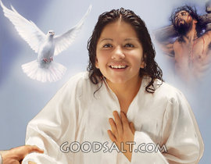
God Positioning System (GPS) Method - Acts 2:38,39 – 5 gifts
³⁸ Peter replied, "Repent and be baptized, every one of you, in the name of Jesus Christ for the forgiveness of your sins. And you will receive the gift of the Holy Spirit.
³⁹ The promise is for you and your children and for all who are far off-for
all whom the Lord our God will call."
(NIV)
Notes:
----- Meeting Notes (9/6/13 23:31) -----
The three gifts to His disciples - the promise

Slide 12
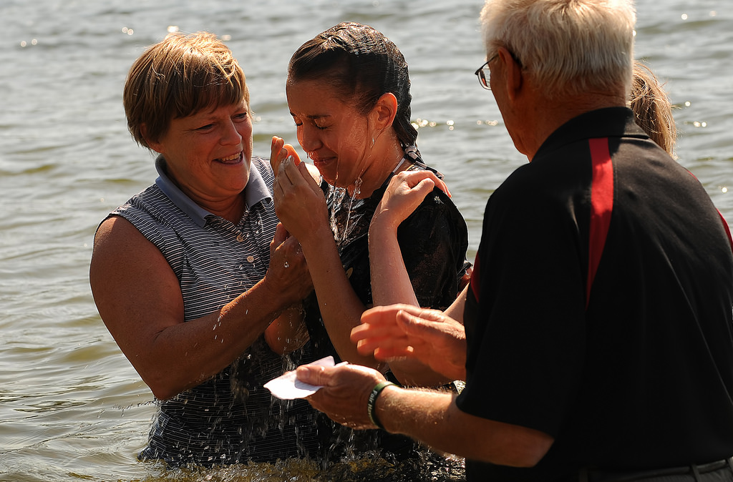
Gift 1 – You are forgiven
Acts 2:38 Peter replied, "Repent and be baptized, every one of you, in the name of Jesus Christ for the forgiveness of your sins. And you will receive the gift of the Holy Spirit. (NIV)
Notes:
----- Meeting Notes (9/6/13 23:31) -----
Gift one - seal of ownership
Gift two - Spirit in our hearts

Slide 13
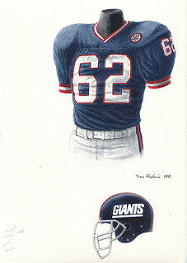
Gift 2 – You belong - God’s Team
2 Cor. 1:21 Now it is God who makes both us and you stand firm in Christ. He anointed us,
22 set his seal of ownership on us, and put his Spirit in our hearts as a deposit, guaranteeing what is to come.
(NIV)
Notes:
----- Meeting Notes (9/6/13 23:31) -----
Gift one - seal of ownership
Gift two - Spirit in our hearts

Slide 14
Gift 3 – Inheritance is assured
Eph. 1:13 And you also were included in Christ when you heard the word of truth, the gospel of your salvation. Having believed, you were marked in him with a seal, the promised Holy Spirit,
14 who is a deposit guaranteeing our inheritance until the redemption of those who are God's possession-to the praise of his glory. (NIV)

Slide 15
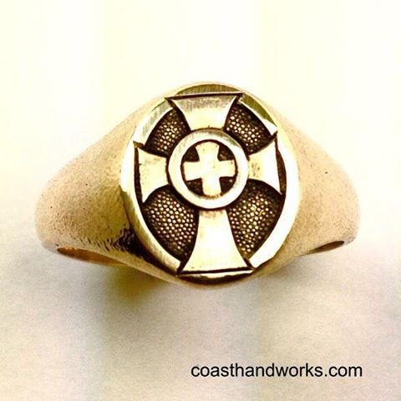
Gift 3 – Inheritance is assured
Eph 4:30 And do not grieve the Holy Spirit of God, with whom you were sealed for the day of redemption. (NIV)
Notes:
----- Meeting Notes (9/6/13 23:31) -----
Sealed - yes we are saved

Slide 16
Gift 4 – A new heart
Ezekiel 36:24-27
²⁴ “‘For I will take you out of the nations; I will gather you from all the countries and bring you back into your own land.
²⁵ I will sprinkle clean water on you, and you will be clean; I will cleanse you from all your impurities and from all your idols.
Notes:
----- Meeting Notes (9/6/13 23:31) -----
When Jesus said go and make disciples, how does this relate to young people?

Slide 17
Ezekiel 36:24-27 (NIV)
²⁶ I will give you a new heart and put a new spirit in you; I will remove from you your heart of stone and give you a heart of flesh.
²⁷ And I will put my Spirit in you and move you to follow my decrees and be careful to keep my laws.
Notes:
----- Meeting Notes (9/6/13 23:31) -----
When Jesus said go and make disciples, how does this relate to young people?

Slide 18
Group Discussion
Example the importance of the 4 gifts
Gift 1 – Forgiveness
Gift 2 – Being part of God’s team
Gift 3 – My future is secured
Gift 4 – I receive a new heart

Slide 19
1 Corinthians 12:4-11 (NIV)
Gift 5
⁴ There are different kinds of gifts, but the same Spirit distributes them.
⁵ There are different kinds of service, but the same Lord.
⁶ There are different kinds of working, but in all of them and in everyone it is the same God at work.
⁷ Now to each one the manifestation of the Spirit is given for the common good.

Slide 20
1 Corinthians 12:4-11 (NIV)
⁸ To one there is given through the Spirit a message of wisdom, to another a message of knowledge by means of the same Spirit,
⁹ to another faith by the same Spirit, to another gifts of healing by that one Spirit,
¹⁰ to another miraculous powers, to another prophecy, to another distinguishing between spirits, to another

Slide 21
1 Corinthians 12:4-11 (NIV)
speaking in different kinds of tongues, and to still another the interpretation of tongues.
¹¹ All these are the work of one and the same Spirit, and he distributes them to each one, just as he determines.
The Spirit determines,
not a church board

Slide 22
Some of the Gifts are
Notice – where is music, prayer, etc.
Notes:
Music,

Slide 23
Group Discussion
Explain the importance of Gift of / from the
Holy Spirit and the disciple

Slide 24
James 2:14, 17 (NIV)
¹⁴ What good is it, my brothers and sisters, if someone claims to have faith but has no deeds? Can such faith save them?
¹⁷ In the same way, faith by itself, if it is not accompanied by action, is dead.
All the pieces
are needed
Notes:
Send it without a stamp – Study to be approved – now a nurse

Slide 25
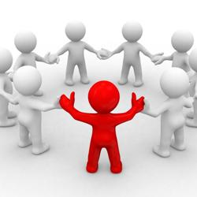
God Positioning System (GPS) Your role as a leader
Eph. 4:11-16
11 It was he who gave some to be apostles, some to be prophets, some to be evangelists, and some to be pastors and teachers,
Notes:
----- Meeting Notes (9/6/13 23:31) -----
As leaders, what is our role

Slide 26
God Positioning System (GPS) Your role as a leader
Eph 4:11-16
¹² to prepare God's people for works of service, so that the body of Christ may be built up ¹³ until we all reach unity in the faith and in the knowledge of the Son of God and become mature, attaining to the whole measure of the fullness of Christ.
Notes:
----- Meeting Notes (9/6/13 23:31) -----
As leaders, what is our role

Slide 27
God Positioning System (GPS) Your role as a leader
Eph 4:11-16 (NIV)
14 Then we will no longer be infants, tossed back and forth by the waves, and blown here and there by every wind of teaching and by the cunning and craftiness of men in their deceitful scheming.
Notes:
----- Meeting Notes (9/6/13 23:31) -----
As each part does its work.
GPS - is part of making disciples.
We follow the master and use the talents He gave us

Slide 28
God Positioning System (GPS) Your role as a leader
Eph 4:11-16 (NIV)
15 Instead, speaking the truth in love, we will in all things grow up into him who is the Head, that is, Christ.
Notes:
----- Meeting Notes (9/6/13 23:31) -----
As each part does its work.
GPS - is part of making disciples.
We follow the master and use the talents He gave us

Slide 29
God Positioning System (GPS) Your role as a leader
Eph 4:11-16 (NIV)
16 From him the whole body, joined and held together by every supporting ligament, grows and builds itself up in love, as each part does its work.
Notes:
----- Meeting Notes (9/6/13 23:31) -----
As each part does its work.
GPS - is part of making disciples.
We follow the master and use the talents He gave us

Slide 30
The GPS Church - 1 Pet. 2:9,10 Your role
9 But you are a chosen people, a royal priesthood, a holy nation, a people belonging to God, that you may declare the praises of him who called you out of darkness into his wonderful light.
10 Once you were not a people, but now you are the people of God; once you had not received mercy, but now you have received mercy. (NIV)
Notes:
----- Meeting Notes (9/6/13 23:31) -----
We are chosen, thus we have to declare the praises. How?

Slide 31
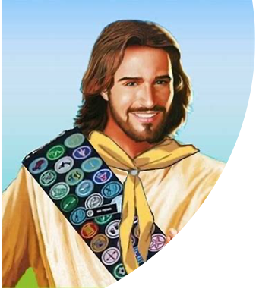
What Christ Wants John 4:23-24
²³ Yet a time is coming and has now come when the true worshipers will worship the Father in the Spirit and in truth, for they are the kind of worshipers the Father seeks.
²⁴ God is spirit, and his worshipers must worship in the Spirit and in truth."

Slide 32
Group Discussion
Explain your part in discipleship

