Slide 1


Adventurer Club Organization
& Programming
Presenter: Jackie Forss
New Jersey Conference

Slide 2


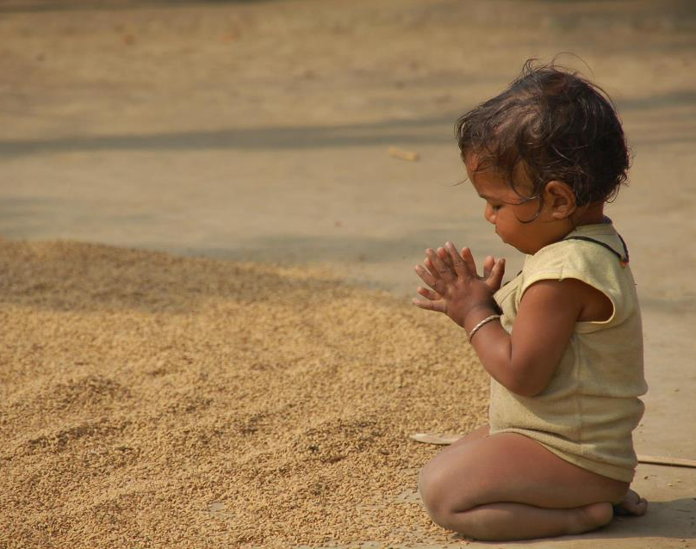
Introduction
&
Opening Prayer
Jackie Forss
Adventurer Assoc. State Coordinator
This Photo by Unknown Author is licensed under CC BY
This Photo by Unknown Author is licensed under CC BY

Slide 3

Club Organization

Slide 4

Local Church
New Jersey Conference
Columbia Union
NAD
General Conference
Denominational Flow Chart
Local Church: is governed by elected officers and departmental leadership. The Adventurer Club Director is elected each year.
Local Conference: is made up of all the local churches.
Union: is a combination of several local conferences
Division: is a combination of several Unions or Missions. The North American Division (NAD) is comprised of 9 Unions and 1 Mission. Headquarters are in Silver Spring, MD.
General Conference: is comprised of 13 Divisions, coordinating church work worldwide. Headquarters are in Silver Spring, MD.
This Photo by Unknown Author is licensed under CC BY-NC
Notes:
Columbia Union includes 8 conferences:
Allegheny East (DE, D.C., MD, NJ, PA, VA, and WV)
Allegheny West (OH, WV, VA, PA)
Chesapeake (DE,MD, VA and WV)
Mountain View (WV and MD pan handle)
New Jersey
Ohio
Pennsylvania
Potomac (VA, D.C., Southern MD)
NJ has 92 churches

Slide 5
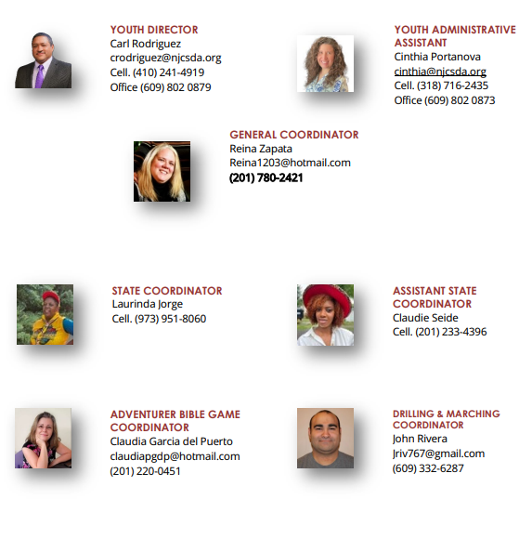
Staff
&
Coordinators

Slide 6
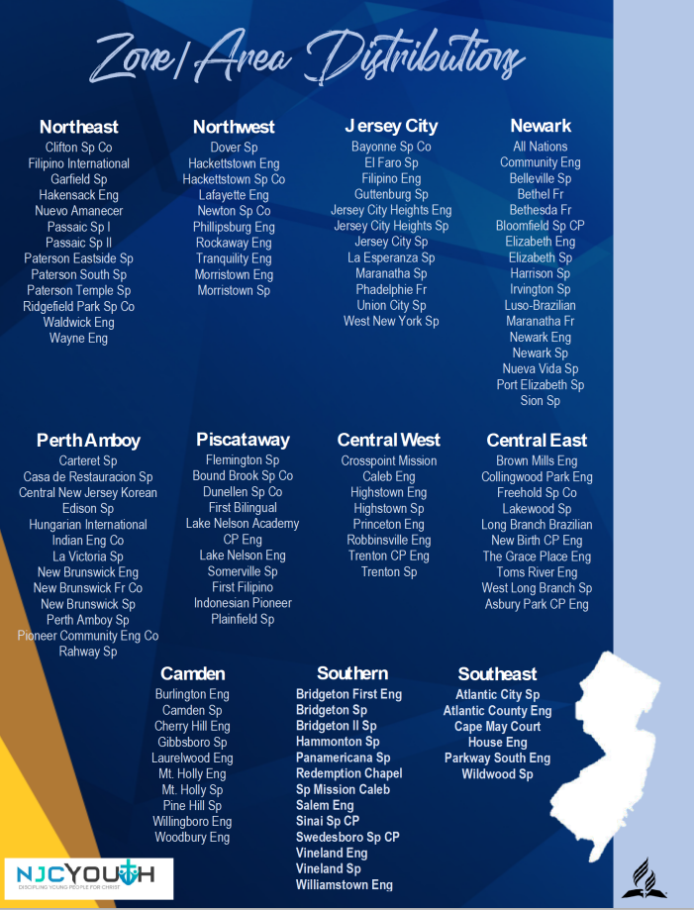

Slide 7
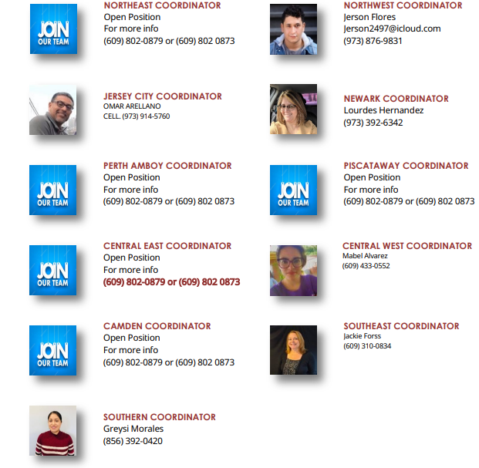
Area
Coordinators

Slide 8

QUESTIONS
&
COMMENTS

Slide 9
How to Start an
Adventurer Club
Talk to your Pastor
Connect with your Conference Leaders
(Adventurer Area Coordinator)
Elect a Director/ Associate Director
The nominating committee/church board will recommend the Adventurer Club Director /Associate Director
Notes:
Director’s Guide pg. 8

Slide 10

Form an Adventurer Club
Executive Committee
In a large church, the committee may be helpful. Involve the Adventurer Club leadership, Pastor, Kindergarten/ Primary Sabbath School Leader, Church School Teacher(s) of Adventurer age children, Adventurer parents. The Adventurer Director is chairperson.
This group sets major policies for operation, goals, objectives, and coordinates the club calendar with church calendar. This committee can give direction on the selection of additional staff.
This Photo by Unknown Author is licensed under CC BY-SA-NC
Notes:
Director’s Guide pg. 8

Slide 11

Church Board Authorization
Submit your plans to the Church Board for authorization to organize an Adventurer Club.
This is very important because this vote allows for you to let the Conference know that your club is official.
Notes:
Director’s Guide pg. 9

Slide 12
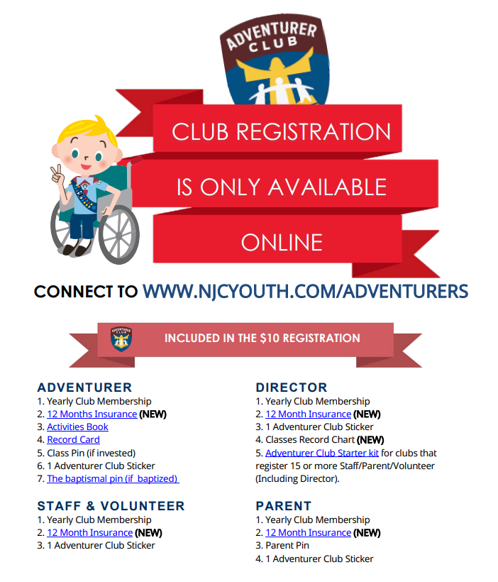
Notes:
Formally inform the Conference, Director’s Guide pg. 9

Slide 13
Bringing it Home
Gather
Gather Support of Parents
Meet with parents of Adventurer age children and have them spread the word.
Call
Call an Organization meeting
Schedule a meeting with those who would be interested in the Adventurer Ministry. Explain the goals of the ministry. Appeal for volunteers.
Notes:
Director’s Guide pg. 9

Slide 14
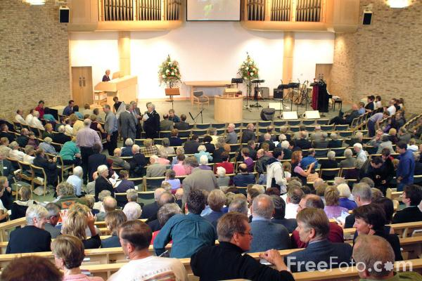
Inform the Congregation
Let the church know about the club and how it’s going to minister to families in church and the community.
This Photo by Unknown Author is licensed under CC BY-NC-ND
Notes:
Director’s Guide pg.
Can invite conference/area leaders to speak during main church service, and have Adventurers in uniform visit from neighboring club to show members what they do

Slide 15

Recruit Volunteers
1. Identify adults who love children and are willing to commit to the club.
2. Members of the Adventurer Team need to be excited about kids.
This Photo by Unknown Author is licensed under CC BY-SA
Notes:
Director’s Guide pg. 10

Slide 16
QUESTIONS
&
COMMENTS

Slide 17

Adventurer Club Team:
Include the Parents!
Director
Associate Director(s)
Instructors for each curriculum level
Instructors for patch requirements
Family Network Coordinator
This Photo by Unknown Author is licensed under CC BY-NC
Notes:
Director’s Guide pg. 10

Slide 18
Participate in
Adventurer Club Ministry Training
Adventurer Basic Staff training course
Put dates on your club calendar
Encourage staff to attend
Learn from the seminars
Meet with others who are involved with Adventurers and share ideas
Those unable to attend, schedule time to share the basics, so you all can be on the same page
Notes:
Director’s Guide pg. 10

Slide 19

Pray
Pray for leaders.
Pray for families.
Pray that God will send the right people to join your Adventurer Club Team.
This Photo by Unknown Author is licensed under CC BY-SA-NC
Notes:
Director’s Guide pg. 10

Slide 20





Forms to be
Kept in the
Club Files
Resources njcyouth.com/ adventurers
Club Yearly Registration
On-line only
Adventurer & Staff
Application Form
Adventurer & Staff
Medical Information
Guidelines for Volunteers & Caregivers
Notes:
Pgs 12-22 of 2023 Manual

Slide 21

Evaluation
& Other
Forms for the Club
Club Inspection
Adventurer Sabbath
Induction
I Will Go
Projects
Due 3/31/23
Investiture
Notes:
Pgs. 23-27 of 2023 Manual

Slide 22
QUESTIONS
&
COMMENTS

Slide 23
Programming

Slide 24






Adventurer Levels
1st Grade
Pre- Kindergarten
Kindergarten
2nd Grade
3rd Grade
4th Grade
Notes:
Curriculum organized around four basic relationships:
My God
My Self
My Family
My World
Patches:
Stars for Little Lambs
Chips for Eager Beavers
Awards for the rest

Slide 25


Discovery Levels
5 y/o
1-2 y/o
3 y/o
4 y/o
Notes:
Curriculum organized around four basic relationships:
My God
My Self
My Family
My World

Slide 26

Planning the
Yearly Calendar
Notes:
Calendar: Put conference Adventurer dates in your calendar along with your local pathfinder club events. There may be siblings in both clubs so to avoid conflict with dates. Keep that in mind.
Plan the ‘I Will Go Project’ one per year, so throughout the span of 4 years, club will complete one project per category: environment, humanitarian, kindness, and community pg. 29 of manual
Sample yearly planning form pg. 20-21 of manual
When and how often do you want to meet?
Registration
Induction
Investiture
Staff meeting dates
Special meetings for holidays
Adventurer Sabbath

Slide 27

Creating a Budget
Typical Income Club membership fees Subsidy from the church Fundraising Donations | Typical Expenses Uniform insignia Stars, Chips, and Awards Certificates Refreshments Craft supplies Equipment Outreach projects Field trip costs Others…..
Notes:
Talk to your church treasurer to learn how they want you to report, track, and request funds.
Ask for last year’s budget report!
All money collected and spent must go through church treasurer so there is an audit trail

Slide 28

Club
Outline
Opening Exercises
Fall in by classes
Pledges: American, Christian, & Bible
Adventurer Pledge & Law, Song
Prayer
Creative Worship
Sing a song
Story or object lesson or skit
Restroom Break
Classwork by level
Group Activity
Choose one of the following:
Start a new award
Complete an award
Play a fun game
Craft
Clean up
Closing
Announcements
Prayer
Dismissal
Notes:
Sample Club Meeting Outline

Slide 29


FIRST CLUB MEETING
Full of FUN and EXCITEMENT!!!
Everyone should be involved in the Activities
(Parents, Staff, and Children)
This Photo by Unknown Author is licensed under CC BY-ND
This Photo by Unknown Author is licensed under CC BY-SA

Slide 30
QUESTIONS
&
COMMENTS

Slide 31

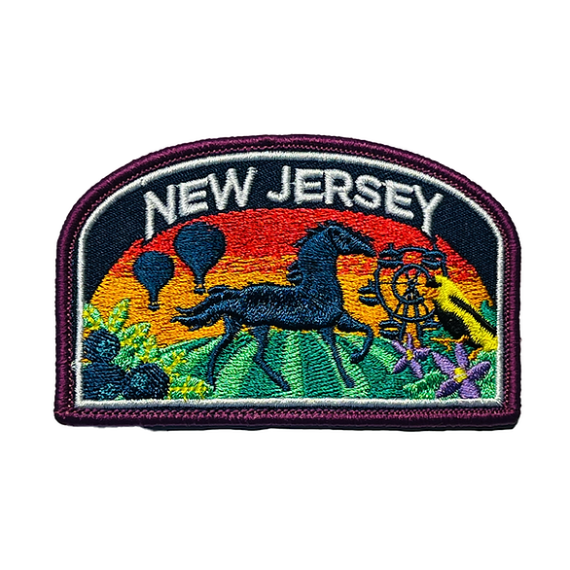
Adventurer Uniform
The uniform makes the Adventurer Club real to its members, especially the children. The uniform becomes an emblem of a standard, builds loyalty to the club, and brings members into a sense of community. The uniform should always be neat, clean, and worn with pride.

Slide 32
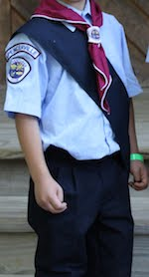
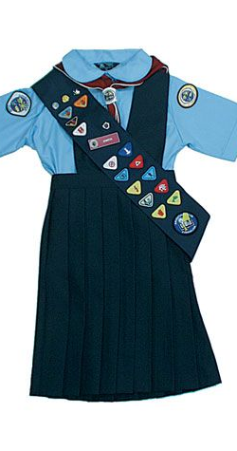
Dress Uniform for the Adventurer
Girls
Navy blue pleated jumper
Light blue or white blouse with Peter Pan/straight collar and short/long sleeves
Boys
Navy blue pants
Light blue or white shirt with straight collar and short/long sleeves
Boys and Girls
Black shoes (uniform within club)
Navy blue socks; if girls wear white blouses white socks may be worn (uniform within club)
Scarf and Slide: Burgundy Adventurer scarf worn with an Adventurer slide.
Sash: Navy blue sash is worn from the right shoulder to the left hip and displays Adventurer stars, chips, awards, pins, event patches, and other club related items
Navy blue beret is optional (uniform within club)

Slide 33
Do I have to buy a new uniform for my Adventurer?
Clubs have lots of options when it comes to uniforms. One option is to have a staff member who is responsible for measuring each Adventurer and ordering uniforms for each. Another option is to have parents purchase uniforms for their child(ren) that are in the club.
Here are some options that can reduce uniform expenses:
Provide rental options
Arrange a time for parents to trade uniforms
Set-up a system where the club loans out uniforms
The key to any of these options is to have a staff member who is responsible for implementing the plan your club adopts.

Slide 34

RESOURCES FOR SUPPLIES
Advent Source –clothing, uniform patches, chips, awards, workbooks, etc.
Pathfinder Shirts-uniform, club crests, custom t-shirts, patches (Old Adventurer logo), pins, etc.
New Jersey Conference- Conference patches for shirts

Slide 35
QUESTIONS
&
COMMENTS

Slide 36
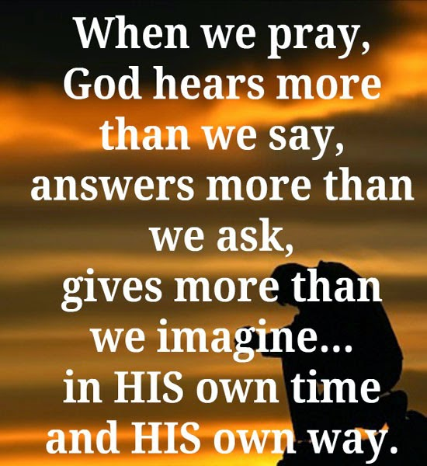
CLOSING PRAYER
This Photo by Unknown Author is licensed under CC BY

