Slide 1

Youth & Pathfinder Leadership
Presented by
Vilma Reynolds, Account Executive

Slide 2


Partnering With You
Our Ministry: We protect the ministries of the Seventh-day Adventist® Church with insurance and risk
management solutions.

Slide 3
Goals
1
2
3
Protect the name and mission of our church
Keep our volunteers, our members, and guests safe
Build an effective ministry

Slide 4
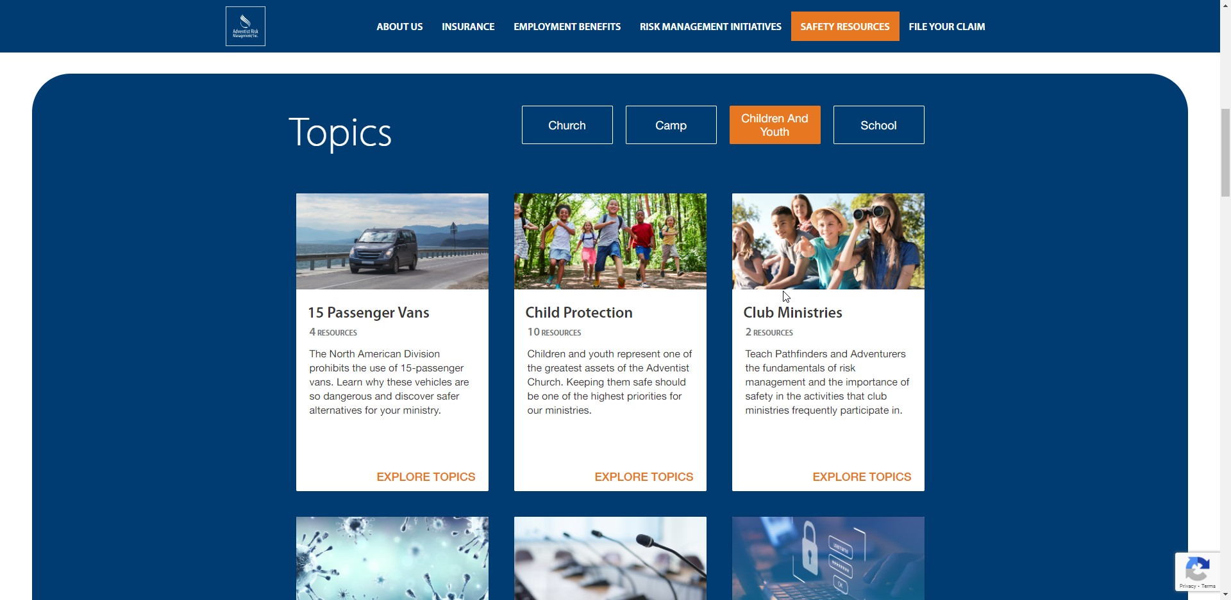

Slide 5

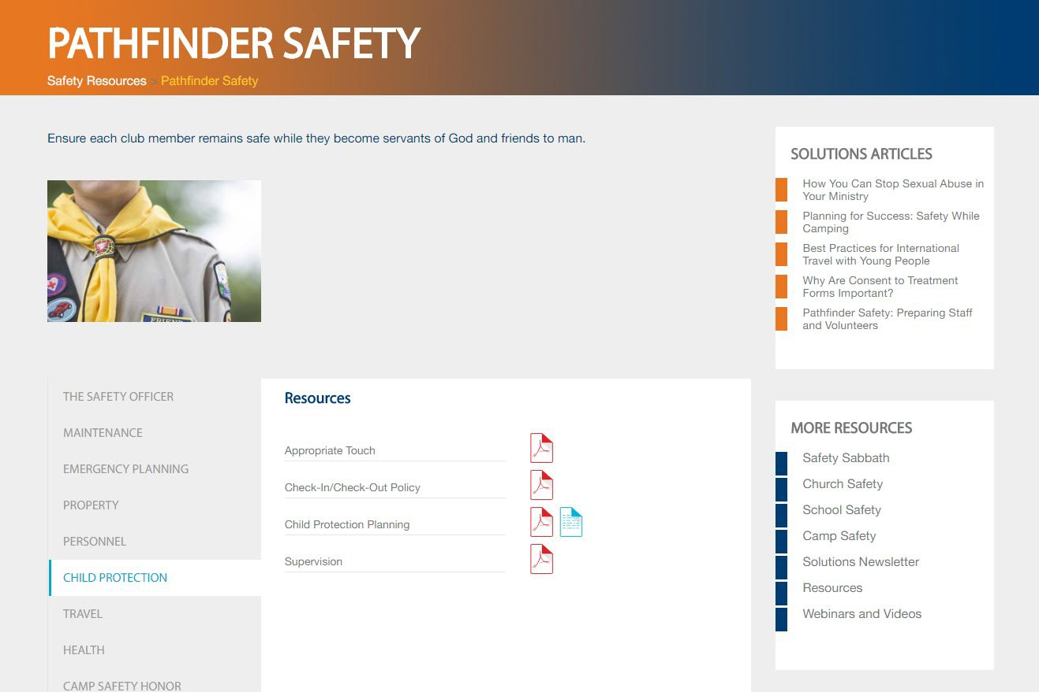
Resources
AdventistRisk.org
Guides
Forms
Resources

Slide 6


Slide 7
Safety and the Counselor
Physical safety issues
Abuse prevention and intervention
Supervision policies
Off-site Activity Planning
Health concerns
Transportation issues
Incident reporting and response

Slide 8
Communicate
STAFF
Assigned Duties
Code of Conduct
Responsibility of Supervision
Disciplinary Practices
Emergency Procedures
Trip Schedules
PARENTS
Expectations
Expected Code of Conduct
Personal Relationships
Trip Schedules
How to Make Contact
Permission/Medical Forms
Disciplinary Practices

Slide 9
Premises Review
Access to premises – doors, locks, windows, other areas of the building, sign-in/out, badges, uniforms,
Interior & exterior lighting – Ensure accessible areas are well lit to ensure good supervision.
Vision panels – be sure all your activities with children are open and visible.
Restrooms – Ensure that children are not congregating in the bathrooms and provide supervision while respecting privacy of attending to needs.

Slide 10

Keeping Sports Safe and Fun

Slide 11
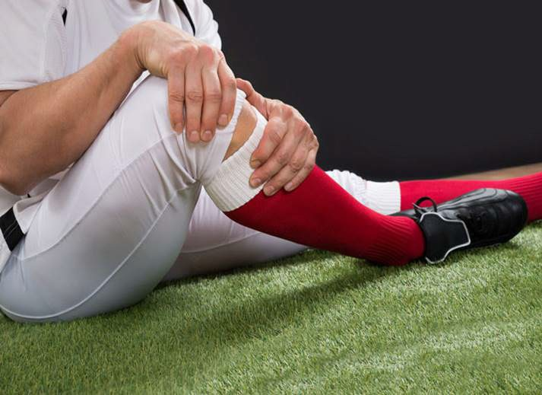
Preventing Sports Injuries
Ask for a physical exam
Use the correct gear
Stay hydrated and stretch often
Practice the correct way
Take time off
Pay attention to temperature
Train your coaches
Lead by example

Slide 12
Preventable Incidents
consider requiring a physical examination
facilitate warm-up exercises and stretches
prohibit participation by injured students or members, and
group children by their skill level and body size, especially for activities that may include contact.

Slide 13

First Aid

Slide 14
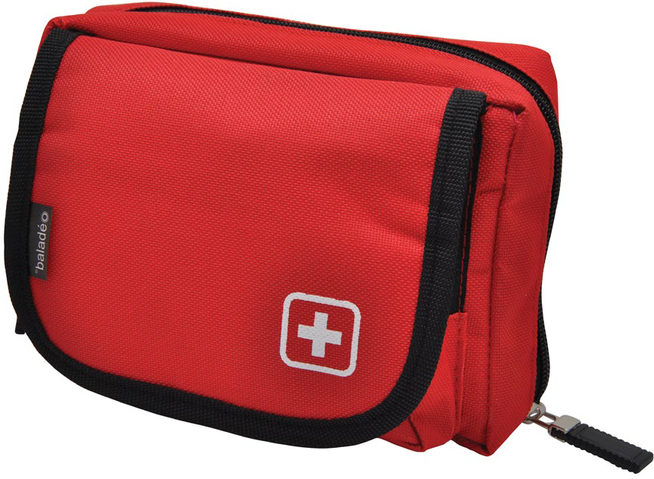
First Aid
Know what is needed in a first aid kit
Keep kit accessible, yet safely
Restock your kit after each use and periodically check for expired or damaged items

Slide 15

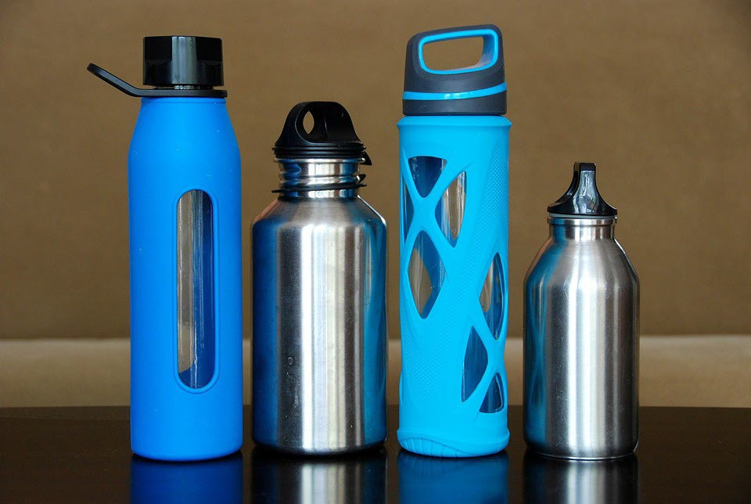
Hydration
Plan for proper hydration before, during, and after exercise
Dehydration occurs when the body loses more fluids than it takes in
Sports drinks?

Slide 16
Supplemental Insurance Policy
Sports League Activities (Note: Adults aged 18 and over are excluded when participating in the following contact sports: soccer, football, lacrosse, and wrestling
Recreational sports activities (snow skiing, go-carts, skateboards, parasailing, in-line skating, dirt bikes, rock climbing/rock propelling)

Slide 17
Miscellaneous Accident
This is an excess accident policy.
Provides benefit to the injured without ill-will. No need to sue the conference. Protects the church’s reputation and relationship.
Available for Pathfinder clubs, day or overnight camps, VBS, or as an annual conference-wide membership activities which includes all of the above.
Available on our website or through your Account Executive.

Slide 18
Miscellaneous Accident
Accidental Death & Dismemberment
  Aggregate Limit
Accidental Medical Expense
  Deductible
$20,000
$250,000
$50,000
$0
Excess policy (health insurance or other pays first after first $100)
Sickness Medical Expense
Emergency Evacuation
  Outside of 100 miles from primary residence
$1,000
$500,000

Slide 19
Exclusions such as:
New or repair of dentures, crowns, caps, eyeglasses, contact lenses, hearing aids, medical equipment.
Pre-existing conditions
Elective treatment or surgery
Charges payable under motor vehicle medical benefits
Any condition for which the insured is entitled to benefits under any Workers’ Compensation Act or similar law.
Recreational sports and sports league activities unless specifically purchased.

Slide 20
Pricing
Annual Conference-wide Membership
  (requires 100% of membership)
Pathfinder clubs
Pathfinder clubs
Pathfinder clubs
$1.45/member/ 12 mo
$3.57/member/ 12 mo
$2.76/member/ 9 mo
$1.83/member/ 6 mo

Slide 21
Pricing
Misc. Trips and Short-Term Activities
$0.41/member/day
BELOW ARE NOT INCLUDED IN CONFERENCE WIDE COVERAGE
Recreational Sports (skiing, rock climbing)
Sports League Activities
$1.90/member/day
$3.76/member/mo
Excluding soccer, football, lacrosse, and wrestling for adults 18 and over

Slide 22
Compare with General Liability
Premises Medical (no fault, excess)
$10,000 person
$25,000 occurrence
Bodily Injury (lawsuit against the church)

Slide 23


Slide 24
Child Protection
More than a LEGAL duty We have a MORAL duty
“Whosoever shall offend one of these little ones that believe in me, it is better for him that a millstone were hanged about his neck, and he were cast into the sea.”
MARK 9:42 KJV

Slide 25
Have two adults present in children’s classrooms or activities.
Two-Adult Policy

Slide 26
Discourage private or one-on-one contact and encourage an open-door policy in all situations.
Where an open door is not possible, station a second adult at the door.
Open Door

Slide 27
Volunteer Screening
Have all volunteers complete a volunteer information form, check their references, and, if required by law, do a police background check.

Slide 28



Adventist Screening Verification
And Sterling Volunteers

Slide 29
North American Division Working Policy
d. All volunteers referenced in this section include all adults, over the age of 18, involved in any capacity in children and youth ministries and activities, and all church ministry leaders and officers voted or appointed by the local church consistent with the SDA Church Manual; volunteers voted or appointed by the conference, union, or the North American Division and its affiliates, as well as all registered volunteers either from within or outside the North American Division voted or appointed to serve in the territory.

Slide 30
Require a waiting period of six months for newly baptized or transferring
Six-month Policy
members who have indicated a willingness to work with children.

Slide 31
Provide regular training for leaders and volunteers to help them understand and protect children and how to nurture their faith.
Training

Slide 32


Supervision Policies

Slide 33
Effective Supervision
Have a minimum of two adults supervising children/youth at all times.
Install vision panels or windows in doors.
Adults should focus on supervision without distraction.
Carefully monitor time and the number of children in restrooms.
Ensure areas not in use are locked.
Ensure exterior is properly lit for nighttime activities.
Provide “roaming” adult supervision through hallways and parking lots.

Slide 34

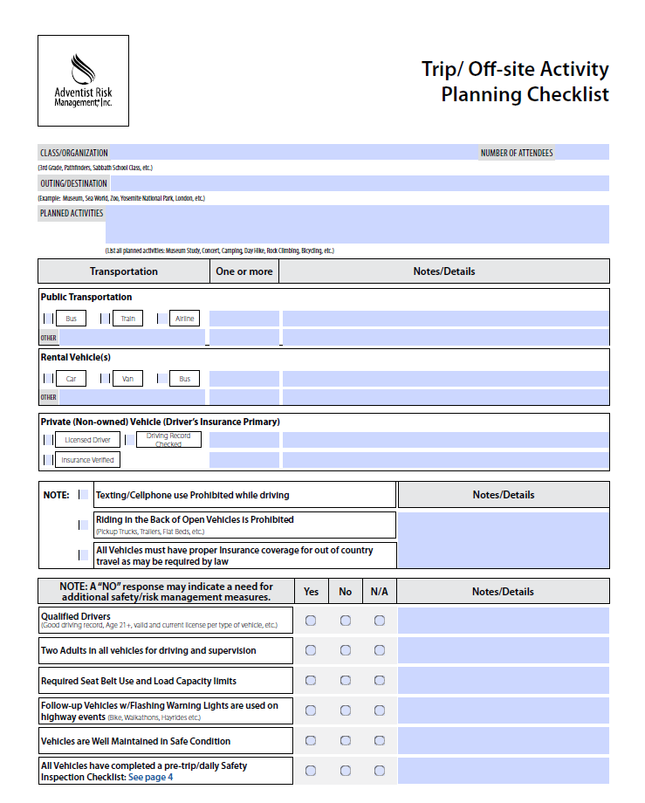
Outing Planning
Pre-Trip
In-Transit
On-Site
Health and safety
Supervision
Transportation
Available at adventistrisk.org

Slide 35



Health History and Training

Slide 36

Permission & Release Forms
Three Specific Purposes
  Consent to Participate
  Emergency Medical Treatment Authorization
  Contact Information
Be Specific to the Activities
Identify Potential Hazards
Identify Medical Limitations
Signed by Parent or Guardian of the child
Copies with Group Leader and Drivers

Slide 37
Common Medical Issues
Allergic Reactions
Asthma Attack
Diabetes

Slide 38


Incident Reporting and Response

Slide 39
How to File a Claim
Fill out the form (available at www.adventistrisk.org)
Death Claim form
Dismemberment Claim form
Medical Services Claim form
and file it by emailing the completed form to Claims@AdventistRisk.org
or by calling 1-888-951-4ARM (276).
For medical referrals, evacuation, repatriation, security, and other services, contact International SOS at:
App: International SOS Assistance App (iOS and Android)
Phone: +1 215-942-8226
Email: philadelphia@internationalsos.com
Member Number: 11BCAM749125
Identify yourself as being with the Seventh-day Adventist Church

Slide 40

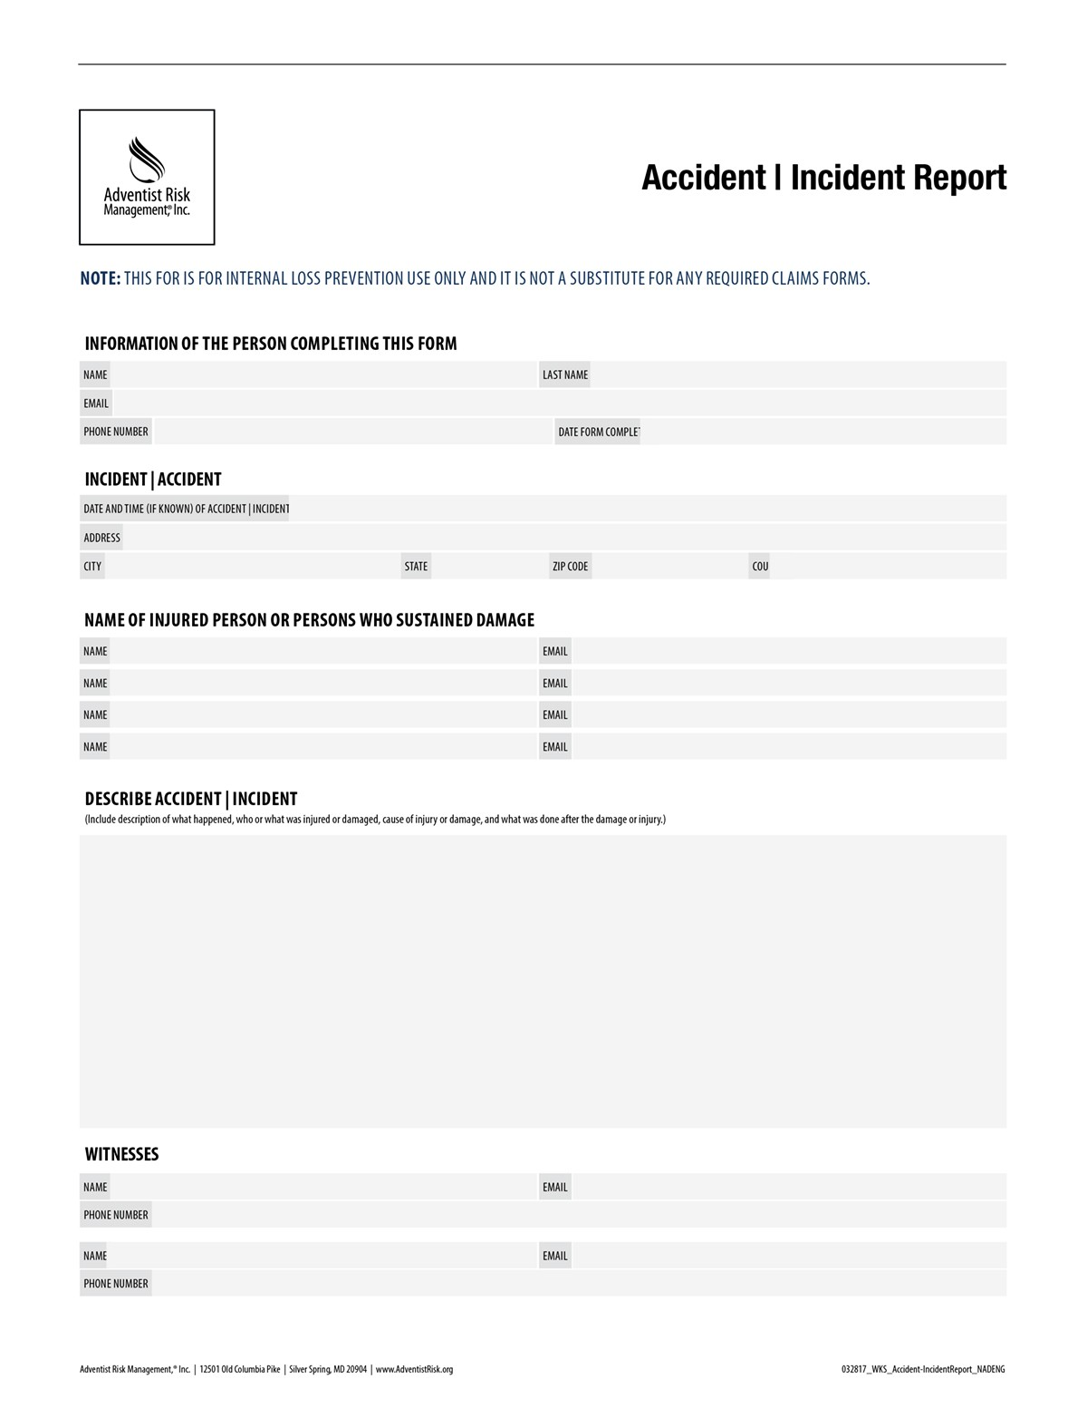
Incident Investigation
Visit the scene
Interview witnesses and record names/contact
Check for causes resulting from
o dangerous practices or disobedience
o poor housekeeping
o improper apparel
Describe Accident/Incident
Available at adventistrisk.org

Slide 41
Things to AVOID
Attempting to place the blame on an individual
Assuming there is just one cause for an accident
Determining causes without investigation
Attempting to take the place Administration in corrective action
Release of information to any unauthorized parties

Slide 42


Transportation

Slide 43
Transportation: Significant Risk
Select and screen good (qualified) drivers
Volunteers driving their own vehicle (insurance follows the vehicle)
Vehicle maintenance
Supervision in a vehicle
Long trips
Do not use 15 passenger vans

Slide 44
NAD Policy
S 60 31 (GC S 60 30-3) Vehicle Insurance
7. Fifteen-Passenger Van Use—In the interest of safety, denominational organizations shall not purchase, lease, rent, or use 15-passenger vans for sponsored activities under any circumstances. Alternatives to 15-passenger vans include: minivans and SUVs, mini-school buses, 15-passenger buses with dual rear wheels.

Slide 45

Safety is more than 15-Passenger vans.

Slide 46
Manage Drivers
Good driving record-previous 3 years
  No accidents resulting in conviction of misdemeanor or criminal charge
  Not more than two citations
Must be at least 21
Reputation for safe driving habits
Proper licensing and registration
Insurance if driving their own vehicle

Slide 47
Drowsy Driving
PLAN TO MANAGE FATIGUE:
Drivers must be well rested before each trip.
Adequate number of drivers must be available for extended trips.
Manage fatigue by rotating drivers every two hours.

Slide 48

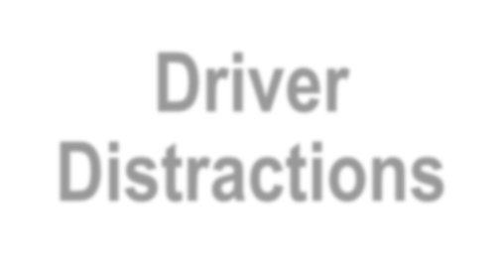
Driver Distractions
Cell Phones Eating & Drinking
Noise, Chaos & Loud Music Grooming
Outside Attractions

Slide 49

Vehicle Maintenance
Enforce a good vehicle upkeep program
Odometer-based maintenance schedule
Maintain a copy of all relevant documents
Conduct a pre- and post-trip inspection

Slide 50

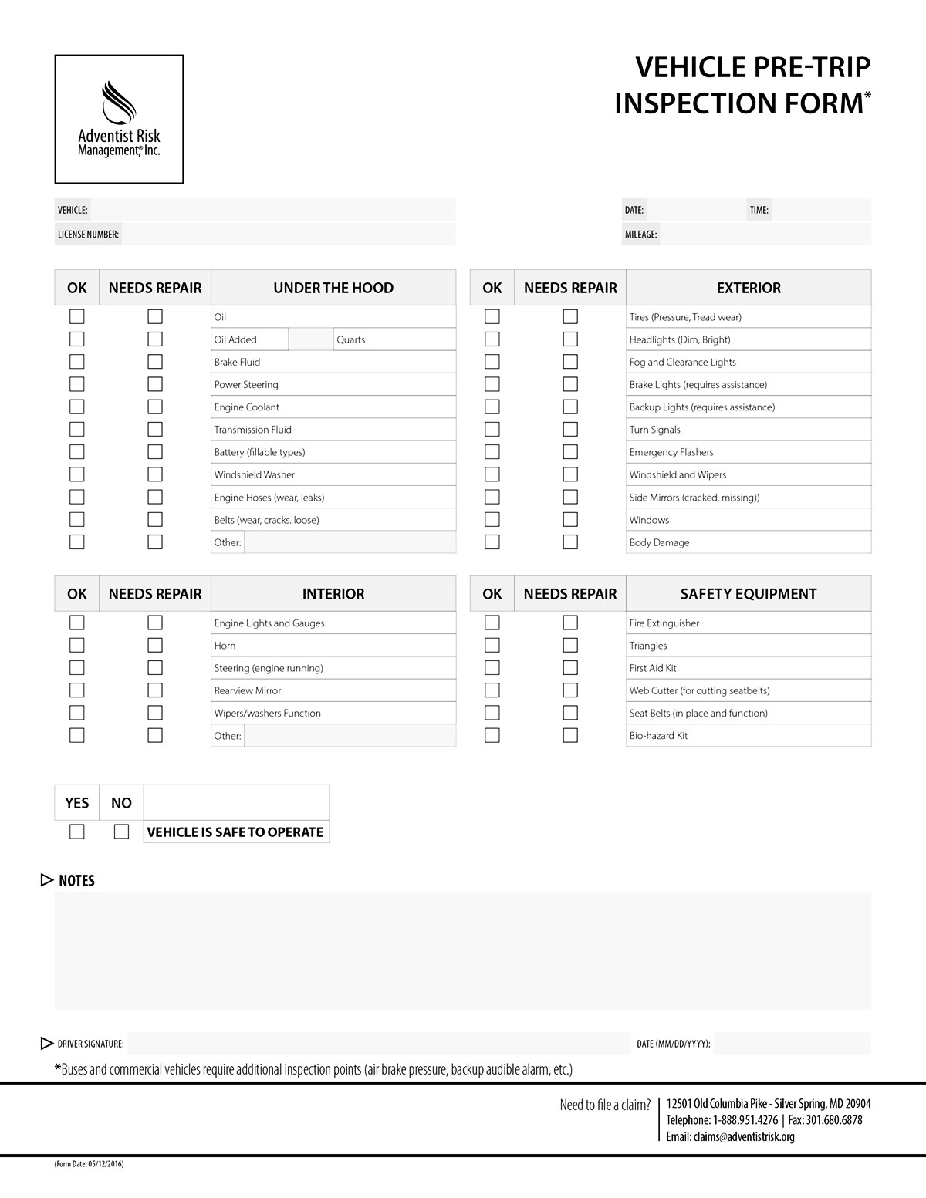
Vehicle Inspection
Tire pressure
Fluid levels
Belts & hoses
Mirrors
Turn signals
Lights
Available at adventistrisk.org

Slide 51

Can We Make a Difference?

Slide 52

This presentation and any materials distributed are fact-based, general information and should not, under any circumstances, be considered specific legal advice regarding a particular matter or subject. Please consult your local attorney or risk manager if you would like to discuss how a local jurisdiction deals with any specific circumstances you may be facing.
Copyright © 2018 Adventist Risk Management,® Inc. All rights reserved.
www.adventistrisk.org

