Slide 1
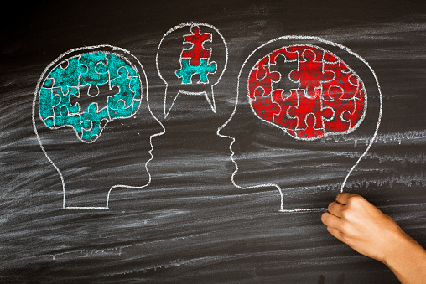
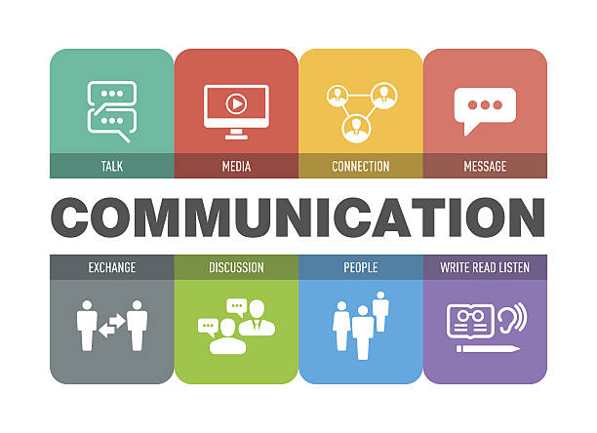
Communication Theory, Listening Skills & Practical Communication
New Jersey Conference
By Edwine Evra

Slide 2
Devotion & Self-Presentation Exercise
Heavenly father, here we are gathered at your feet to humbly ask you to teach us how to be efficient communicators for you. Please help us successfully learn and grow together for the betterment of your work through our service. In Jesus name we pray, Amen!
Briefly Introduce yourselves to others and share what you learned from one another. In three (3) minutes: Hi, my name is Edwine Evra, and I am the Master Guide Coordinator for the Newark Zone. Please don’t mind my lack of eye contact /its cultural but I’m improving. I am very pleased to meet you!

Slide 3
What is Communication?
The definition of Communication varies by individuals.
However, for this course, we can settle that communication is simply the act of transferring information from one place, person, or group to another.
Who communicate to whom?
Why communicate?
How do we communicate?
What about?
What are the consequences ?

Slide 4
Communication theory
Communication theory - studies the scientific process of sending & receiving information. There are many principles, methods, and components that can affect a message, and communication theory explains it all, but we will focus only on two theories for now.

Slide 6
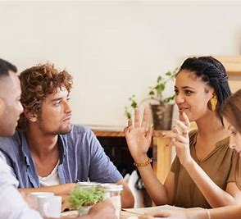
Break Out
What stood out the most to you from Mehrabian’s theory of communication ?

Slide 7
Types of Communications
Verbal & Nonverbal
Visual & Written
Direct & indirect
Personal & Professional

Slide 8
Types of Communications Barriers
Message => Too lengthy, disorganized, erroneous
Message => Poor verbal and body language.
Source => Lack of Self-Confidence
Source &/or Receiver => lack of enthusiasm.
Source &/or Receiver => Discrimination
Message => disagreement between verbal and non-verbal messages.
Source => Negative Self Image.
Receiver => Lack of Feedback
Source &/or Receiver => Language and Vocabulary Level.
Receiver => Selective Perception.
Receiver => Lack of Interest in the Topic/Subject
Channel => voice quality / Venue / Effect of Noise

Slide 9
Talking At vs Talking To A person who talks at you is having a one-sided conversation. They're there to tell you things and don't care for your input on the matter. Someone talking to you is having a conversation. You and they are both active participants.

Slide 10
Hear vs listen
Listening describes an intentional activity. When you are listening, you are actively trying to hear something. In contrast, hearing is something that happens without any intentional effort. You can hear something even when you don't want to hear it and don't try to hear it

Slide 11
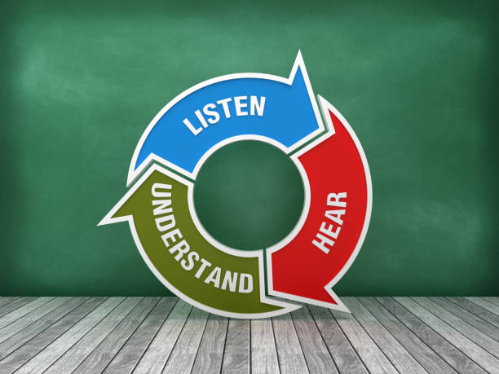

Slide 12
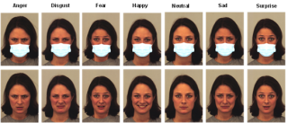
Social interaction: How do we distinguish nonverbal cues with mask on and off?
Angry/Disgust/Fear/Happy/Neutral/Sad/Surprise…
Facial muscles, body language self-awareness, cultural humility, and opened mindness.
Never take everything personal (we never know all someone is going through) and always ask the Holy spirit to assist.

Slide 13
Break IT Down! Share Two of your Strengths & Weaknesses In Communication
How do you currently communicate with others ?
How would you like to communicate in the future?
Notes:
Five (5) minutes
What are your Strength vs weaknesses?
Share your barriers and triggers.

Slide 14
Skills & Practical Communication Tips
Be mindful of the communication process
Respect the receiver (his or her time)
Use bullet, bold, and italics
Verify and list the assumptions
Ask for clarification and feedback
Use the correct medium/channel/tools
Add all relevant information
Anticipate noise interference
Allow the communication to be tracked
Listen and do not anticipate
Adapt a Two-hands Constructive Criticism

Slide 15
Notes:
Insight => Is what I am sharing beneficial to my growth and the one of others?

Slide 16
How to improve Communication Skills
Be an active listener ( an empath).
Adapt good mannerism (eye contact, soft but strong voice…).
Hold effective meetings
Check in with your team members (staff, parents, and members).
Ask for feedback in order to improve.

Slide 17
Proverbs 18:21 Death and life are in the power of the tongue, and those who love it will eats it’s fruit.
Powerful Warning!

Slide 18
² Devote yourselves to prayer, being watchful and thankful. ³ And pray for us, too, that God may open a door for our message, so that we may proclaim the mystery of Christ, for which I am in chains. ⁴ Pray that I may proclaim it clearly, as I should.
Colossians 4: 2-6

Slide 19
⁵ Be wise in the way you act toward outsiders; make the most of every opportunity. ⁶ Let your conversation be always full of grace, seasoned with salt, so that you may know how to answer everyone.
Colossians 4: 2-6

Slide 20
Psalm 19:14 (KJV)Let the words of my mouth and the meditation of my heart be acceptable in thy sight, O Lord, my strength, and my Redeemer
Daily request

Slide 21
James 1:19, 20 (KJV) Wherefore, my beloved brethren, let every man be swift to hear, slow to speak, and slow to wrath; for the wrath of man worketh not the righteousness of God.
Motivation

Slide 22
Review!
What did you learn from this presentation?

Slide 23
With good and clear communication, we all can build lasting relationships and lead others TO GOD, THROUGH GOD AND FOR GOD!

