Slide 1
Adventurer Curriculum
and Awards
Mabel Alvarez
Notes:
Me presento , oramos y luego preguntó de dónde vienen y como se llaman.

Slide 2
Philosophy of the Adventurer Club
The Adventurer Club is a Seventh-day Adventist church-sponsored ministry open to all children, in which the church, home and school join together to help children grow joyfully in wisdom and stature and in favor with God and man. The Adventurer Club is to assist parents in making the development of their children a richer and more meaningful experience.

Slide 3
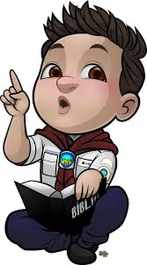
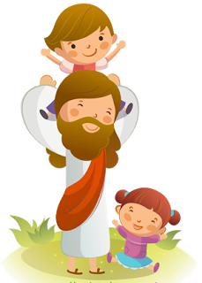
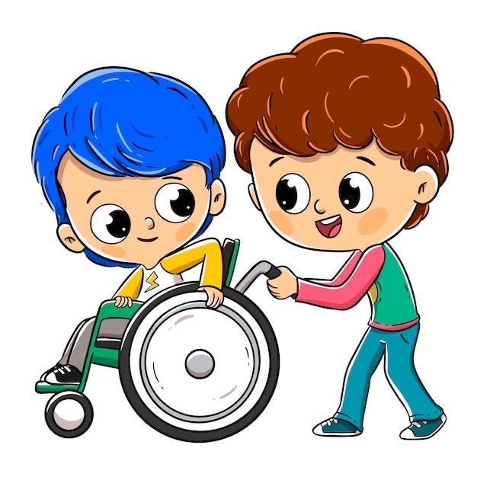
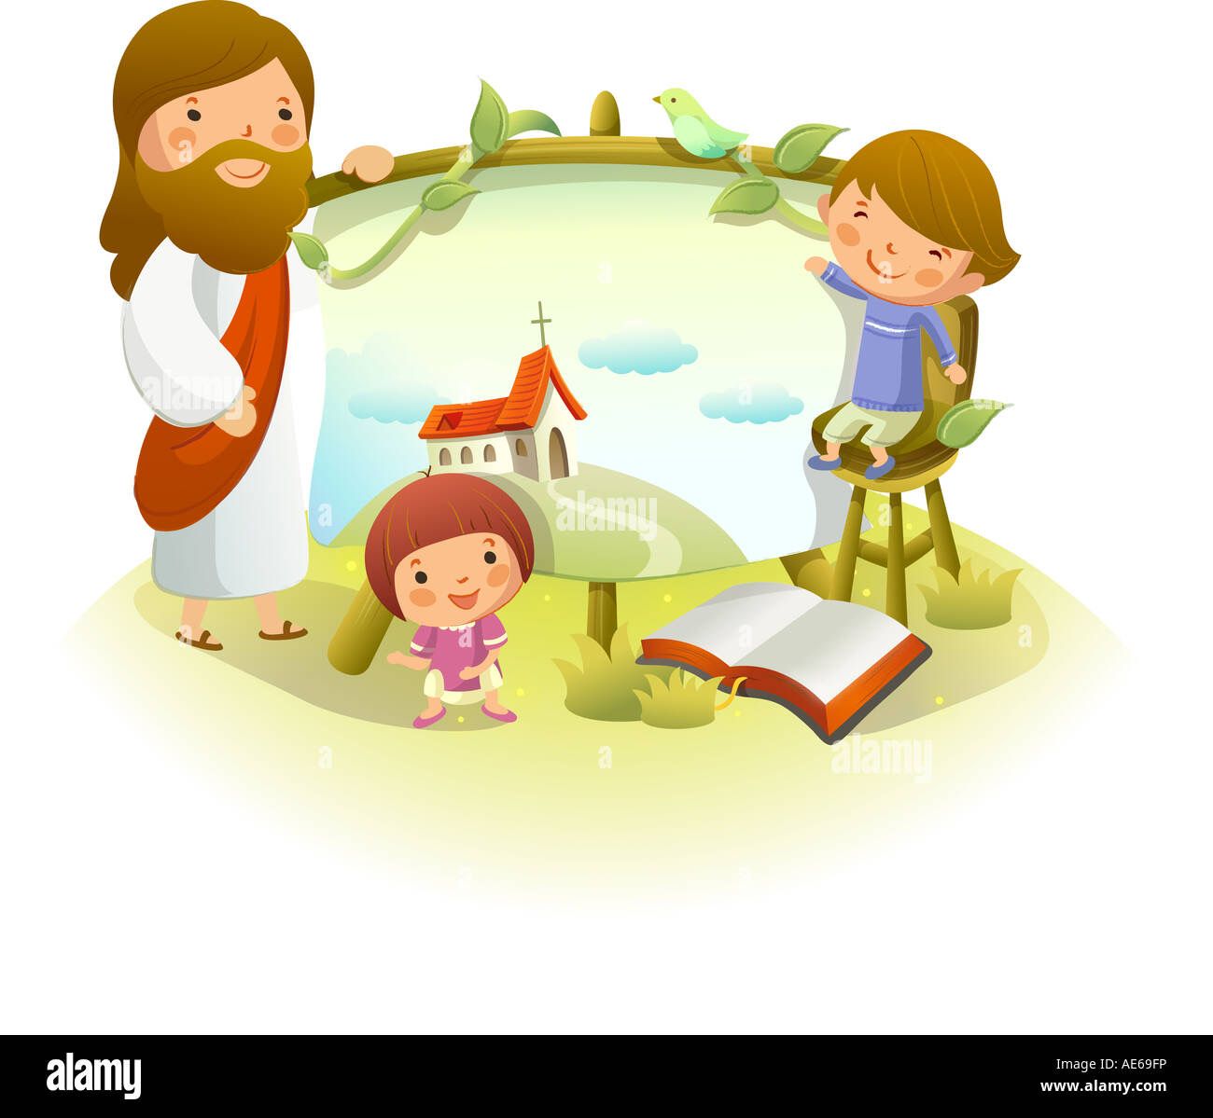
Objective
The Adventurer Club provides fun and creative ways for children …
1.
2.
3.
4.
Strengthen their ability to get along with others
Joy and satisfaction
of doing things well.
Christ-like character
Love for Jesus

Slide 4
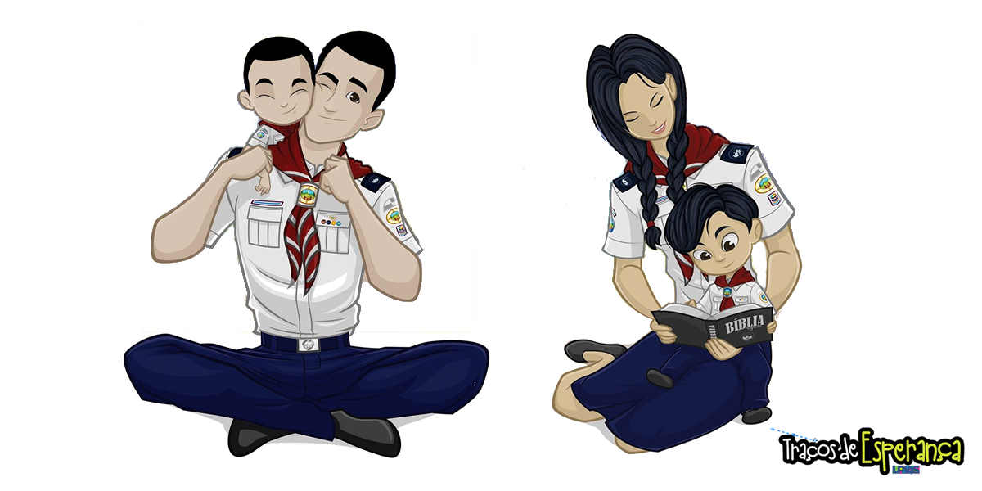
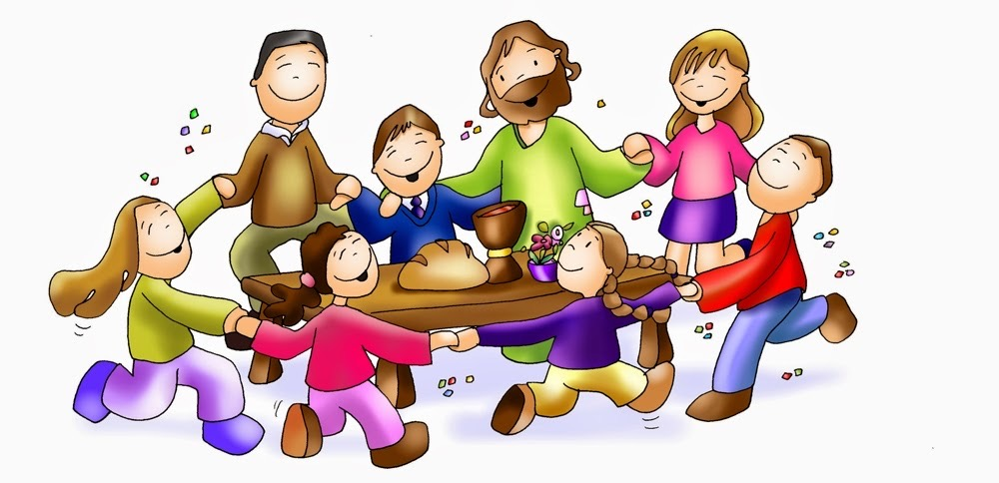
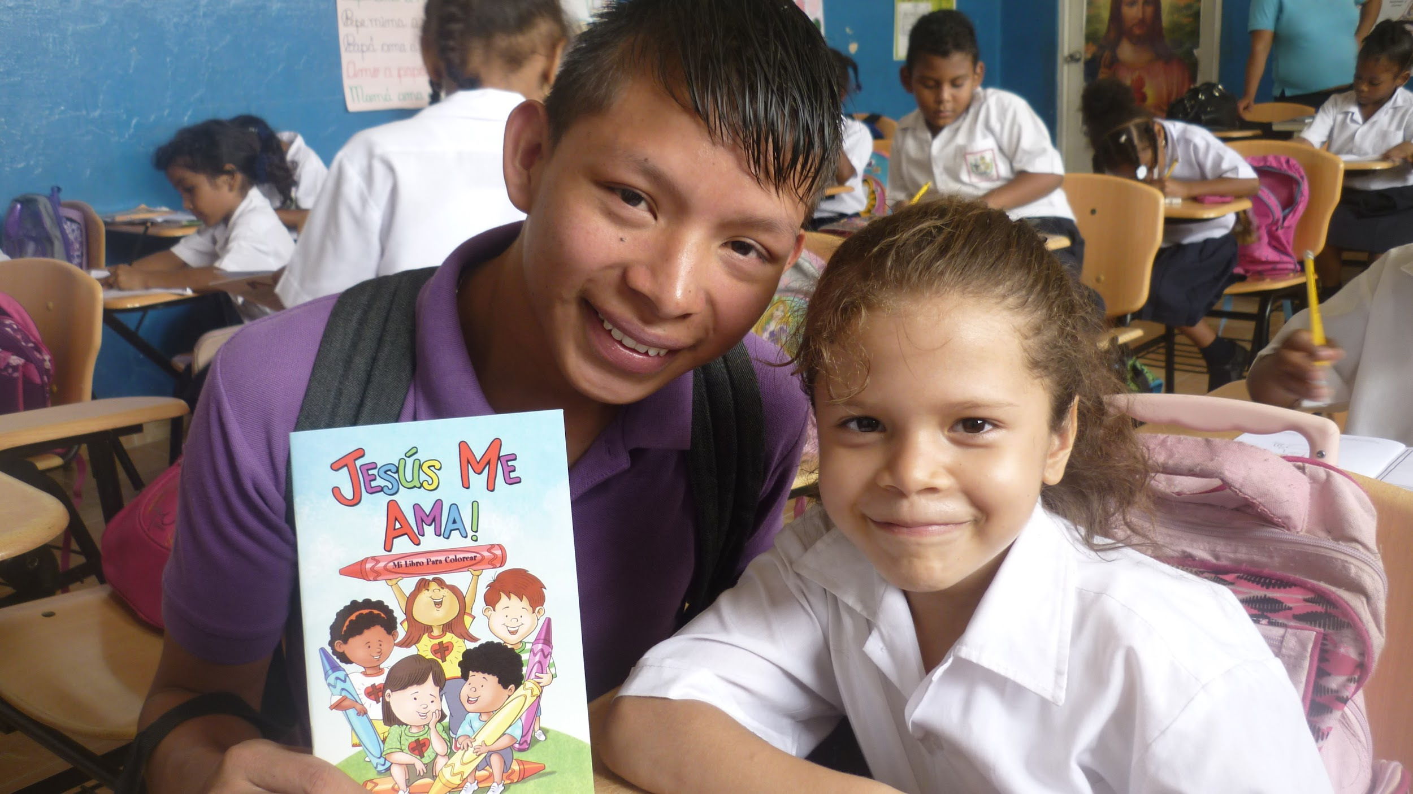
Objective
5.
8.
6.
7.
God-given abilities to benefit self and serve others
Make families Strong
Parental support
Discover God’s world
Notes:
5

Slide 5
Breakout Why is Parent Involvment important to Adventurer Ministry

Slide 6
We have a Nondiscrimination policy
Notes:
It is the policy of the Seventh- day Adventist Church to admit children to all the rights, privileges, programs and activities made available by the church, regardless of race, gender, handicap or religion.

Slide 7
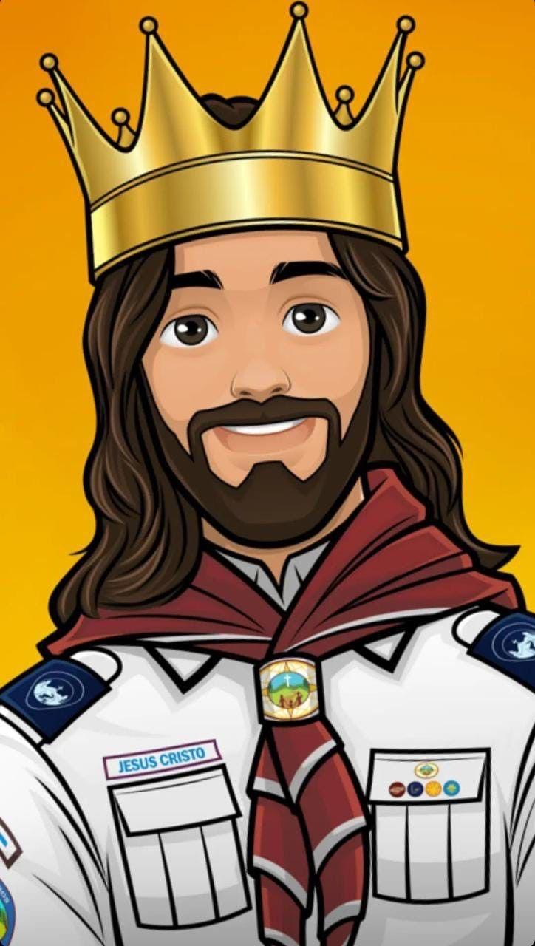
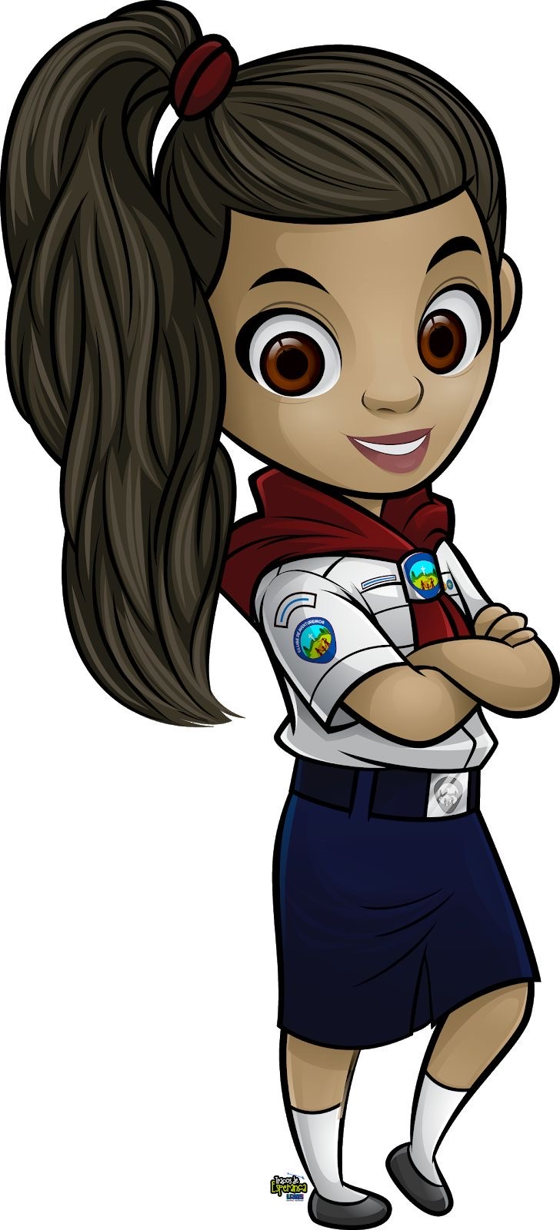
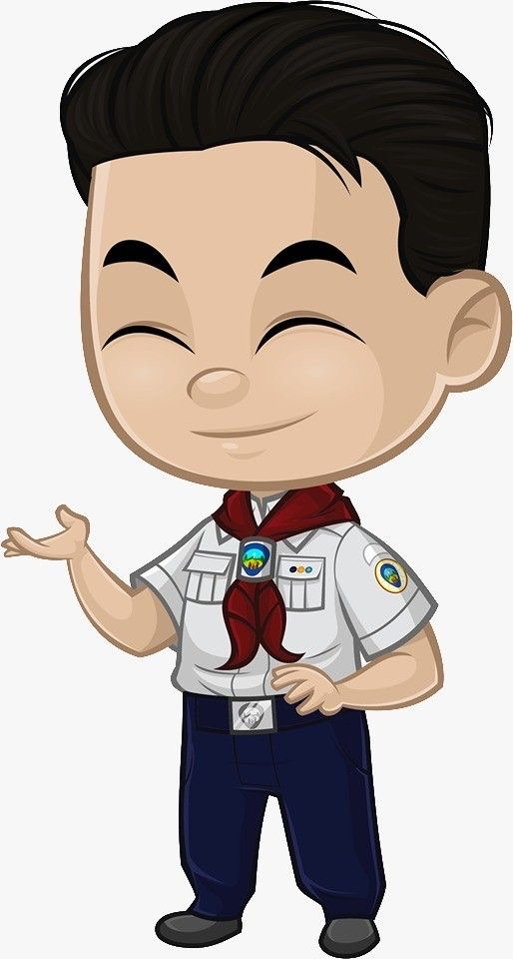
Curriculum
Basic
3. My Self
2. My God
4. My Family
5. My world
Notes:
all the book’s are divide in this 5 part

Slide 8
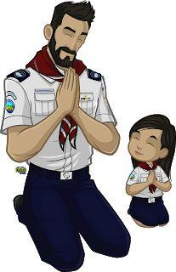
Basic
Goal: Promote understanding of the Club's ideals and inspire children with role models.
Major components
*Responsibility *Reinforcement
Notes:
introduction and review of the Adventurer concepts through reading.

Slide 9
My God
Goal : Promote the spiritual relationship of children with God.
Mayor components
His plan to save Me
His message to Me
His Power in my life
Notes:
The concepts are about the god’s love, forgiveness, conversion and obedience. They will learn from the Bible to memorize verses and the names of their books. They will also learn to pray, study and live for Jesus.

Slide 10
My Self
Goal : Reinforce in the child self-esteem, appreciation and care for himself, as a person created by God.
Major Components
*I am Special
*I can make Wise choices
*I can care for My body
Notes:
every person is uniqueness and value of each person, responsibility for service and talents
feelings, values, decision-making
health, fitness, anatomy, temperance and sexuality.

Slide 11
My Family
Goal : Train the child to be useful, productive and happy with the family that God gave him.
Major Components
Have a Family
Families care for each other
My family Helps me care for Myself
Notes:
All the family are uniqueness, family changes , roles and responsibilities.
Authority and respect, appreciation, family activities
safety, stewardship indore skills and outdoor skills.

Slide 12
My World
Goal : Teach the child to live in society with confidence and compassion.
Major components
the world of friends
the world of other people
the world of nature
Notes:
social skills, courtesy, serving the church, community, country and world
God and nature, nature study

Slide 13
Breakout Why are the following important for the Curriculum? - My God - My Self - My Family - My World

Slide 14
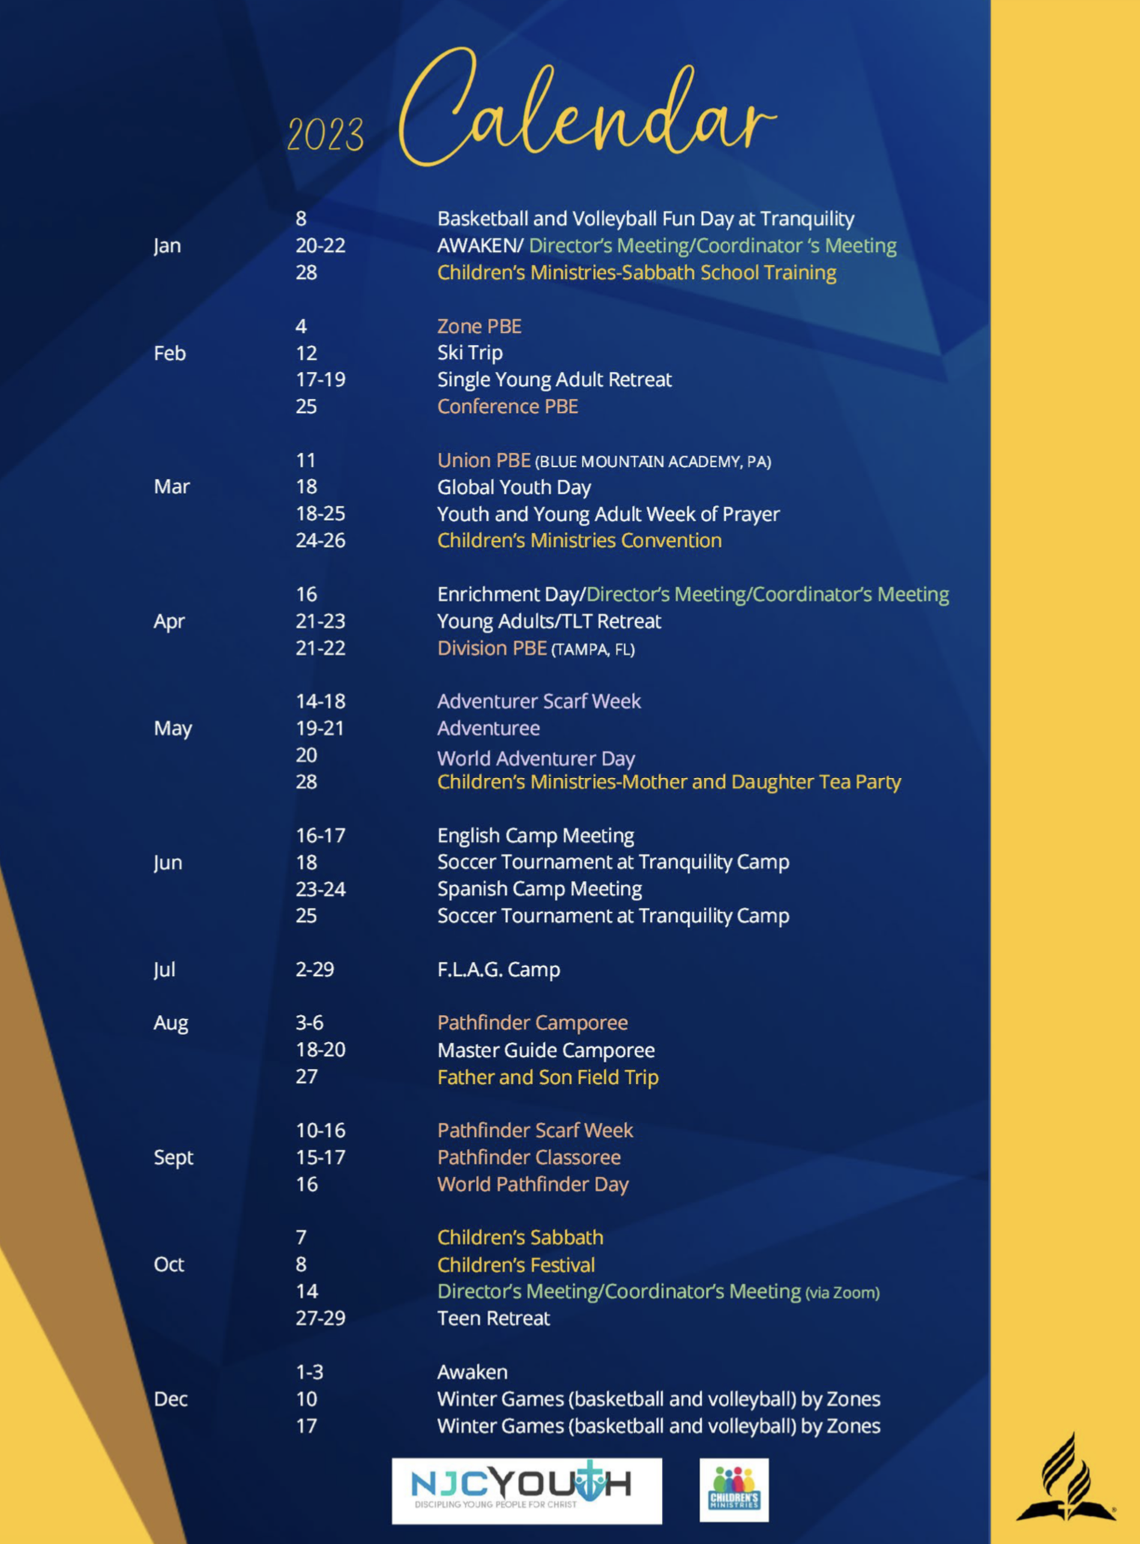
How to Teach an Adventure Class
Make a full year calendar
2023 Calendar
January
7 - Parents Meeting
8 - Regular Meeting – Kite Award
14 – Regular Meeting – Soap Craft
February
5 - Regular Meeting – Jump Jax Award
12 – Regular Meeting – String Craft
18 – Missionary Trip to …
Notes:
planning the year will help to know how much time we will have to work and complete the requirements.

Slide 15
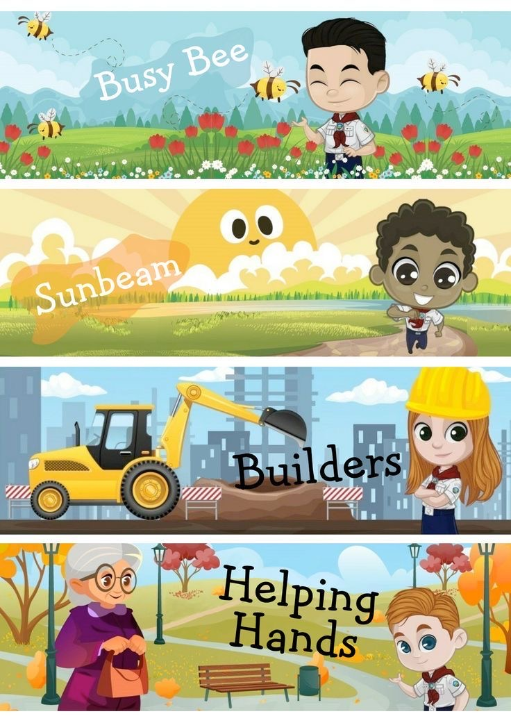
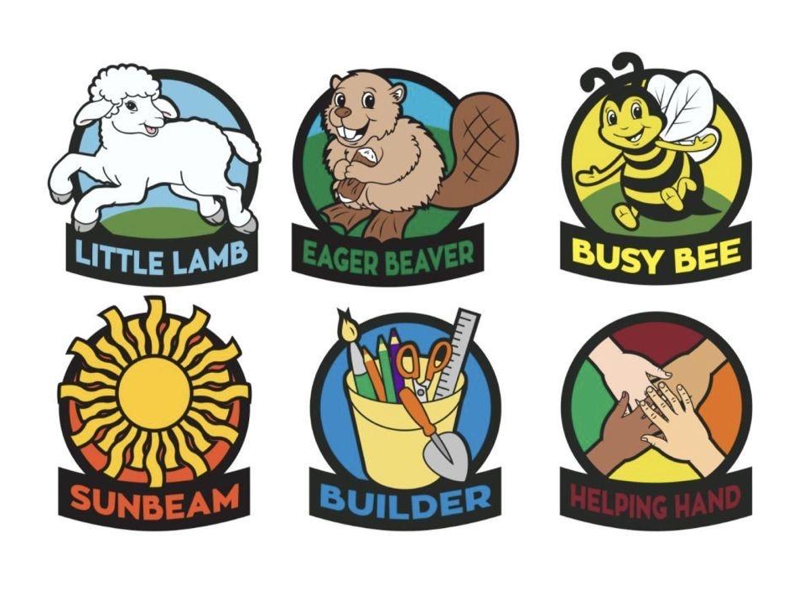
2.Know your requirements and Understand the requirement you are working on.
4 year
5 year
6 year
7 year
8 year
9 year
Notes:
each class is designed for different ages
little lamb 4 year
eager beaver 5 year
busy bee 6
sunbeam 7
bulder 8
helping hand 9

Slide 16
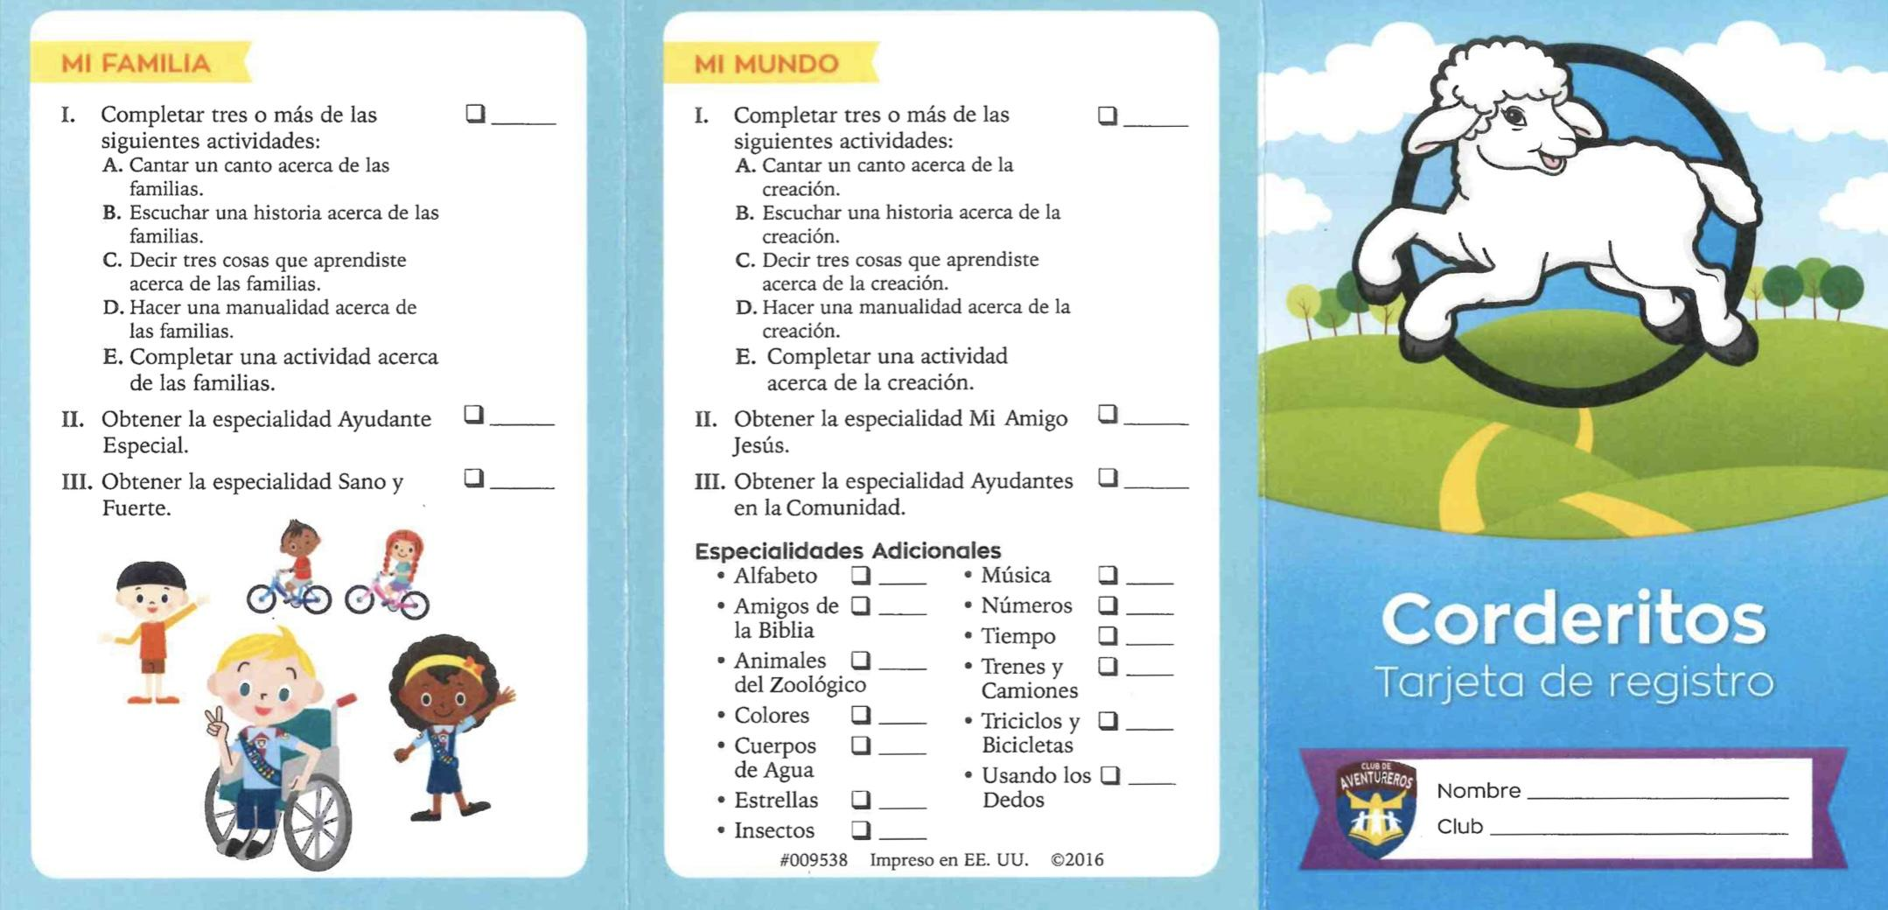
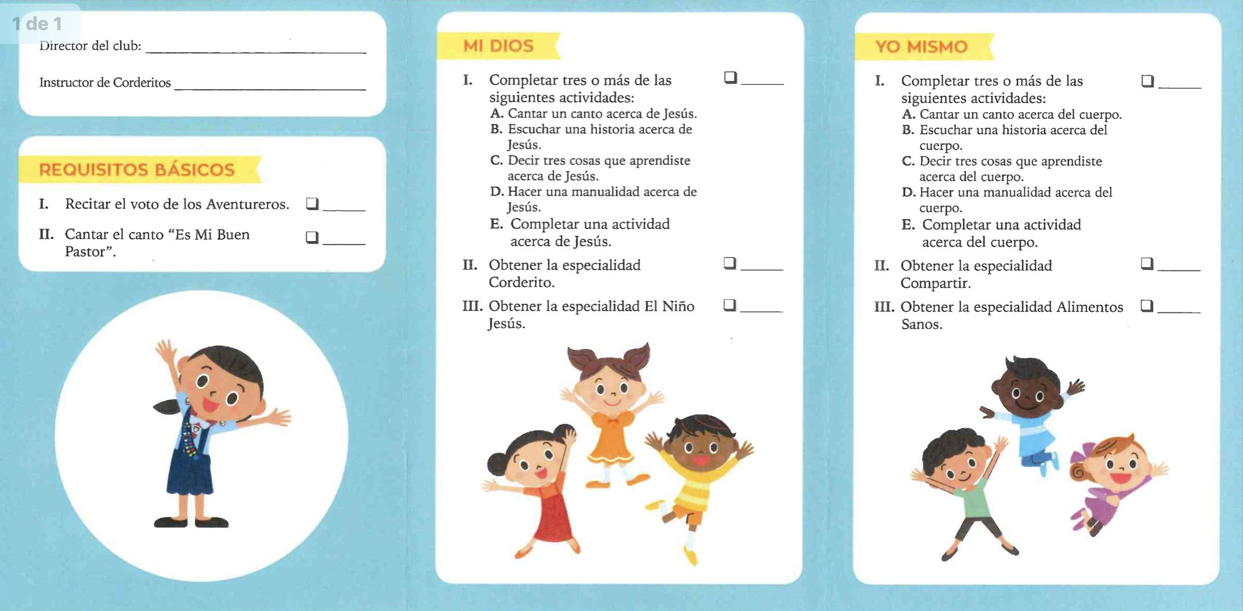
Notes:
this is the requirements sheet that is delivered with the book and is the one that should be used when evaluating in order to know if it is complete.

Slide 17
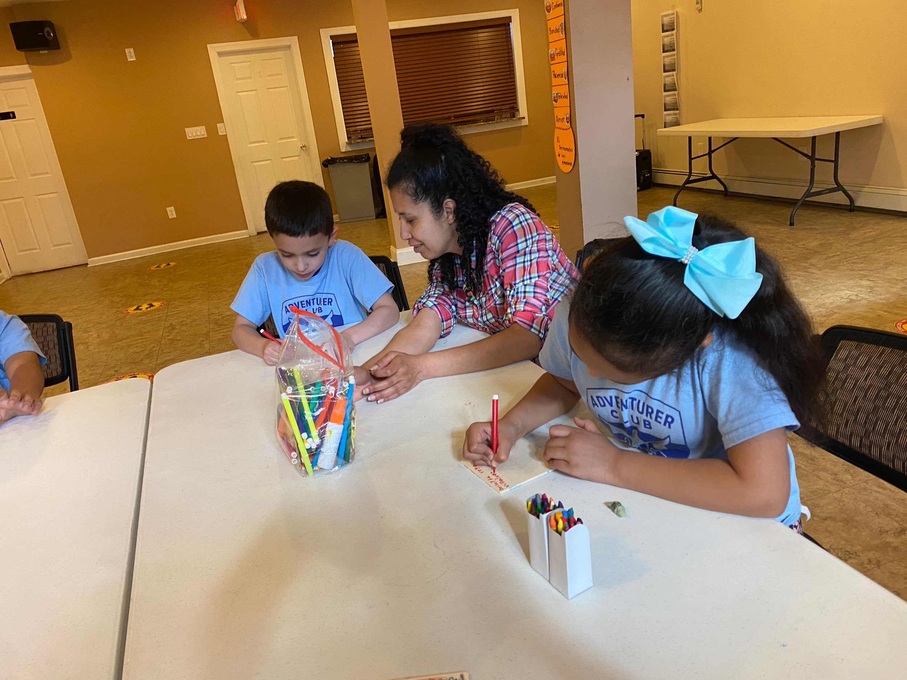
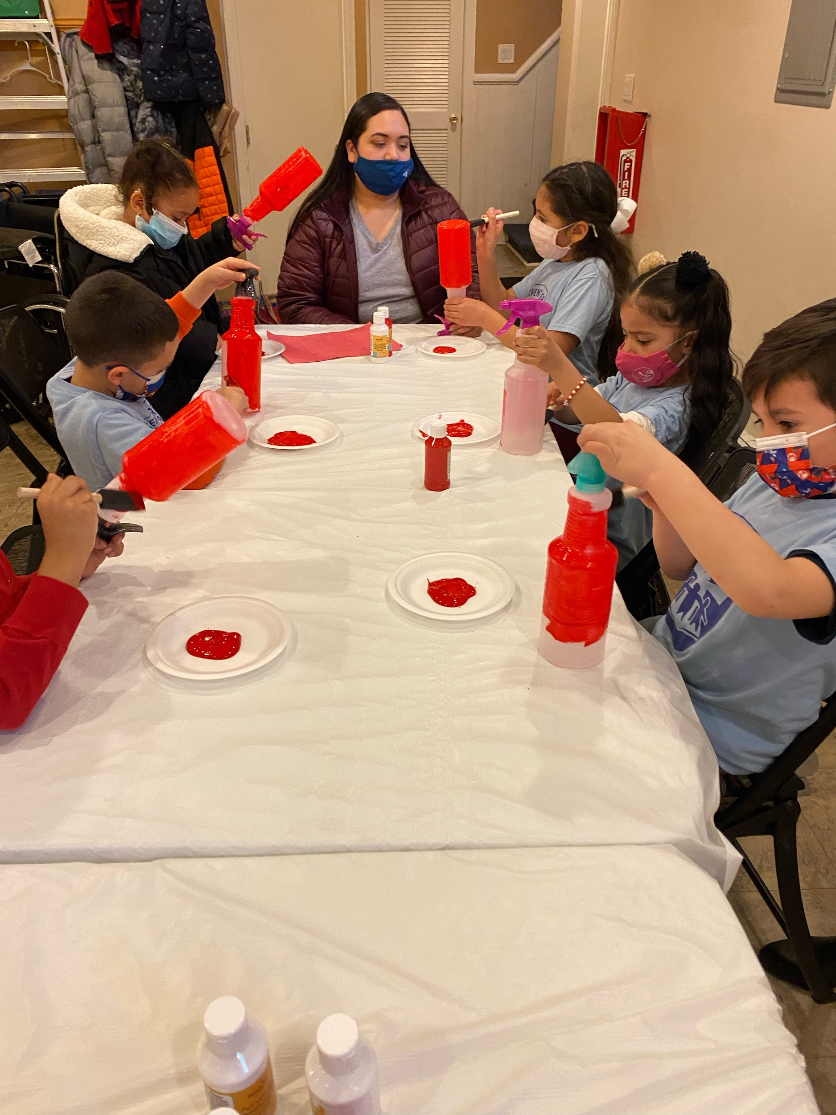
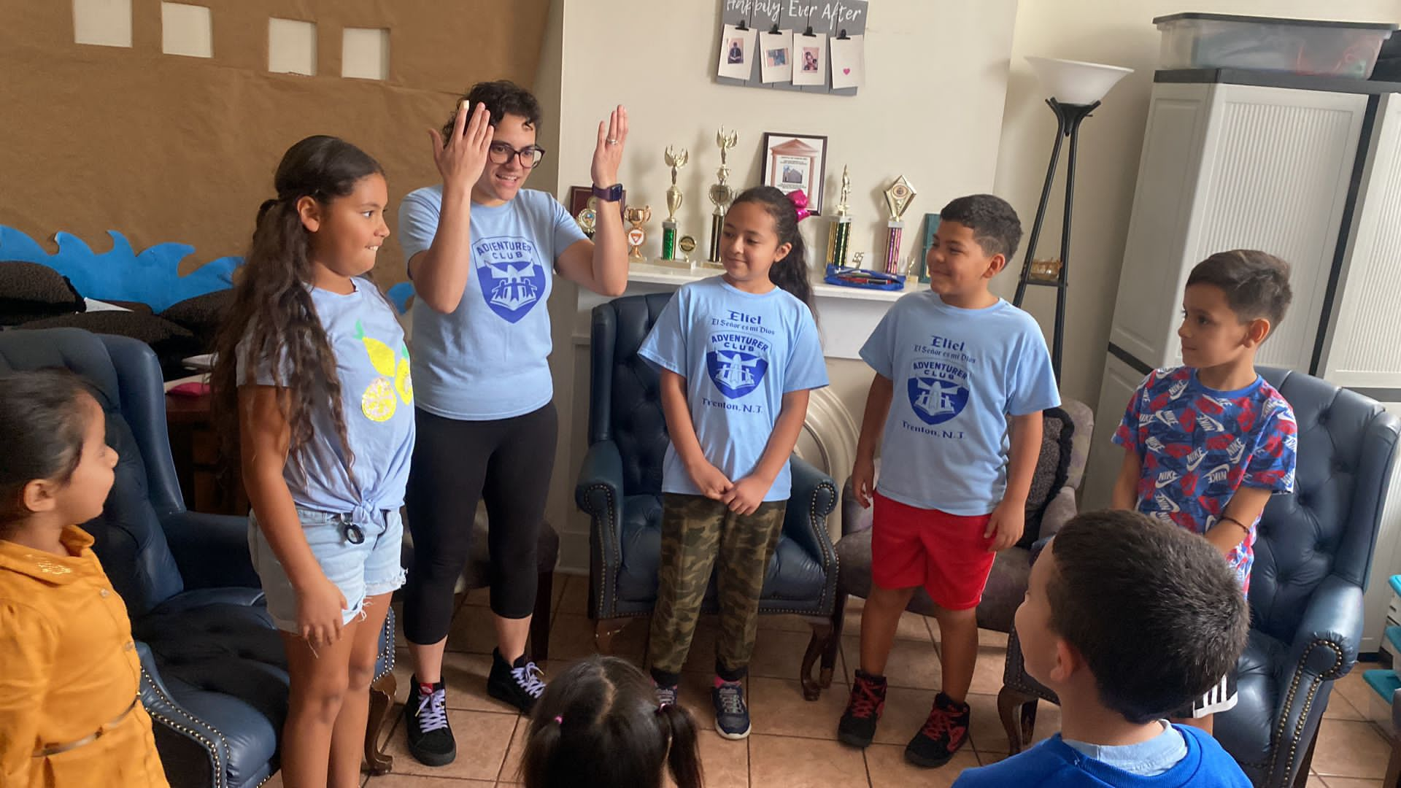
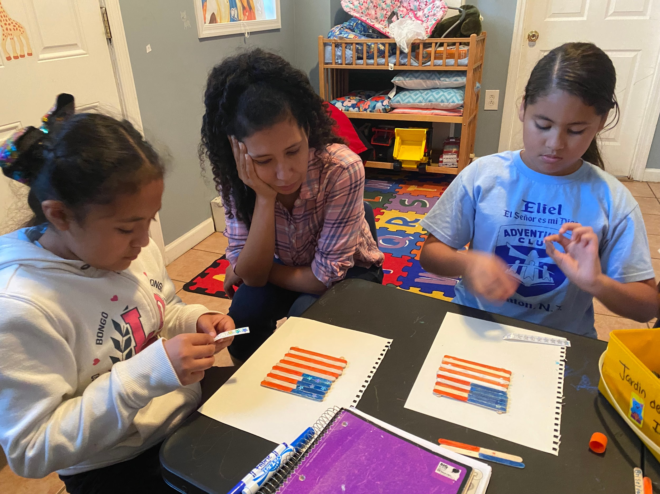
3.Consider the children and the experience they will have in each class.
4.Always involve parents
Notes:
remember your enthusiasm for the subject and for Jesus is what will make the greatest difference in the children’s live .

Slide 18
5. Schedule your class work.
Example : meeting protocol
First 10 min
Fall in
Song
plege
Law
Prayer
Devotional
Classes 40 min
Activity and games 30min
closing (prayer) and snack 10min
Total: 90 min
Notes:
this is the order that I use and it works for me and just like the meeting days, it is at the discretion of each club , but in my church we meet 3 times a month.

Slide 19
Breakout Why is Classwork important?

Slide 20
Plan the class Period
40 min
Captures child's interest
Presents interesting information, visual, demonstration.
Practice before presenting.
Make his experience personal and he learns how to apply to his life.
Finally: assess each child in order to collaborate that all have meet the requirements of what was taught.
Notes:
To have a good class, you must have the responsibility of preparing yourself well and always having all the materials at hand, because there is nothing more annoying for children than seeing their teacher not knowing what to do or wasting time looking for things that are not have. Be prepared.

Slide 21
Breakout Why is Planing class period important?

Slide 22
Adventurer Stars chips and Awards
Stars, tokens, and prizes are fun ways for adventurers to explore their world, learn skills, and get creative. When the requirements are completed, the Adventurer receives a patch that he wears proudly on his sash.

Slide 23
Resources
http://www.guiasmayores.com/club-de-aventureros.html (Español)
https://www.adventsource.org/store/adventurer-club/investiture-patches-and-pins
https://www.njcyouth.com/adventurers
https://adventistbookcenter.com/

Slide 24
Thank you and God Bless
Mabel Alvarez

