Slide 1
LET’S TALK
How to create great questions that contribute to meaningful discussions
By John Rivera
New Jersey Conference

Slide 2
“KNOWING WHERE YOU ARE GOING ENABLES YOU TO ASK THE RIGHT KINDS OF QUESTIONS ALONG THE WAY. . . . . . . .THERE ARE BASIC TECHNIQUES FOR ASKING QUESTIONS, WHICH IS MORE OF AN ART THAN A SCIENCE.”
—The Place to Belong, Youth group Essentials, p.74

Slide 3
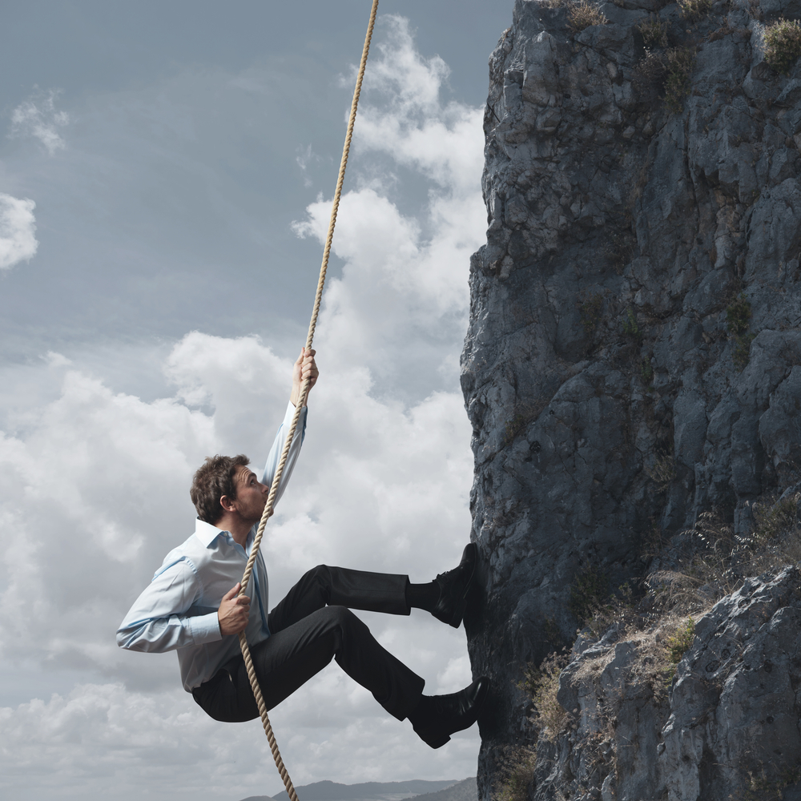
What Is a Leader?
What is the Hardest Part about being a Leader?
Take 3 Minutes

Slide 4
WHY HAVE A DISCUSSION?
💡
You Want the discussion to lead somewhere other than yourself.
You want the Youth Group to grow Spiritually.
🕯
📹
🔦

Slide 5
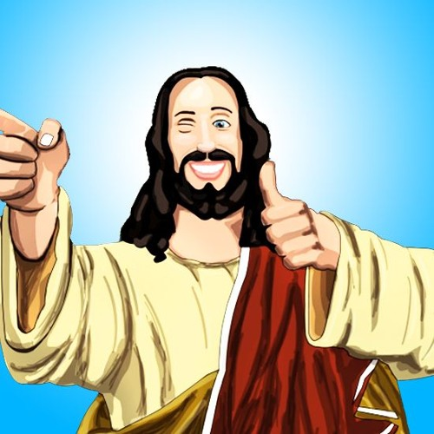
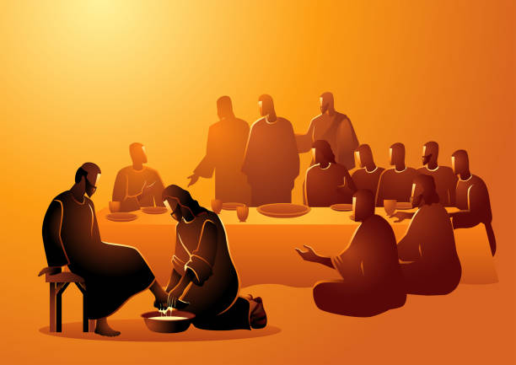
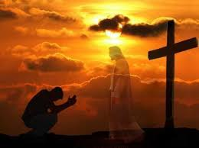
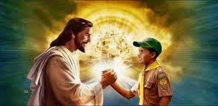
HERE ARE THREE POINTS ABOUT GROWING SPIRITUALLY:
Remember our philosophy: Fostering Relationships that Build Responsible Servant Leaders.
Our youth group knows Jesus as their friend, which leads to faith, which leads to good behavior, which leads to serving others.
You might choose to start with a service project, which leads to good behavior, which leads a youth group to faith, which leads to knowing Jesus as one’s friend.

Slide 6
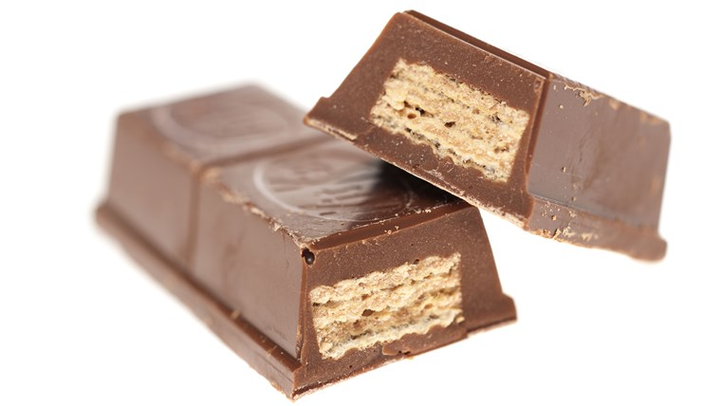
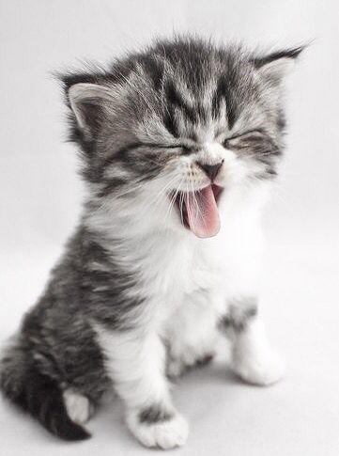
6 KEY POINTS OF ASKING QUESTIONS:
K. A. T. C. A. T.
Key Questions
Advance
Timing
Clear
Adapt
Trail

Slide 7
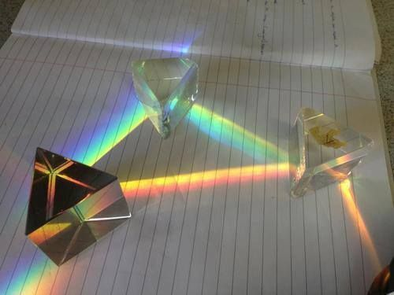
KEY QUESTIONS:
Ask questions that take a great deal of time, thought, and effort to answer. (10-20)
Ask yourself, “What is this really about?”
Bible Study
Mission Trip
Focus every question on the key question & the other questions will come naturally.

Slide 8
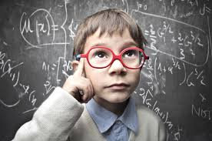
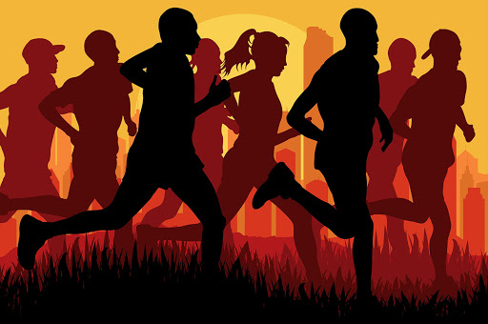
ADVANCE:
How you move your discussion & flow forward in the group you are leading.
You can start by asking general questions, but then prepare to be more specific, and deeper.
You want to prevent repeating yourself.
This will cause your group to get bogged down, and the discussion will go nowhere.

Slide 9
TIMING:
Give your listeners time to respond
“Okay everyone take 30 seconds to respond.”
***(This takes pressure off the silence by giving permission to be silent).
After the 30 seconds, repeat the question & ask for the response. (These responses sometimes can be written individually, then discussed in a group).
***Example: Writing responses on post-it notes & placing them on a poster/wall.

Slide 10
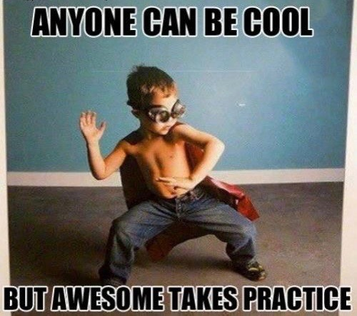
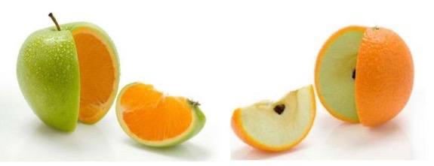
CLEAR:
Be sure to be clear with the listener(s) because, your question maybe clear to you, but not to everyone.
A person might answer a question differently than expected, but that’s ok, because their answer could be an acceptable answer.
If the answer doesn’t go down the expected trail, simply acknowledge their response & move on.
Since practice makes perfect, you may want to try your questions on others before your group. Sometimes questions are too vague to be clear and may need to be refined.

Slide 11
ADAPT:
Be sensitive to the promptings of the Holy Spirit. You may be impressed to go in a different direction in your discussion, because dynamics in discussions change.

Slide 12
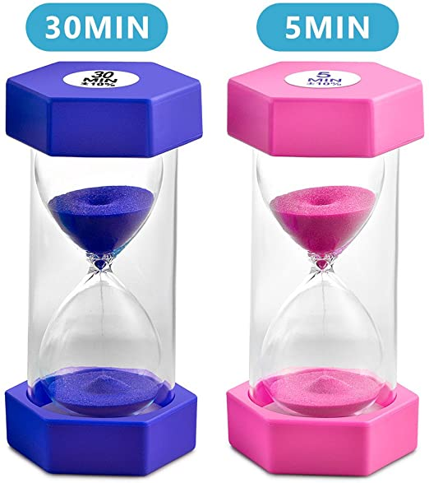
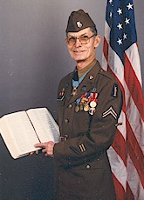
ADAPT: (CONTINUED)
Sometimes you’re prepared for a small group of four and end up with a group of twenty.
You may have been expected to give a 30-minute discussion but end up giving just 5-minutes.
Are you Flexible?
Can you go with the flow?
Are you able to, “Adapt & Overcome!?”

Slide 13
TRAIL:
You may follow up with what one person said, and simply acknowledge what another said, but not go down that direction.
Your compass is making sure your philosophy is clear (“Fostering Relationships that Build Responsible Servant Leaders”) and your goal (“Christlikeness”).

Slide 14
BREAK OUT
TLT’s Come up with 2 questions that take a great deal of time, thought, and effort to answer using the 6 Key Points we just learned on Asking Questions.
( AKA K A T C A T )
Age Group: 10-15
Gender: Boys & Girls
DYNAMIC: 1 DATA ; 1 FEELINGS

Slide 15
TWO KEYS ON HAVING GREAT DISCUSSIONS
• Commitment • Variety

Slide 16
KEY ONE: COMMITMENT
You need at least a small commitment from the participants
You don’t’ want to present this ”Commitment” as a life, or death matter. Example: “Are you willing to die for me right now.”
All you need for a small commitment is—a “yes” or “no” or “maybe”

Slide 17
KEY TWO: VARIETY
You need a variety of responses. If everyone answers the same there’s no discussion.
Example if you ask the question: “Do you love Jesus?”
To get variety answers you would ask:
Example: “What are some of the ways Christians show their love for Jesus?”

Slide 18
KEY TWO: VARIETY (CONTINUED)
The questions need to be worded in such a way that it awakens more than one answer in the mind.
Obstacles to overcome before hand:
Know the size of your group.
Know the format & style of your group.

Slide 19
BREAK OUT
TLT’s Come up with 2 questions using the Two keys on having Great discussions.
Example:
—a “yes” or “no” or “maybe” & “Variety”.
DYNAMIC: 1 DATA ; 1 FEELINGS
Scene: Baltimore Aquarium TRIP
Age Group: 10-15
Gender: Boys & Girls

Slide 20
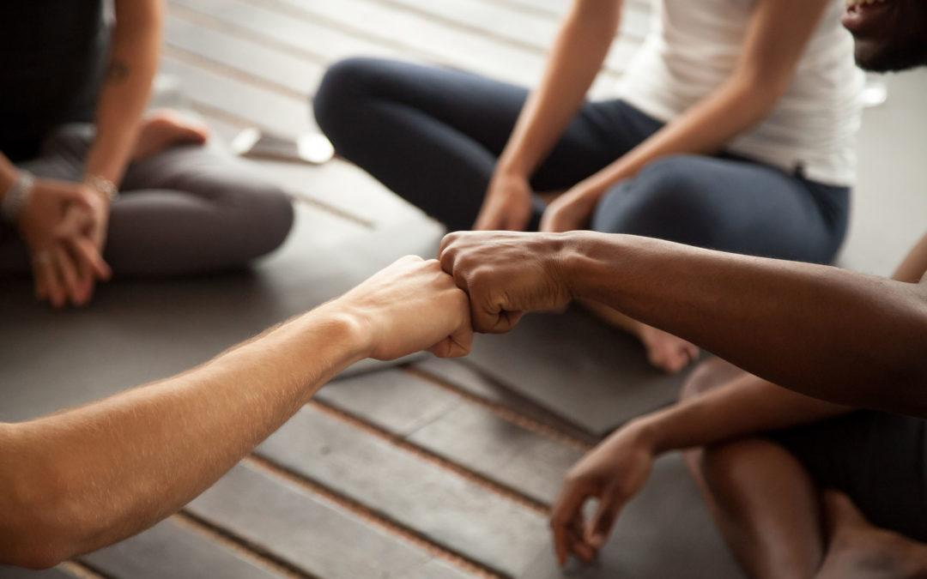
SMALL GROUPS

Slide 21
SMALL GROUPS:
The larger the group, the less likely you will have a significant involvement, and you end up as the “bystander” with only a small number of participants.
If a group is large (10+ people), you might want to break into groups of 3-4 to discuss a question & then report back to the larger group.

Slide 22
SMALL GROUPS: (CONTINUED 2)
A Proven Small Group Method
Give a short introduction to Scripture or a list of Bible texts. Place a Facilitator in each group to guide the discussion after reading the texts.
At the end of set time period the small groups can report to the leader what was learned. The leader than writes all points on the board.
Everyone sees the reports, and are amazed at all the different responses because, one group may have thought they exhausted the texts then they see great ideas from the other groups.

Slide 23
SMALL GROUPS: (CONTINUED 3)
This method accomplishes several things:
The leader can overlook as key questions are asked jumping from one group to the next listening in.
Facilitators get experience in leading small groups. Which get them ready to lead up front.
Most importantly, participants get involved! They get a sense of belonging, because someone was listening.
When you reach a sense of belonging you are accomplishing your goal.

Slide 24
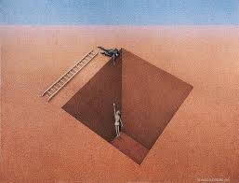
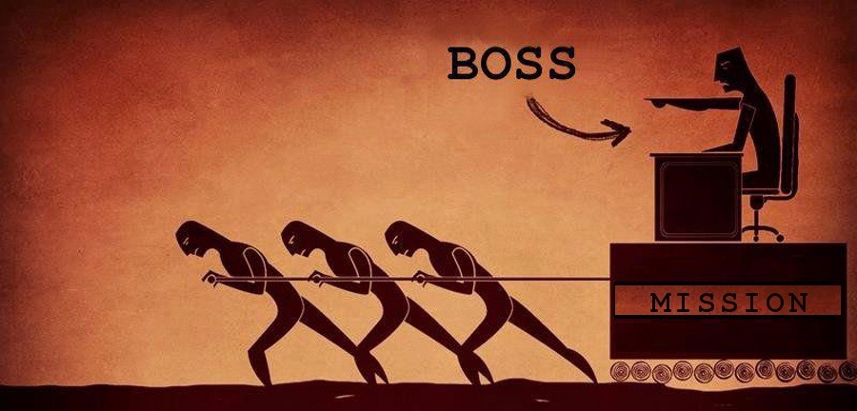
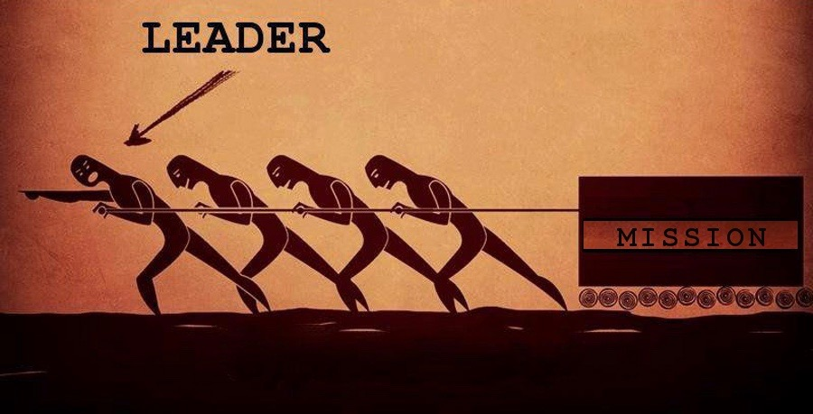
SMALL GROUPS: (CONTINUED 4)
Prevent being tempted to Do Everything Yourself:
There are many “do-It-Yourself-Leaders” “discussion leaders” or “teachers” who find it easier to stand up (or sit down) and lecture, then call it a day, without exercising the groups sense of belonging.
This method is a youth group killer.
Some leaders say, “I can’t get any adults to help me!”
Use the young people themselves by modeling how it works & team up with them as co-discussion leaders. When they are ready have them lead the discussion on their own.

Slide 25
“So many young people complain that youth group is boring. We guarantee that if they are leading out, it won’t be boring for them. Just make sure that the other youth do not make fun — their turn is coming soon enough. Start with those who you sense might have talents they can develop in this area. begin with those who are ready to be used by God and are teachable themselves.”
— A Place to Belong, Youth Group Essentials, p.81

Slide 26
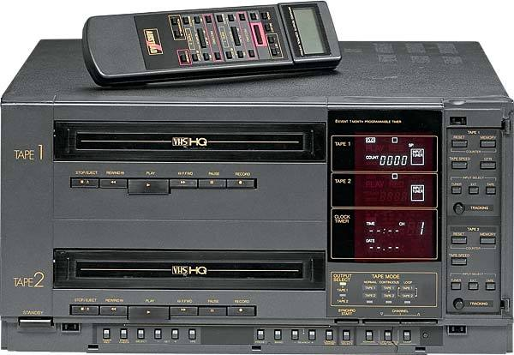
EIGHT CREATIVE QUESTION STYLES: THE V C R G L I D E
Voting
Continuum
Ranking
Goal Setting
5. Listening / Watching
Interview
Dilemma
Either-Or

Slide 27
VOTING:
At their core, teenagers haven’t changed much in 20 years.
Either by writing on paper,
Or you can try the thumbs up / Thumbs down
___ Strongly Agree
___Agree
___Uncertain
___Disagree
___Strongly Disagree
___ (Both thumbs up)
___ (One Thumb UP)
___ (Sideways Thumb)
___ (One Thumb Down)
___ (Both Thumbs Down)
❌
👎🏻

Slide 28
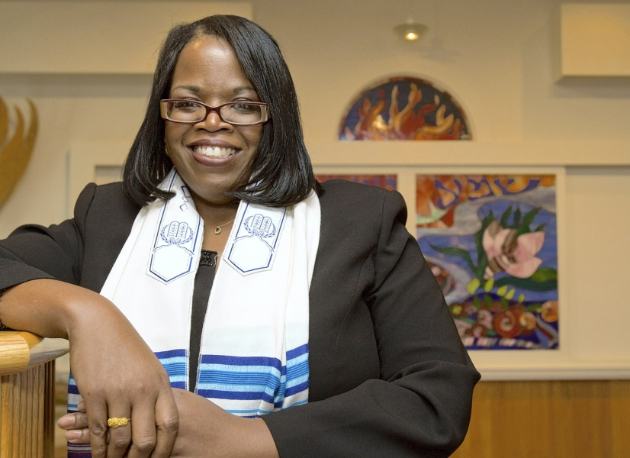
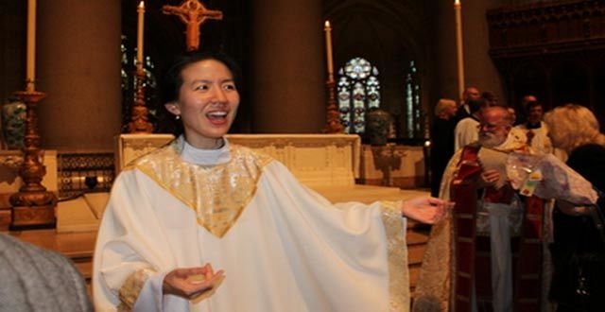
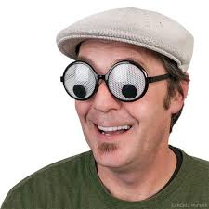
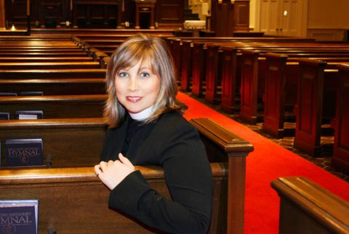
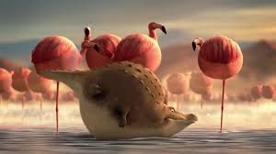
OTHER VOTING EXAMPLES YOU CAN USE TO TURN UP THE HEAT:
“Does God accept homosexual / lesbian behavior?”
“Is being obese as bad as drinking?”
“Is it alright for women to be pastors, rabbis, or priests?”

Slide 29
CONTINUUM:
“God’s will for my life is”
Clear
Fuzzy
X
X
X
X
Pastor
Jailene
Billy
Next Person
A continuum is a line that separates two opposites, and can be used by asking a key question such as:
On opposite sides of the line, you can have the words, “Clear” and on the other side, “Fuzzy.”
Somewhere along the line is where everyone is asked to place an, “X.” Etc. .

Slide 30
RANKING:
“God communicates to us primarily through:”
____Words
____Loving Actions
____The witness of the Church
____The Holy Spirit
“Who would you go to if you need advice?”
___Dishonest Politician
___Self-righteous Person
___Prostitute
___Local Drug Dealer
Participants hear a statement, then they respond to three or more options by numbering them in order.
2
1
3
4
Sometimes the options seem equally good. At times you can also make the options equally bad.
4
3
1
2

Slide 31
RANKING: (CONTINUED)
In time you as the leader will gain the skills in preparing options that are close to one another, that will stimulate discussion.
practice makes perfect. Look for a variety of possible answers that could be right or like in the last example all the options could be bad.

Slide 32
GOAL SETTING:
“Hey Pathfinders, we’re about to begin a 1-month emphasis on reading the Bible for our personal devotions.
Our goal is for 100% of our group to read the Bible for 30 minutes a day
7 days a week
1 month straight
Is this a good goal or should we adjust it?”
Usually given at the end of a discussion. You can use it to start a discussion by revealing the goal and asking the group for adjustments in reaching the goal.
A statement like this can be given at the beginning of a discussion and adjusted during the interaction.

Slide 33
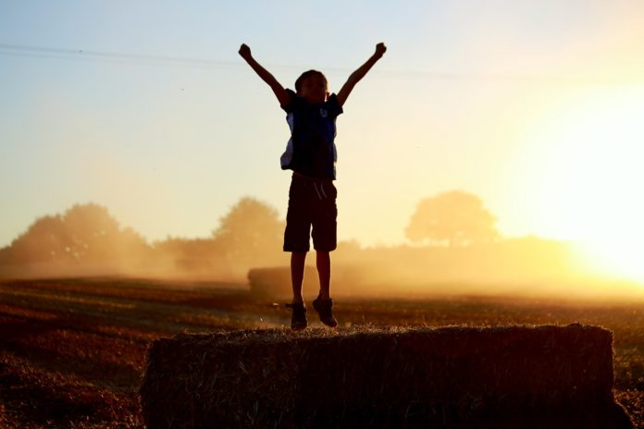
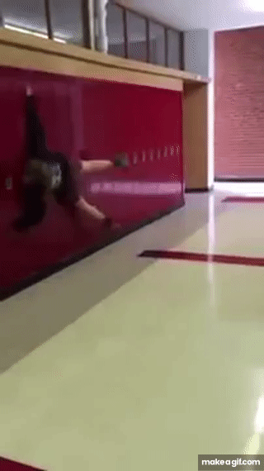
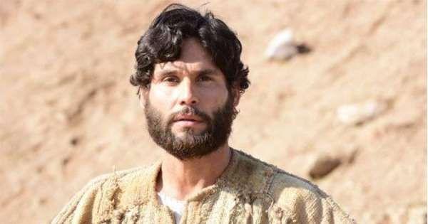
LISTENING / WATCHING:
After hearing a paragraph of information (via a skit or YouTube video), participants then respond based on the information they received.
“Hector has just discovered Jesus for himself, and he’s very excited about his discovery!
He wants to share this good news with everyone — now!! So Hector walks up to students at school and throws them up against the lockers, and ask, “Are you saved now Heathens ?!?!?!” ”

Slide 34
LISTENING / WATCHING: (CONTINUED)
Then you ask Follow-up questions:
What do you think of Hector?
Comment: Hector is a magically excited unicorn.
What do you think of Hector’s method?
Comment: He needs practice being kind and gentle.
What are some other ways to share the Gospel?
Comment: Living like Jesus and sharing your testimony.

Slide 35
INTERVIEW:
This method can be done 1-on-1 in front of the group, or the group facilitator can jump from person-to-person with a question or a flow of questions on a given topic.
Example: Ask several people the 1st question, then several other people the 2nd question, & so on. The 3rd question tends to get people into deeper thought. Yet handle all questions the same, rather than making a big deal.

Slide 36
INTERVIEW: (CONTINUED)
Example of questions to ask:
What do you do when you have some free time?
On most days, do you spend time with friends or with family?
Do you spend more time each day getting physical food or spiritual food?

Slide 37
DILEMMA:
A situation gets presented in which there is no easy next step. Then the listeners make suggestions on what can be done, and they give their reasons for their ideas.
First day
“heather reluctantly accepts Jason’s invitation to the banquet, figuring it’s better than going alone.”
The Dilemma
“That evening, Heather gets jolted back to reality when Jason calls and asks her the color of her dress for the banquet, since he wants to buy a corsage that matches her dress.”
Second Day
”Marcus catches Heather in the school hallway and asks her if she’ll go with him to the banquet. Heather can’t believe it! She’s been waiting for two years for Marcus to notice her. She quickly says, “Yes,” to Marcus and walks on air the rest of the day.”

Slide 38
DILEMMA: (CONTINUED)
Is this a dilemma?
What could Heather do?
What should Heather do?
What would you do if you were Heather?
What would you do if you were Jason?
Is there anything from the Bible that could help Heather know what to do?

Slide 39
EITHER / OR:
Participants are given and “either-or” statement and are asked to choose one or the other, then give reasons for their choice.
Example One
Example Two
”Would you rather:
Hear God’s voice once, clearly and out loud
OR
Hear God frequently in a still, small voice?”
“Which is more important to God:
The Beliefs we hold
OR
The life we live?”

Slide 40
BREAK OUT
TLT’s Using the 8 Creative Question Styles of the
V C R G L I D E , come up with one question using the Voting style or the Ranking style.
Example:
What should we eat on 1st day Family Fun Day
(give 3-4 options)
What is your favorite theme park?
(Rank 1, 2, 3, & 4)

Slide 41
“With tender earnestness David entreated Solomon to be manly and noble, to show mercy and loving-kindness to his subjects, and in all his dealings with the nations of earth to honor and glorify the name of God and to make manifest the beauty of holiness.”
—Prophets and Kings, p.26.2

Slide 42
Heavenly Father,
Do You have a question for me?
I’m listening. . . Amen

