Slide 1



Discovery Club
Purpose and Benefits
Claudie W. Seide
New Jersey Conference
Adventurer State Coordinator

Slide 2
New Jersey Conference Discovery Program
Promotion to Adventurers
Eager Beavers
5 years old
Curious Cubs
4 years old
Little Lambs
3 years old
Baby Birds Birth to 2

Slide 3
The NJ Conference Coordinators and Directors have voted to adopt the classes by ages as in the Wright Publishing Program.

Slide 4

Discovery Program is only available through Wright Publications
www.wrightpublications.org
Use drop down menu and click on Discovery Program

Slide 5
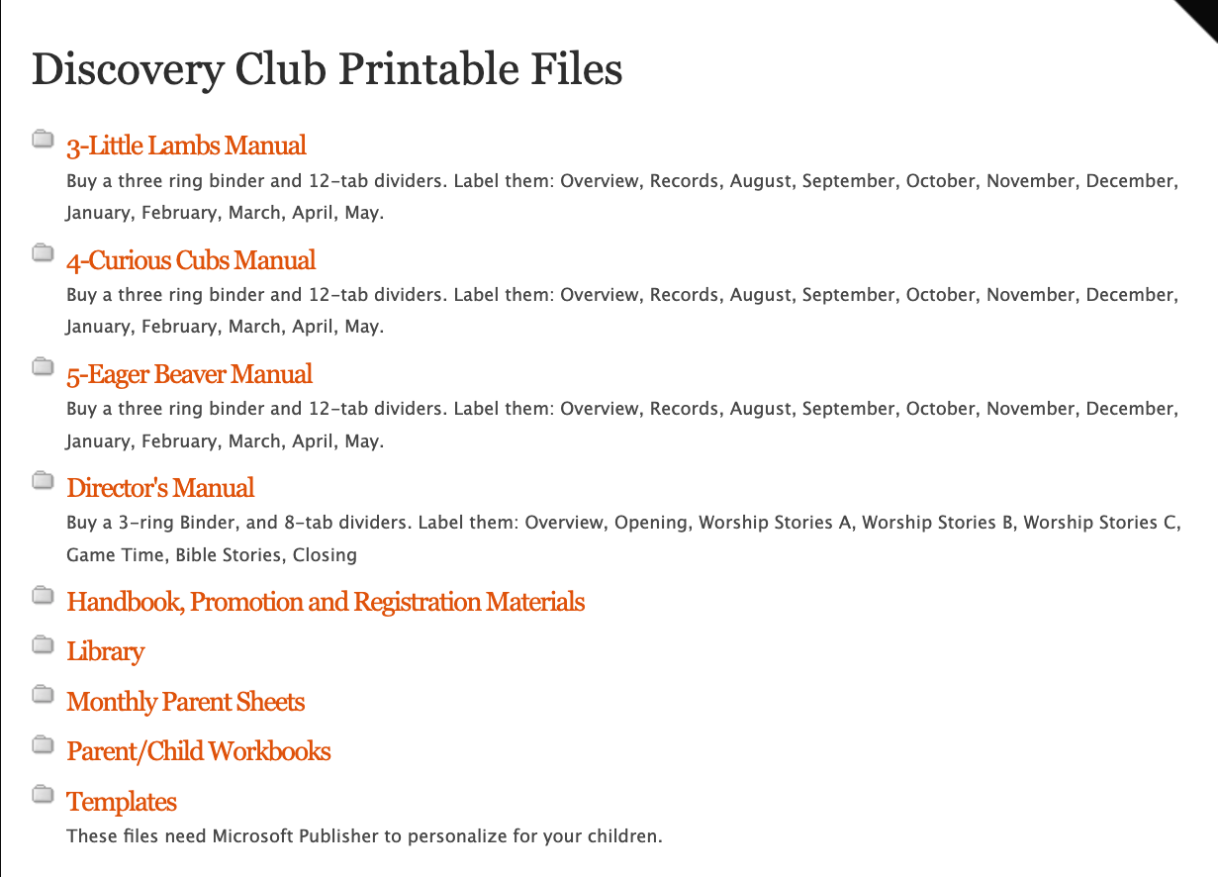

Slide 6
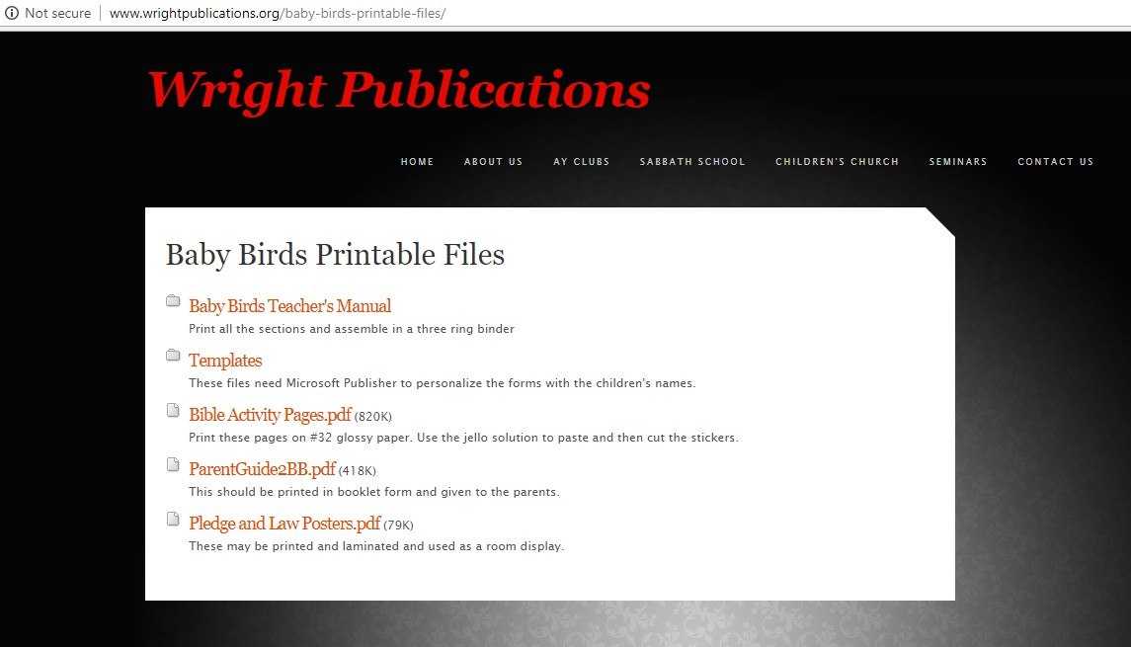

Slide 7
New Jersey Conference Discovery Program
Baby Birds Birth to 2

Slide 8

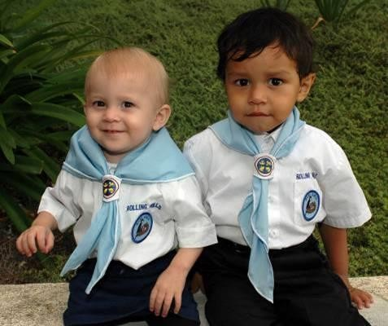
There are no award patches for Baby Birds.

Slide 9
Group activity:
Tell the story of the lost sheep so a two-year-old to understand.
What props would you use?
What activities would you do?

Slide 10
New Jersey Conference Discovery Program
Little Lambs
3 years old
Baby Birds Birth to 2

Slide 11




Little Lambs
3 year olds
Preschool
Class Patch
Award Star
Class Patch Award Star
NAD curriculum – clubministries.org Products can be purchased through Adventsource.org
Curriculum is through Wrightpublications.org Products can be purchased through Pathfindershirt.com
When we have conference events the Wright Publications age will drive what
classes they are eligible be able to take as they will be geared to that age.

Slide 12
Group activity:
Create a worship around the Adventurer Law.
Ex. Be obedient, be true, be kind, etc.

Slide 13
New Jersey Conference Discovery Program
Curious Cubs
4 years old
Little Lambs
3 years old
Baby Birds Birth to 2

Slide 14


Curious Cubs – Preschool – 4 years old
Class Patch
Award Patch
Wrightpublications.org
for curriculum
Pathfindershirt.com
for products

Slide 15
Group activity:
How can you make the Creation Story meaningful to the children?

Slide 16
New Jersey Conference Discovery Program
Eager Beavers
5 years old
Curious Cubs
4 years old
Little Lambs
3 years old
Baby Birds Birth to 2

Slide 17




Eager Beavers – Kindergarten- 5 years old
Eager Beaver Patch
Florida Patch
Eager Beaver Patch
NAD Patch
Curriculum is through
Wrightpublications.org
Products can be purchased through
Pathfindershirt.com

Slide 18
Group activity:
What are fun ways to teach the kids about choosing healthy foods?

Slide 19


The official supplier of Adventurer and Discovery supplies is www.Adventsource.org
for NJ Conference.
Did you know?
They know what our conference requirements are.

Slide 20
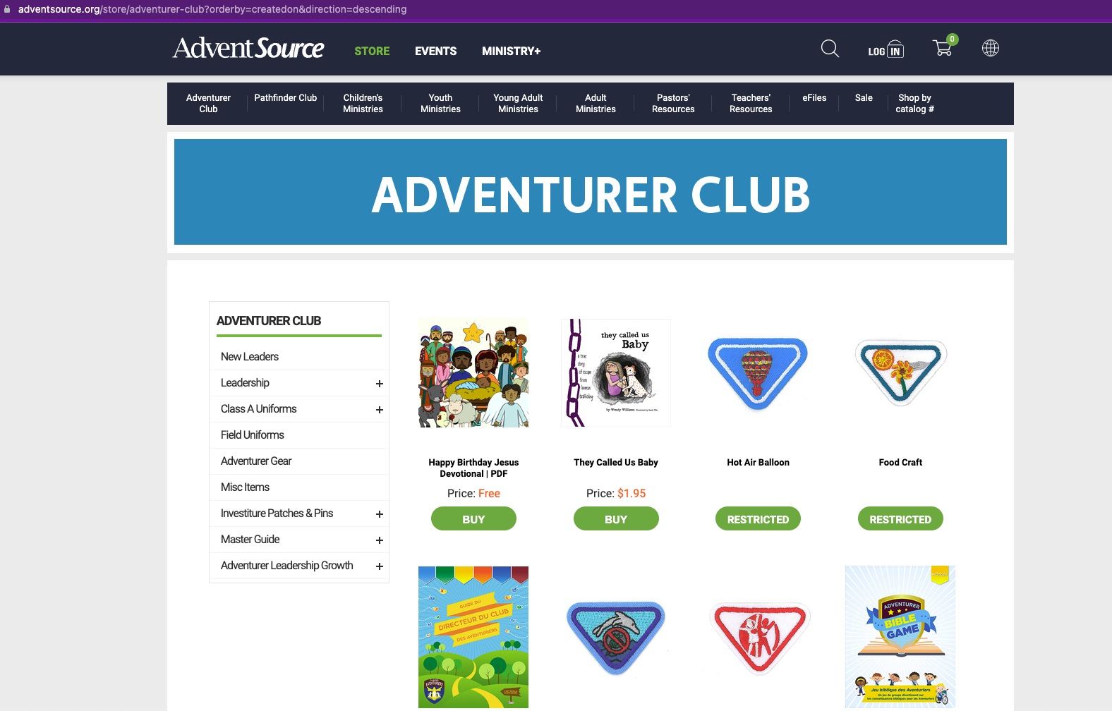

Slide 21
You can also obtain supplies from www.Pathfindershirts.com
Did you know?
They carry all the “old” logos.

Slide 22
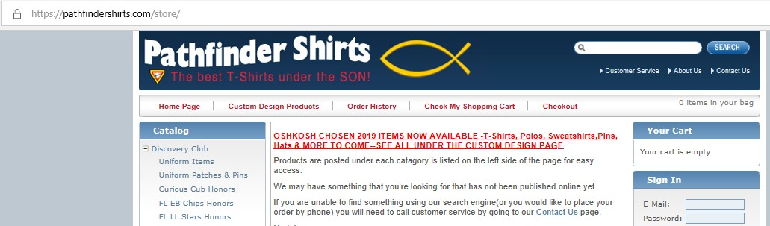

Slide 23
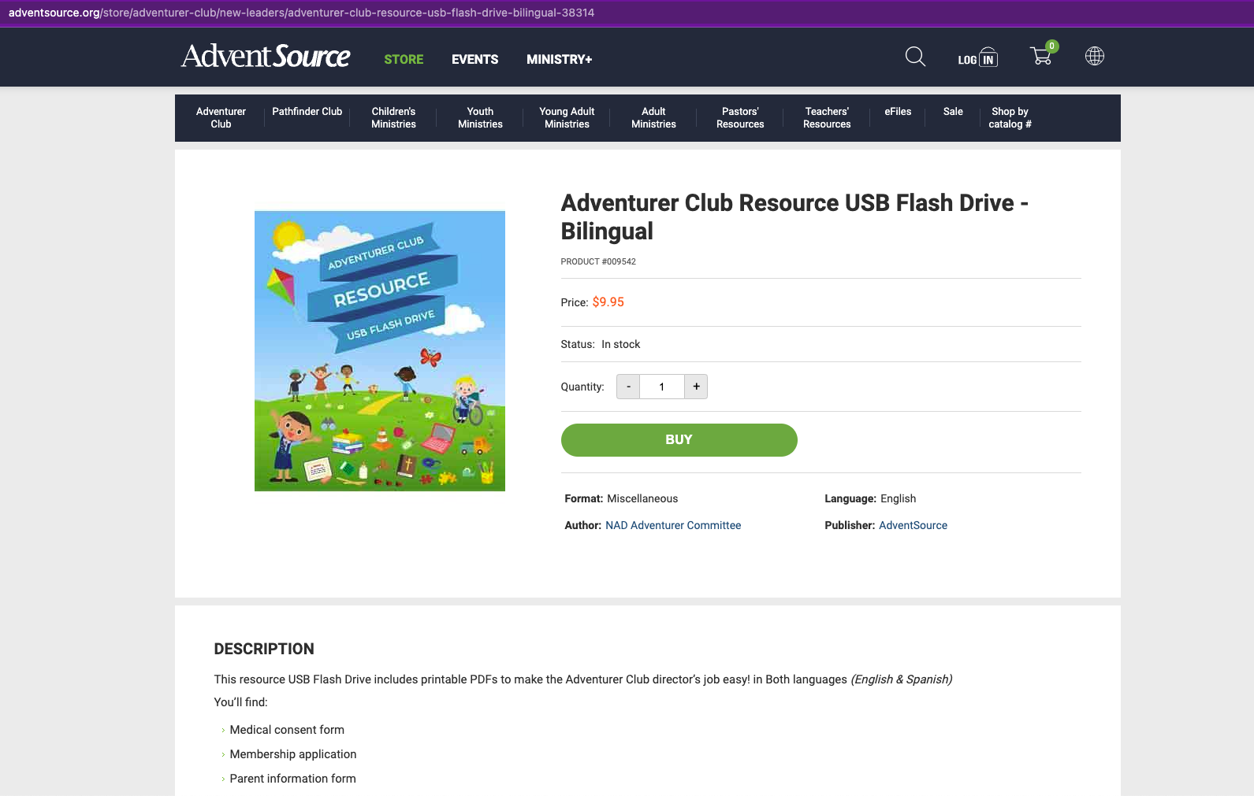

Slide 24
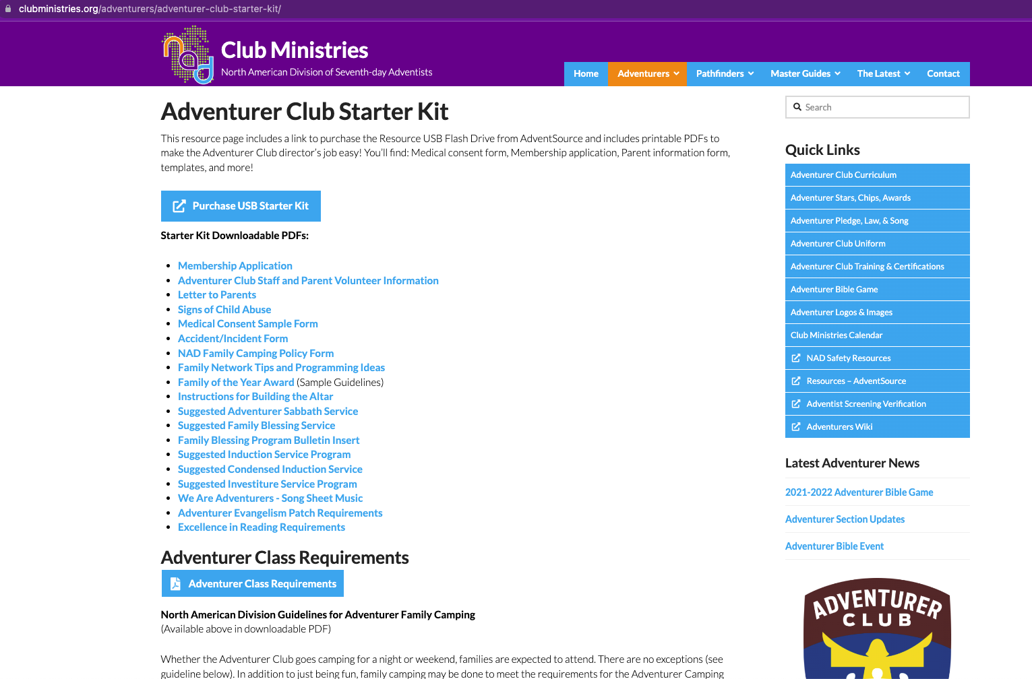

Slide 25

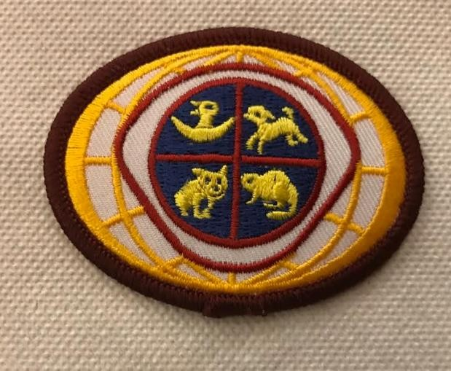


Patches, Slide and Scarf.
You can call the Conference Office to see what
new supplies are in stock.
Old Stock

Slide 26
Before we Conclude
Comments & Questions
Time

