Slide 1
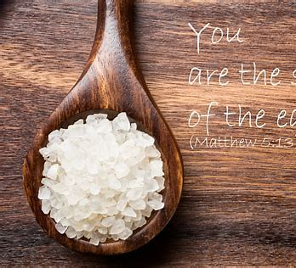
Becoming Salty Christians
Matthew 5 :13
New Jersey Conference

Slide 2
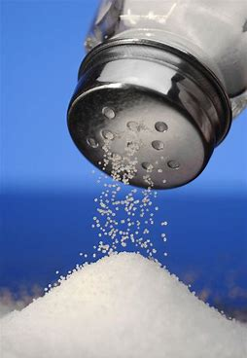
Matthew 5:13 – What does this mean?
¹³ “You are the salt of the earth. But if the salt loses its saltiness, how can it be made salty again? It is no longer good for anything, except to be thrown out and trampled underfoot.
Share your thoughts

Slide 3
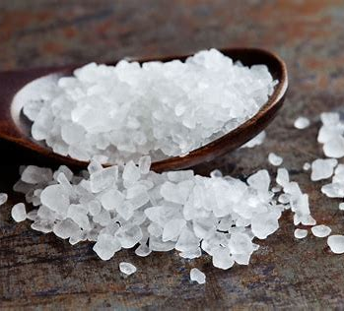
What is Salt used for?
It Preserves
It Seasons and Flavors
It is to be used - thirst
Share your thoughts

Slide 4
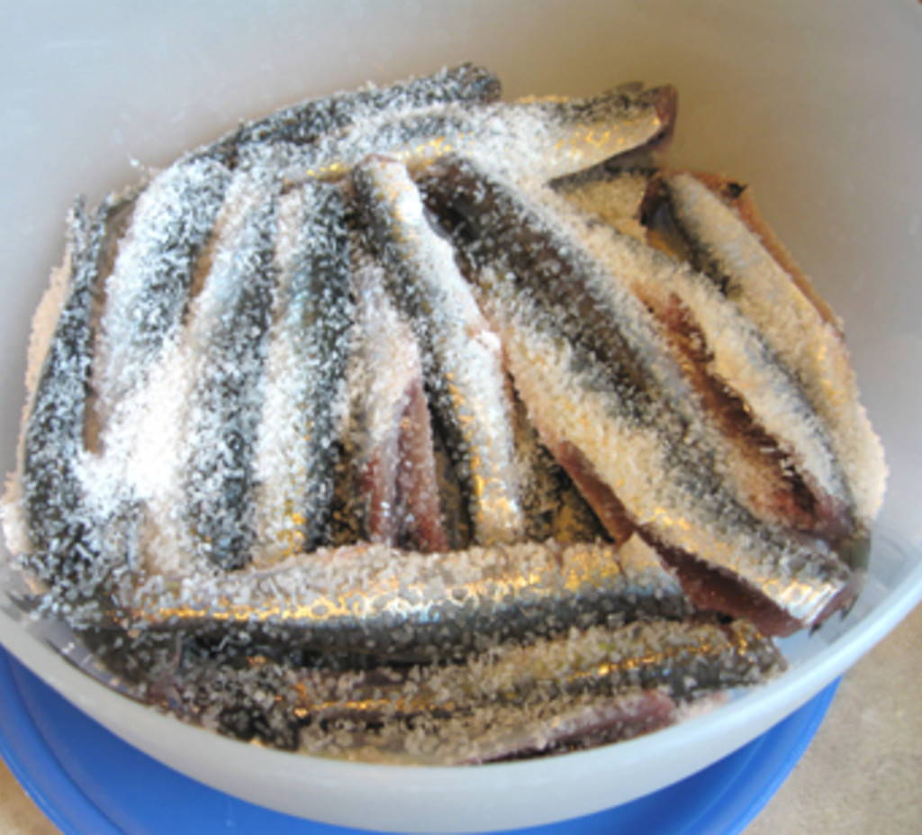
Preserve
Food was preserved by it.
How can we apply this for our country, ourselves.
Share your thoughts
Story of preserving stamps / food / comics

Slide 5
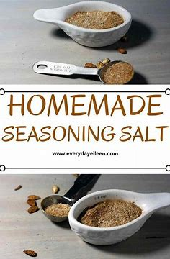
Season & Flavor
We are to bring the best out of others
We add flavor for good to humanity
Share your thoughts
Story of a mom’s soup

Slide 6
Creating the Thirst – for His Grace
Story of the Resume – we help people → grace
Zacchaeus & Bartimaeus – path of grace
Paralyzed Man – the mat was place in the path of Grace
Share your thoughts

Slide 7
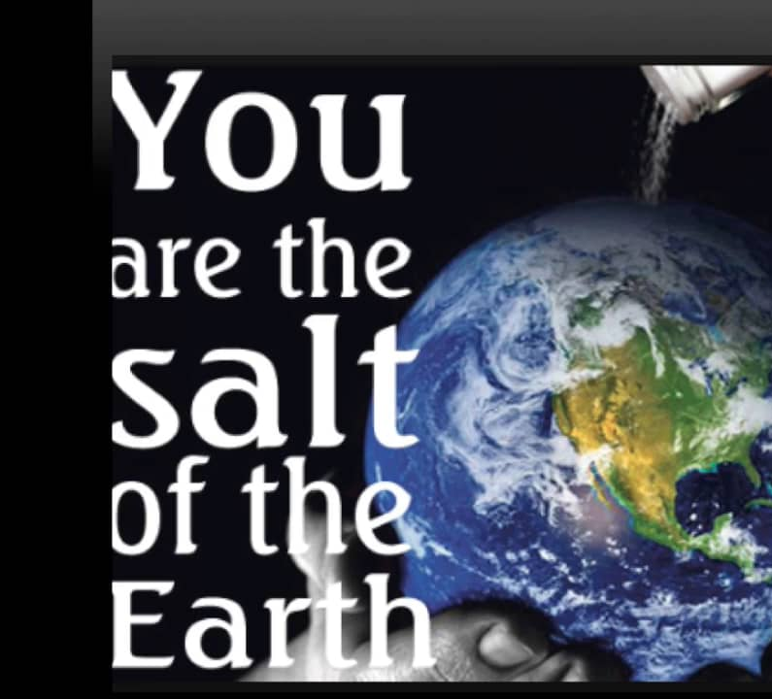
Summary
It Preserves
It Seasons and Flavors
It is to be used - thirst
Share your thoughts

