Slide 1



Pathfinder Club Organization & Programming
DARIBEL ALVAREZ
COORDINATOR CENTRAL WEST
Notes:
DAR LA BIENVENIDA,
COJER LA ASISTENCIA
QUIENES SON NUEVOS DIRECTORES
QUE SE PRESENTEN CADA UNO.

Slide 2
Steps In Organizing a Pathfinder Club
Counsel with the Conference Youth Department
Meet with your Pastor
Present the plan to the church board.
Notes:
THIS ARE THE 3 FIRST STEP YOU NEED TO DO FOR BE A PATHFINDER DIRECTOR.
Get ALLTHE information for the pathfinder club.

Slide 3
Second meeting of the Church Board to elect Pathfinder Director and Staff.
Inform the congregation during the worship service.
Pathfinder Staff.
Notes:
when you done doing all this steps, you need to be training to help you and your staff to work with the pathfinder club. and thats why whe are here.

Slide 4


Notes:
Pathfinder officers and staff attend conference Pathfinder Basic Staff Training Course. THAT'S WHY WE ARE HERE AT AWAKEN.
BECAUSE SOME OF US ARE DIRECTORS OR STAFF OF THE PATHFINDER CLUB.

Slide 5
Breakout

Slide 6
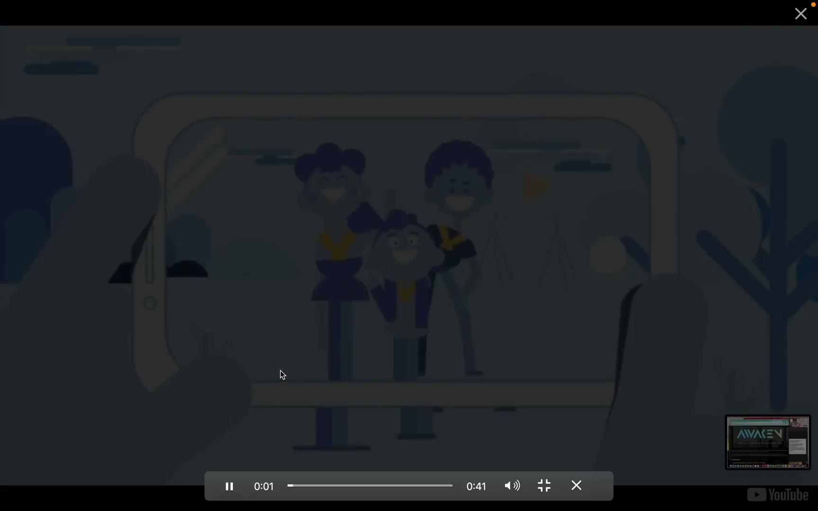
Notes:
Advise, write letters or personally contact potential families.
YOU CAN USE THE VIDEO THAT THE CONFERENCE MADE TO PROMOTE THE CLUB.
OR THEY CAN MAKE ONE WITH THEIR PATHFINDERS.
WE NEED TO USE THE TECHNOLOGY AND MAKE A GREAT PROMOTION. SO THEY CAN FIND MORE KIDS FOR THE CLUB
AND SELECT A DAY WITH YOUR STAFF TO DO THE REGISTRATION,

Slide 7
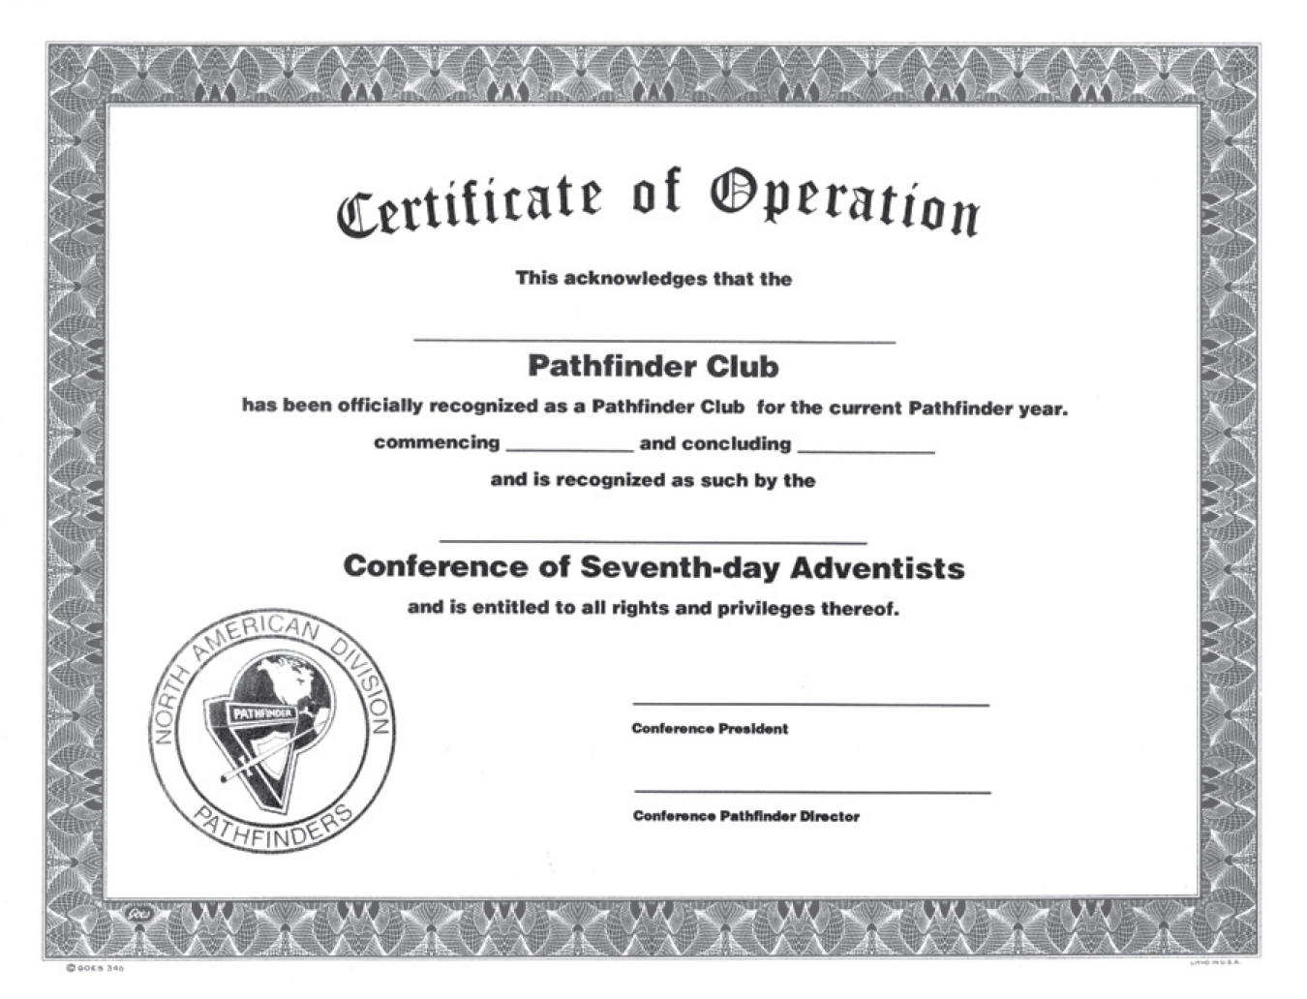
Notes:
WHEN YOU ARE A NEW CLUB THEY HAVE TO GO TO THE CONFERENCE TO REGISTER THE CLUB. AND THEN THE CONFERENCE GIVES THEM A CERTIFICATE LIKE THIS.

Slide 8
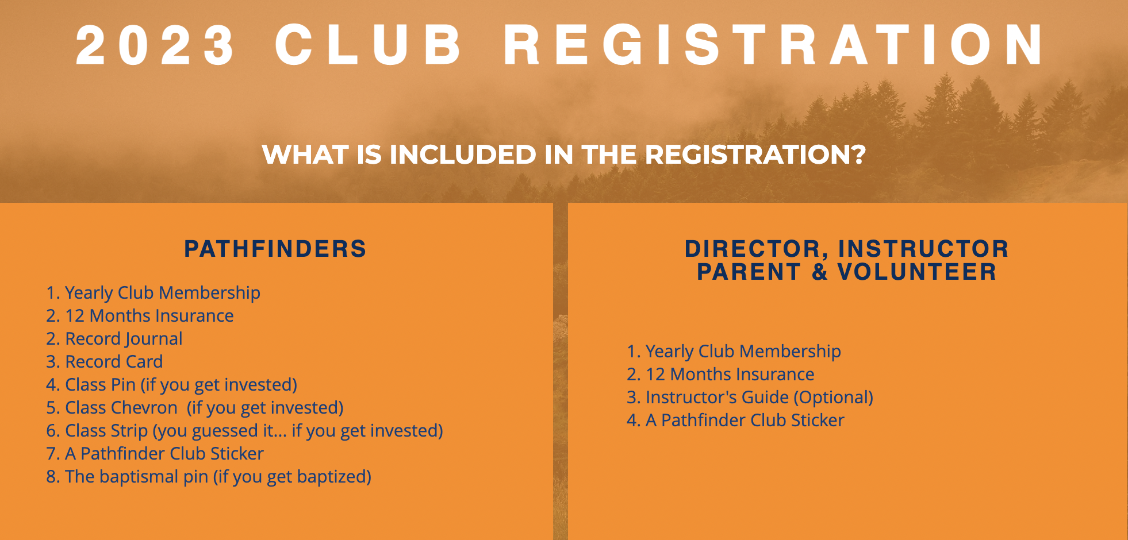
Notes:
All Pathfinders must pay membership and insurance fees as required. $11 AT THE BEGINNING OF THE YEAR I ALWAYS GIVE THE PATHFINDERS AND STAFF A NEW SHIRT. SINCE SOME OF THEM GROWN UP AND OTHERS ARE NEW. WELL, I ADDED $10 OR $15 MORE TO THAT $11. THATS MEAN A WILL ASK THE PARENT $20 OR $25 FOR EACH PATHFINDER. THEY WILL PAY THAT ONLY ONE TIME.
I PERSONALLY DO T SHIRT AND I DO DISCOUNT FOR THE CHURCH. IF SOME IS INTEREST ONLY LET ME KNOW WHEN WE ARE DONE.

Slide 9
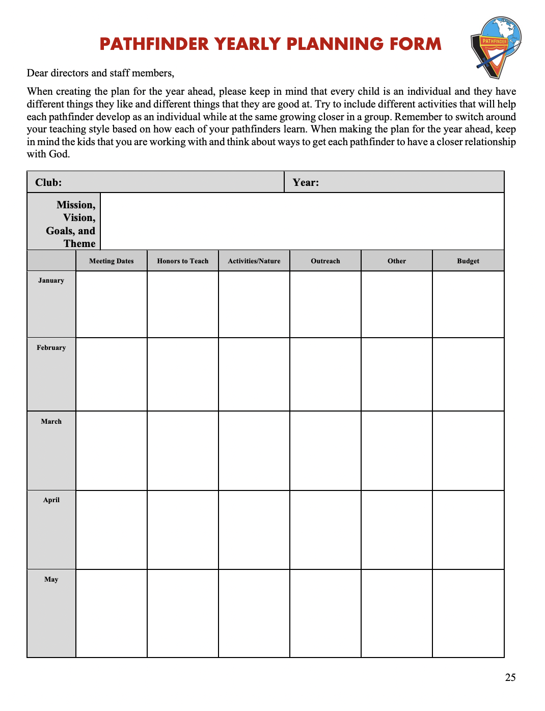

Notes:
Plan yearly program. WE CAN FOUND THIS AT THE MANUAL. WE NEED TO SEND THIS TO THE CONFERENCE.
BUT BEFORE MAKE THIS I LIKE TO DO MY CALENDAR. GO TO NEXT SLIDE.

Slide 10
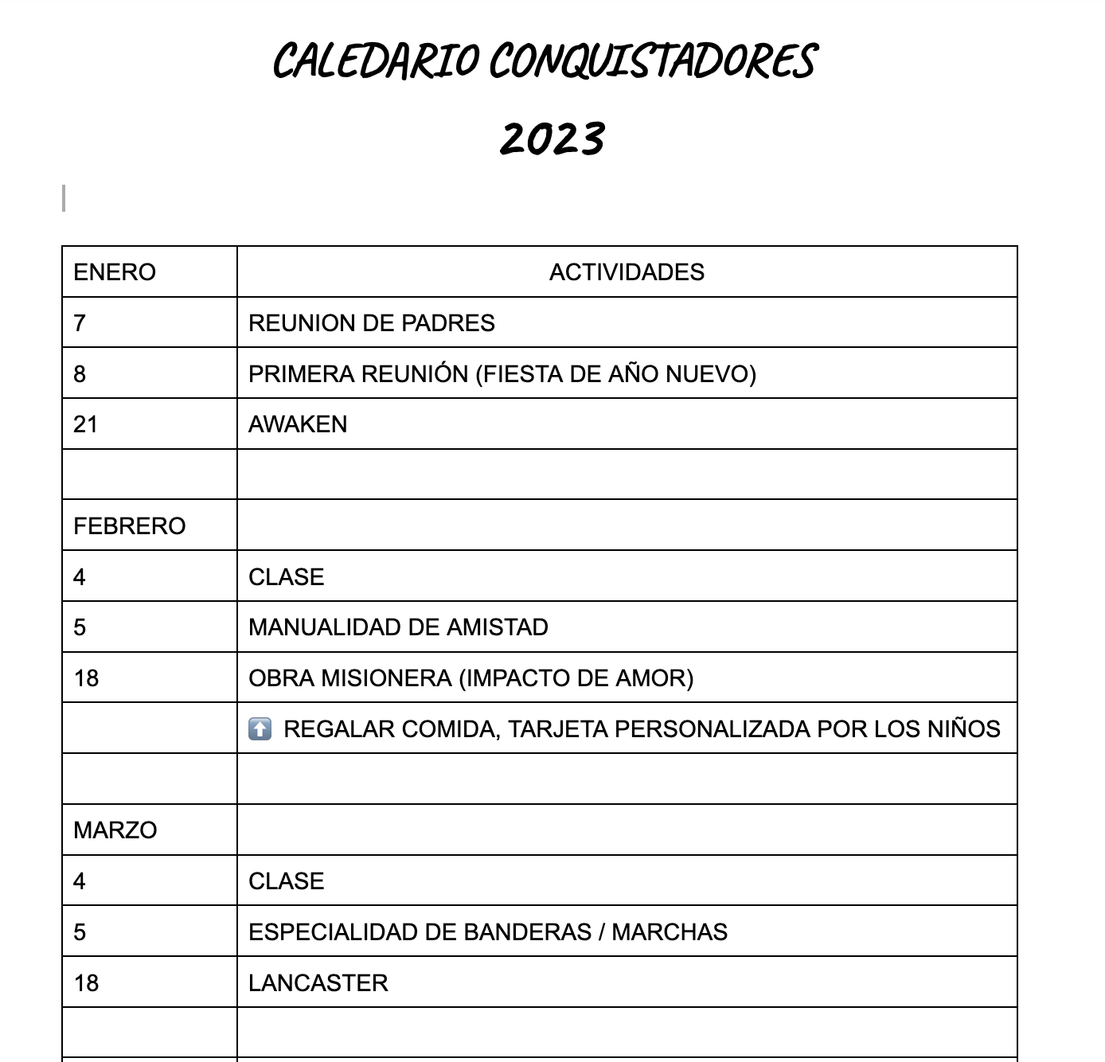
Notes:
I LIKE TO DO THE PLAN YEAR LIKE THIS FIRST TO MAKE SURE EVERYTHING I WANT TO DO IS ON IT.
Present all plans at a Pathfinder Staff Meeting.
IN THE MEETING DISCUSS ALL THE PLAN YEAR IF THEY HAVE MORE IDEAS YOU CAN CHANGE OR ADD TO THE CALENDAR.

Slide 11
Breakout

Slide 12
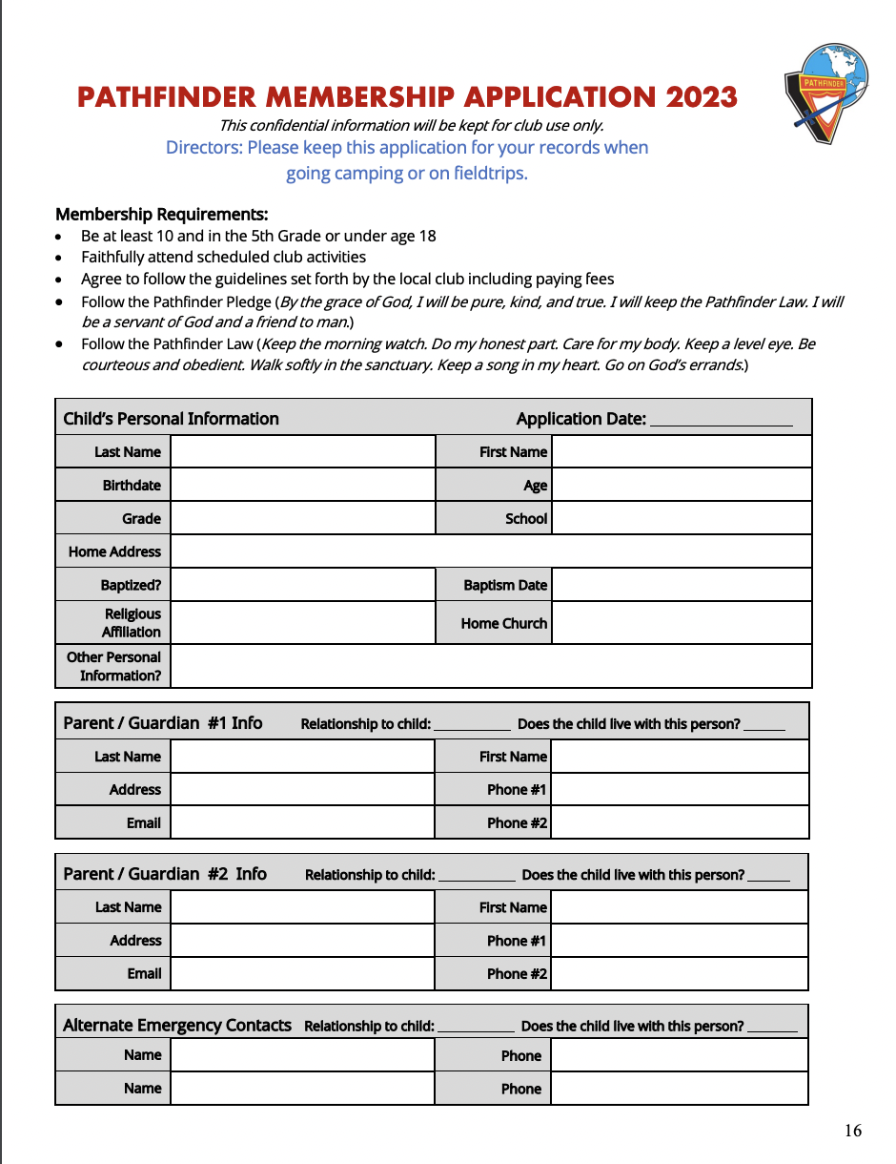
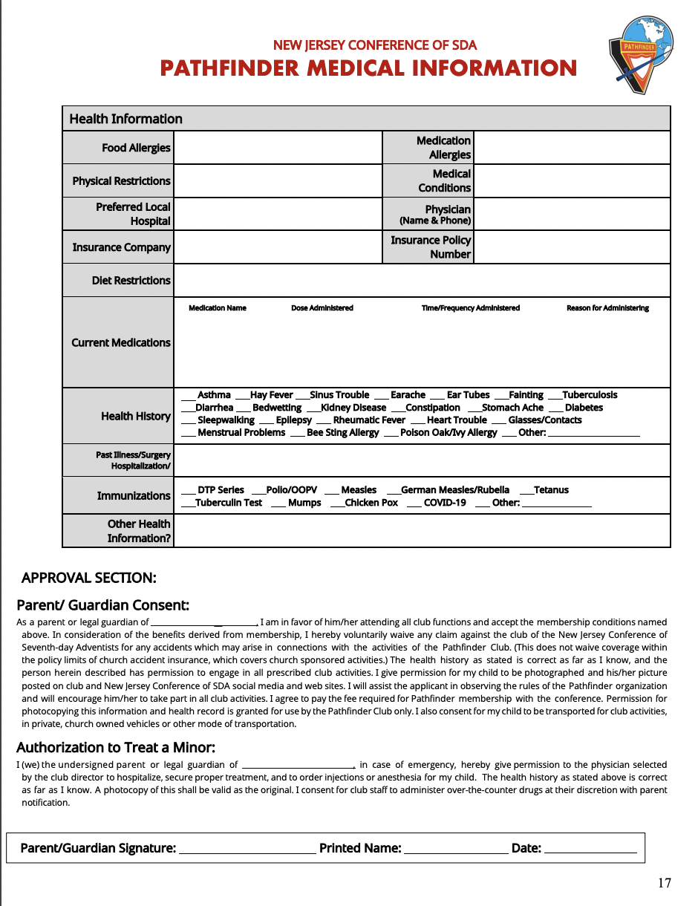
Notes:
IT IS VERY IMPORTANT THAT EACH DIRECTOR HAS A FOLDER WITH ALL THE DOCUMENTATION OF THEIR PATHFINDERS. AND FOR ALL TRIP OR ACTIVITY YOU HAVE TO TAKE IT WITH YOU.

Slide 13
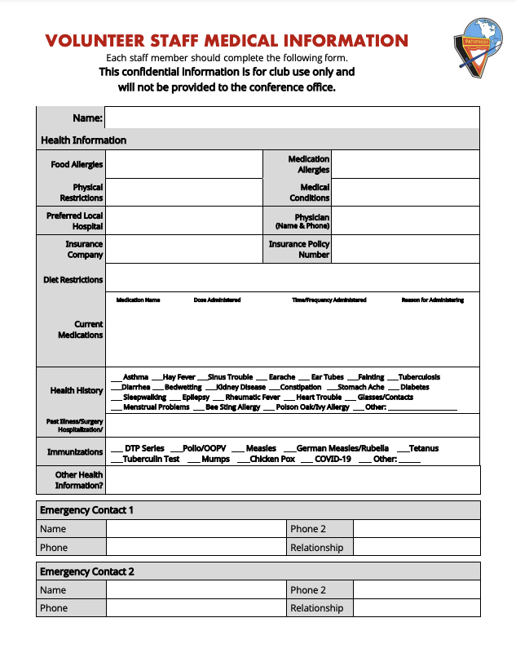
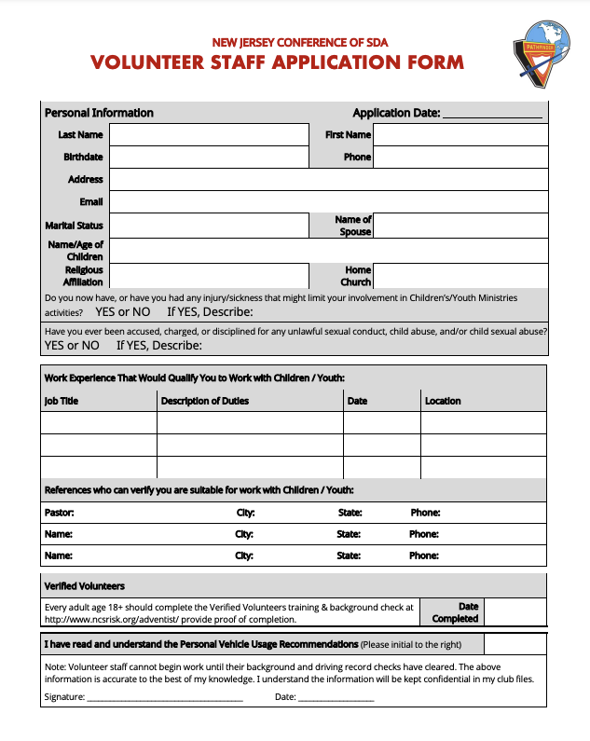

Slide 14
Breakout

Slide 15
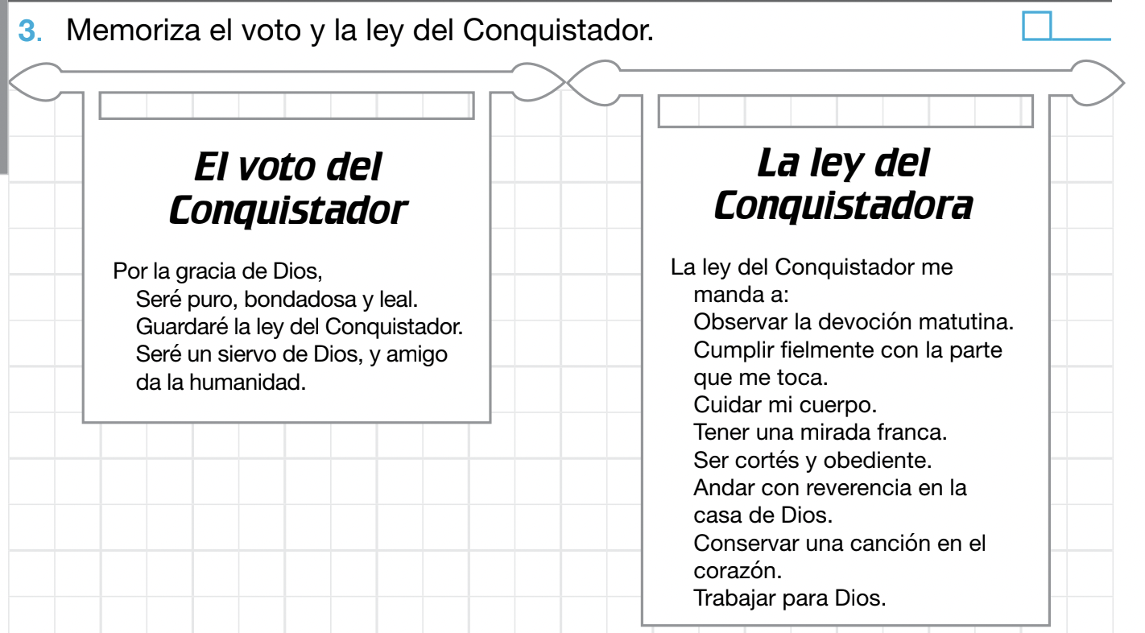
Notes:
Pathfinders must come to meetings and club-sponsored events in the uniform unless otherwise indicated by club director. CLASE C
Learn and keep the Pledge and Law.

Slide 16

Notes:
IF WE WANT TO HAVE A GOOD CLUB. WE MUST KEEP THESE POINTS IN MIND.
Faithful in attendance.
Participate in club activities.
Parents willing to support and cooperate with the club staff.

Slide 17
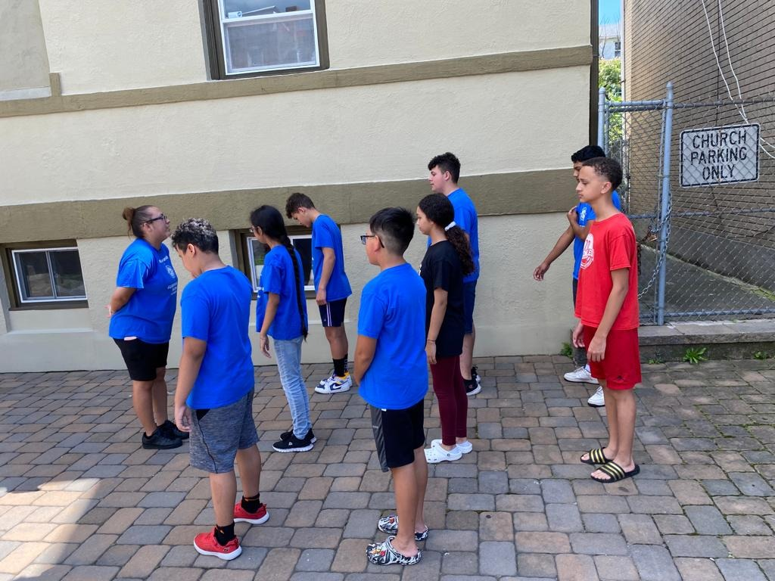
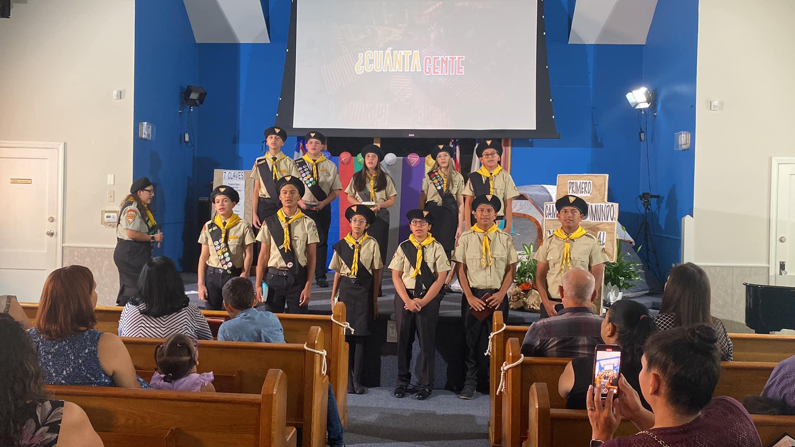

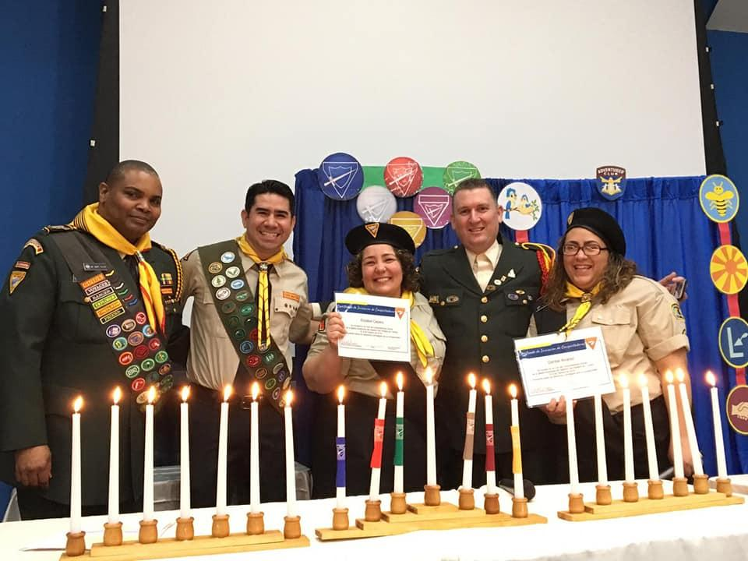
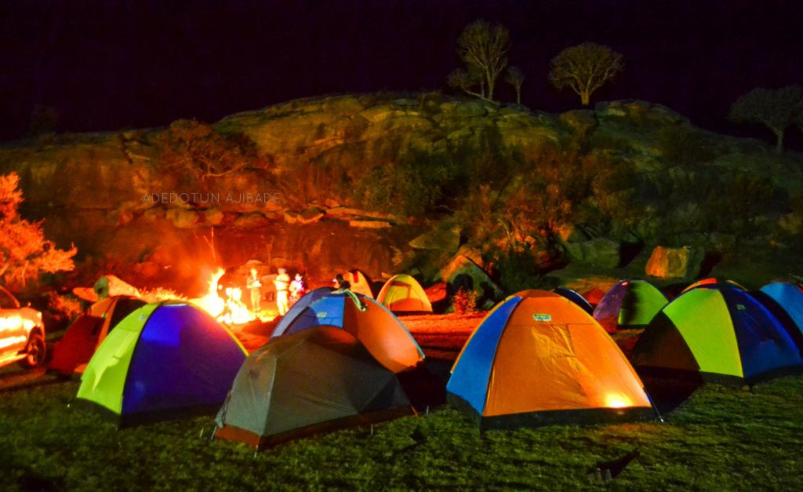
Notes:
WHAT WOULD BE THE PATHFINDER CLUB PROGRAM? WHO CAN TELL ME?
Meetings
Inductions
Pathfinder Day
Investitures
Conference Events
Camping

Slide 18
Breakout

Slide 19
UNIFORM
Notes:
Purpose of the Uniform
When it should be USED
When it should not be USED
Uniform for directors and counselors; also parade uniforms, and field uniforms.
Insignia and placement on uniform.

Slide 20

GIRL
Black Skirt or Pants (by Club)
Tan Blouse
Black Sash
Neckerchief & Slide
Dress Shoes
Black Pathfinder Belt
Black Socks or Tan Hose (by Club)
Black Tuxedo Tie (Staff Only)
Berets are optional
Notes:
Girls
Black Skirt or Pants (by Club)
Tan Blouse
Black Sash
Neckerchief & Slide
Dress Shoes
Black Pathfinder Belt
Black Socks or Tan Hose (by Club)
Black Tuxedo Tie (Staff Only)
Berets are optional

Slide 21
BOY
Black Pants
Tan Shirt
Black Sash
Black Socks
Neckerchief & Slide
Black Dress Shoes
Pathfinder Belt
Black Tie (Staff Only)
Berets are optional
Notes:
Boys
Black Pants
Tan Shirt
Black Sash
Black Socks
Neckerchief & Slide
Black Dress Shoes
Pathfinder Belt
Black Tie (Staff Only)
Berets are optional

Slide 22
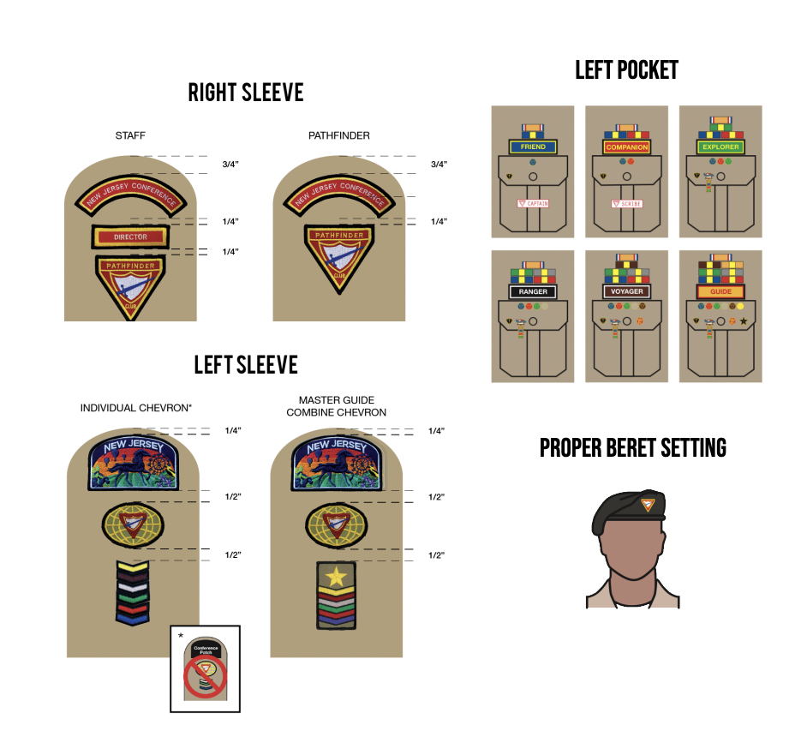
Notes:
IN THIS PART OF THE UNIFORM, IT IS VERY IMPORTANT THAT YOU SEE THE MEASURES THAT ARE PRESENTED HERE. EACH PATCH HAS ITS PLACE.

Slide 23
Breakout

Slide 24
HONOR
TRIPS
MONTHLY FEE
CRAFT
SUPPLY
Notes:
I DO THIS SINCE I START MY CLUB ON TRENTON. AND I ASK THE PARENT $5 EVERY MONTH. AND WITH THAT I BUY THE HONOR. BUT YOU CAN CHOOSE YOUR BETTER OPTION. EVEN YOU CAN USED FOR WHATEVER YOU NEED FOR THE CLUB.

Slide 25
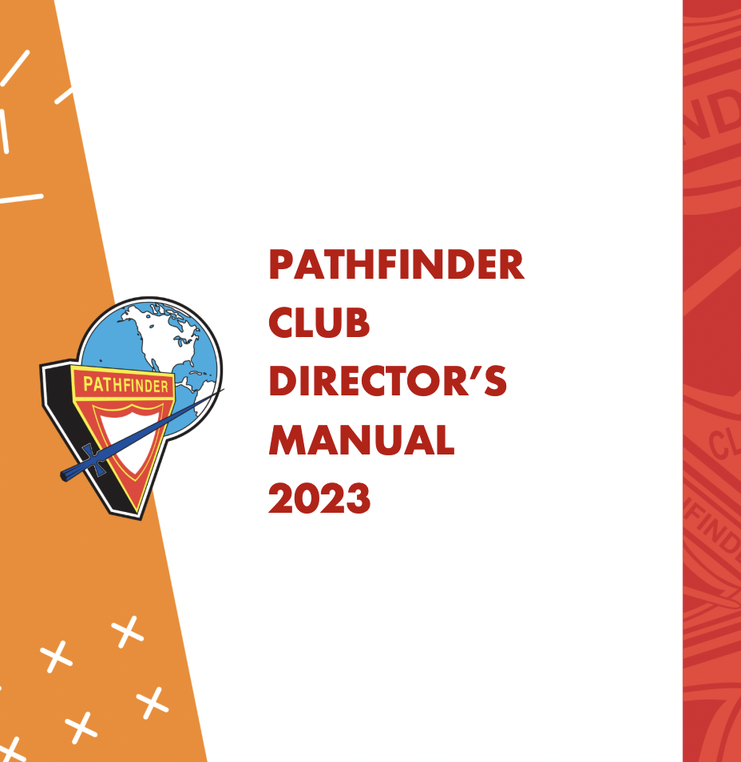
Notes:
https://www.njcyouth.com/_files/ugd/62c177_1b10ff685b9946b8a21b7a05c24138c6.pdf
IS IMPORTANT TO HAVE THE PATHFINDER MANUAL. HERE YOU GONE FOUND ALL THE INFORMATION YOU NEED TO HAVE.

Slide 26
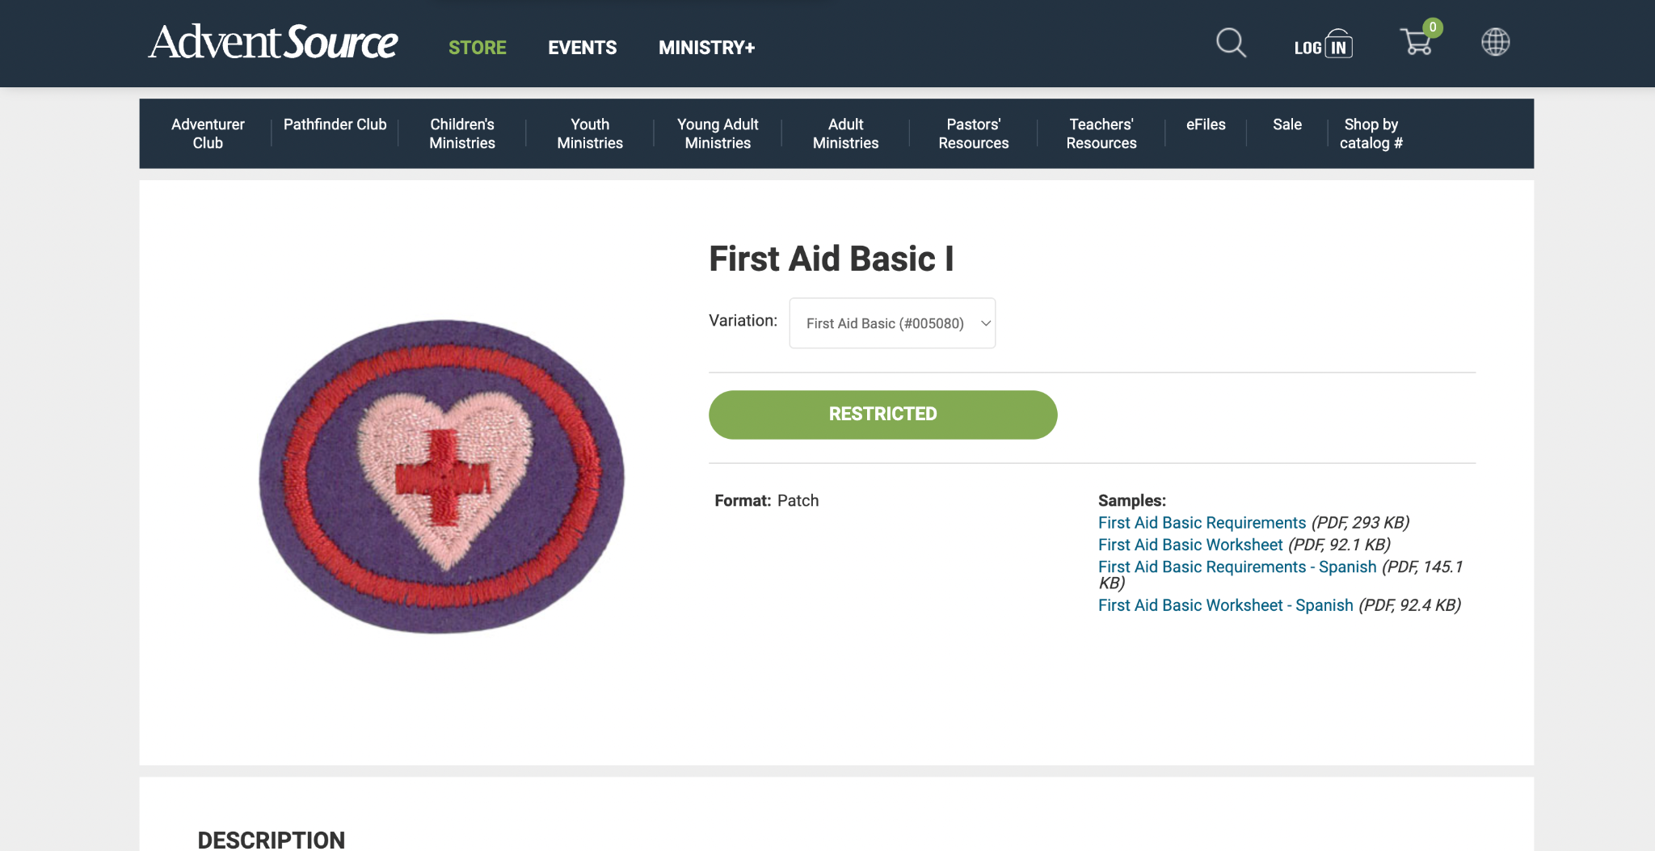
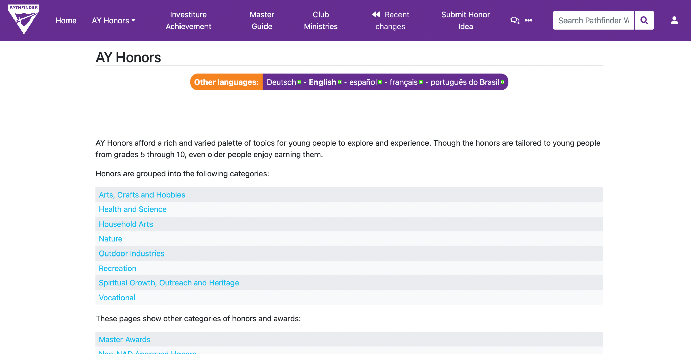
Notes:
https://wiki.pathfindersonline.org/w/AY_Honors
https://www.adventsource.org/store/pathfinder-club/investiture-patches-and-pins/honors/first-aid-basic-i-730
FOR THE HONOR I USE THIS TWO LINK. ONE HAVE THE WORK SHEET AND THE OTHER ONE HAVE THE INFORMATION.

Slide 27


Slide 28
THANK YOU
GOD BLESS YOU ALL

