Slide 1



THE PURPOSE AND UNDERSTANDING OF PATHFINDERS
Sara Mejia
New Jersey Conference

Slide 2


The Pathfinder Club is a church-centered spiritual and recreational program for young, ages 10-15.
9 Ideals and objectives of the seventh-day Adventist Church must be made relevant and attractive to its youth. To do so, the following goals must be achieved:
Help the youth to understand that God loves them, cares for them and appreciates them.
Encourage Pathfinders to discover their own God-given potential.
Inspire young people to give personal expression of their love for God.
Make the personal salvation of each Pathfinder the priority of the Pathfinder club.
Build into a Pathfinder’s life a healthy appreciation and love for God’s Creation.

Slide 3
The Pathfinder Club is a church-centered spiritual and recreational program for young, ages 10-15.
9 Ideals and objectives of the seventh-day Adventist Church must be made relevant and attractive to its youth. To do so, the following goals must be achieved:
6. Teach Pathfinders specific skills and hobbies that will make their lives more
satisfying and will occupy their time with profitable accomplishments.
7. Encourage the Pathfinder to keep physical fit.
8. Give opportunity for the development of leadership.
9. Seek to foster the harmonious development of the physical, social, intellectual,
and spiritual life of the Pathfinder

Slide 4


WHAT WE INTEND TO ACCOMPLISH
  Understand the issues faced by Pathfinder age (10-16) children
  Understand the purposes behind the Pathfinder program
  Understand how these purposes relate to the needs of this particular age group

Slide 5
ADOLESCENCE
  The term adolescence comes from the Latin verb adolescere, which means “to go into adulthood.”
  Transition between childhood and adulthood
  From about the ages of 11-19
  Adolescence is a period of rapid physical, cognitive,
  sexual, social and emotional changes.
  It is an adjustment period for the adolescent,
  their parents, and those who are in
  frequent contact with them.

Slide 6


Childhood
(dependent)
Adulthood
(independent)
Adolescence

Slide 7
How was your adolescence years?

Slide 8

THE ASPECTS OF DEVELOPMENT
Physical
Mental/Emotional
Spiritual/Moral

Slide 9


THE PHYSICAL CHARACTERISTICS OF ADOLESCENCE
  Rapid, irregular growth
  Undergo body changes that may result in awkwardness, lack of coordination
  Have varying maturity rates, with girls tending to mature 1.5-2 years earlier (on average) than boys
  Experience restlessness and fatigue due to hormonal changes
  Need daily physical activity because of increased energy

Slide 10

THE PHYSICAL CHARACTERISTICS OF ADOLESCENCE (CONT.)
  Increased sexual awareness
  Concerned with body changes that accompany sexual maturation
  Have a propensity towards junk foods but need good nutrition
  Many lack good physical fitness (poor physical strength, endurance, and flexibility)
  This is the age where experimentation with risky lifestyles occurs (sex/drugs/alcohol/tobacco etc)

Slide 11

THE MENTAL/EMOTIONAL CHARACTERISTICS OF ADOLESCENCE
  Display a wide range of intellectual development
  Transitioning from concrete to abstract thinking
  Are curious and dabble in a wide range of pursuits, few of which are sustained
  Prefer active over passive learning activities
  Prefer interaction with peers during learning activities
  Expression of sense of humor may take place at the most embarrassing and least expected times.

Slide 12

THE MENTAL/EMOTIONAL CHARACTERISTICS OF ADOLESCENCE (CONT.)
  Respond positively to opportunities to participate in real life situations
  Often preoccupied with self
  Have a strong need for approval and are easily discouraged
  Developing an increased understanding of personal abilities
  Are inquisitive about adults, often challenging their authority, and always observing them

Slide 13

THE MENTAL/EMOTIONAL CHARACTERISTICS OF ADOLESCENCE (CONT.)
  May show a disinterest in conventional academic subjects but
are intellectually curious about the world and themselves
  Experience mood swings with peaks of intensity and unpredictability
  Need to release energy, often in sudden, apparently
  meaningless outbursts of activity
  Seek to become increasingly independent, searching for adult identity and acceptance
  Are increasingly concerned about peer acceptance

Slide 14
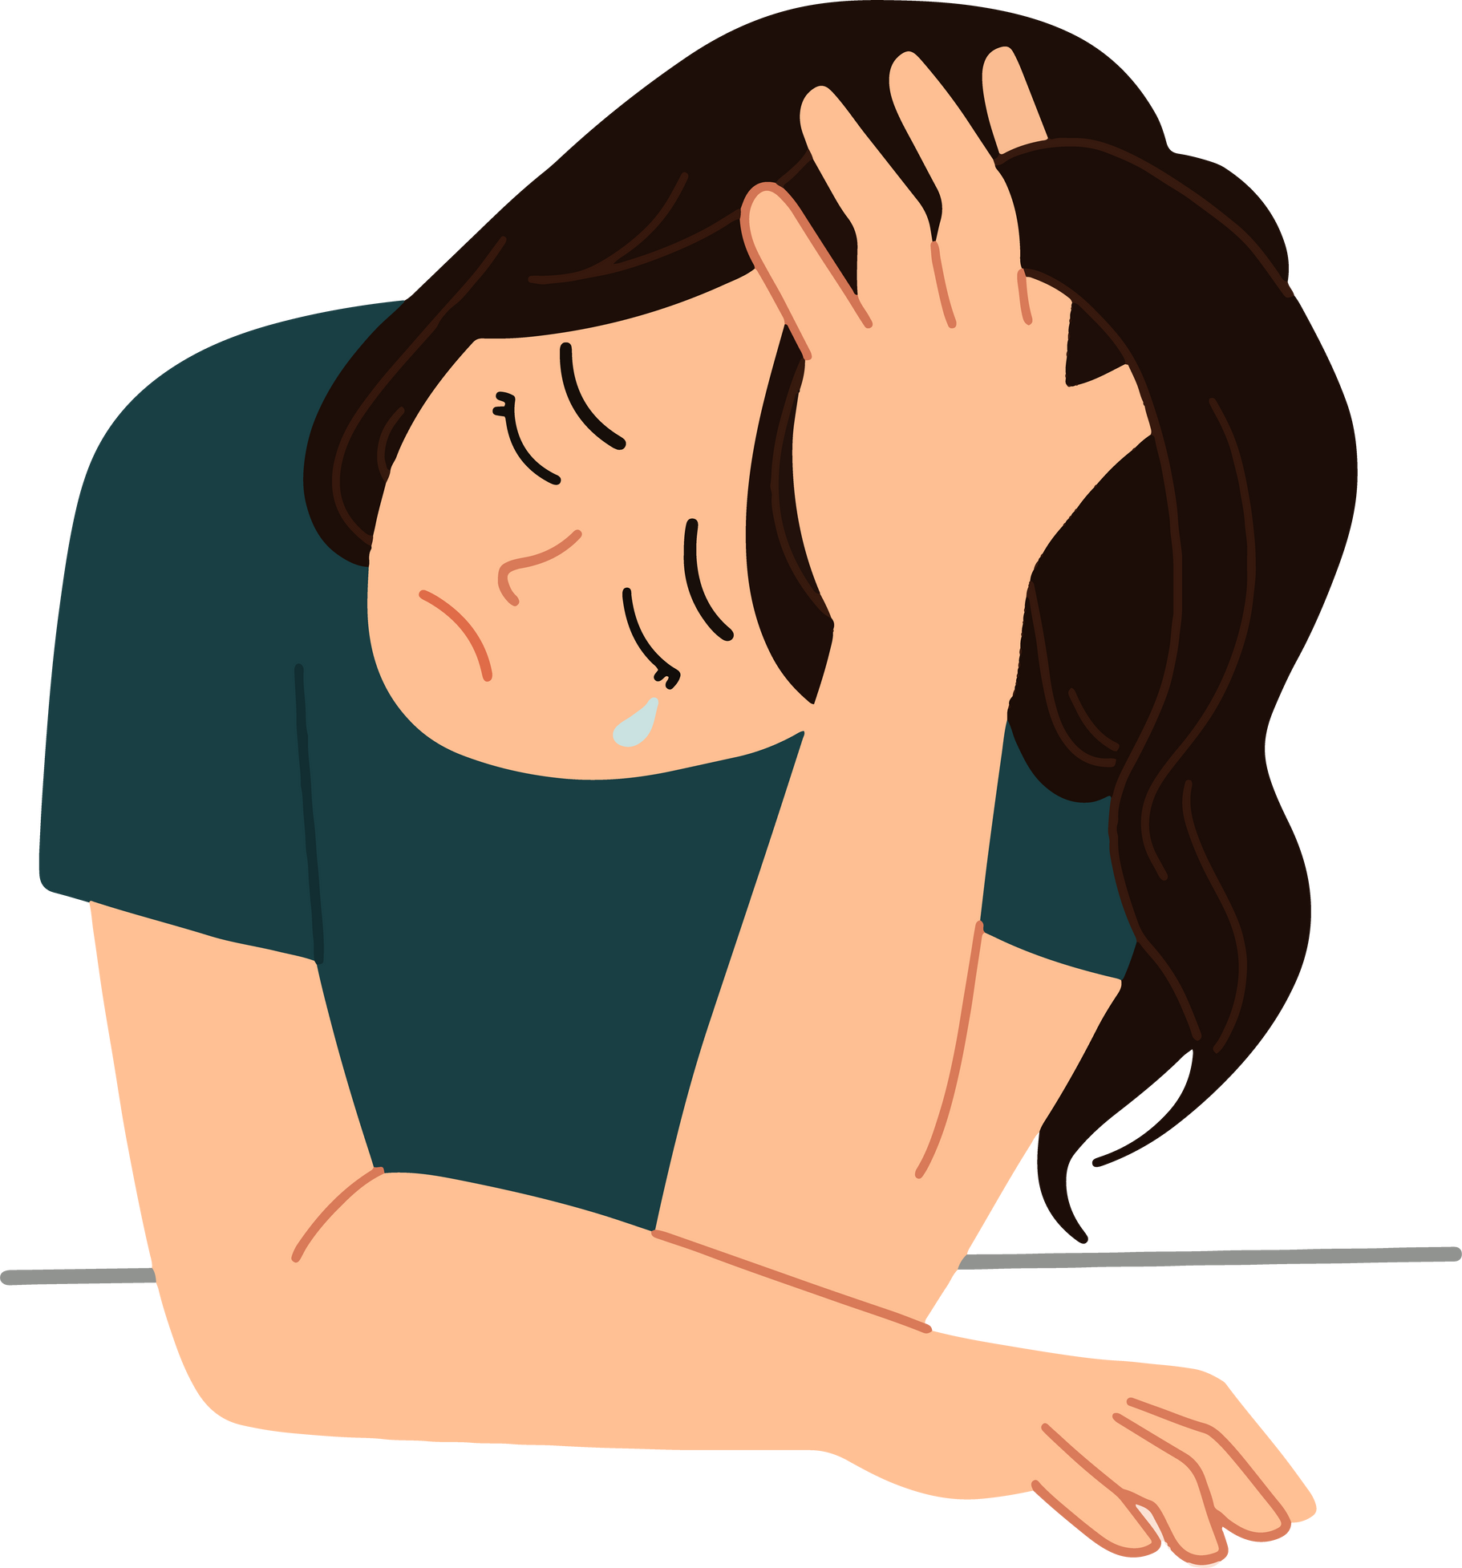
THE MENTAL/EMOTIONAL CHARACTERISTICS OF ADOLESCENCE (CONT.)
  Tend to be self conscious, lacking in self esteem, and highly sensitive to criticism
  Increasingly behave in ways associated with their gender
  Are concerned with many societal issues as their personal value system develops
  Believe that their personal problems, feelings, and experiences are unique to them

Slide 15

THE MORAL/SPIRITUAL CHARACTERISTICS OF ADOLESCENCE
  Often show compassion for those who are downtrodden or suffering
  Are moving from acceptance of adult moral judgments to development of their own personal values
  Are capable of participation in discussion of spiritual values
  They need and are influence by trustworthy adult role models who will listen to them and affirm their positive spiritual values
  Are increasingly aware of and concerned about inconsistencies between the values adults talk about and the values they exhibit

Slide 16


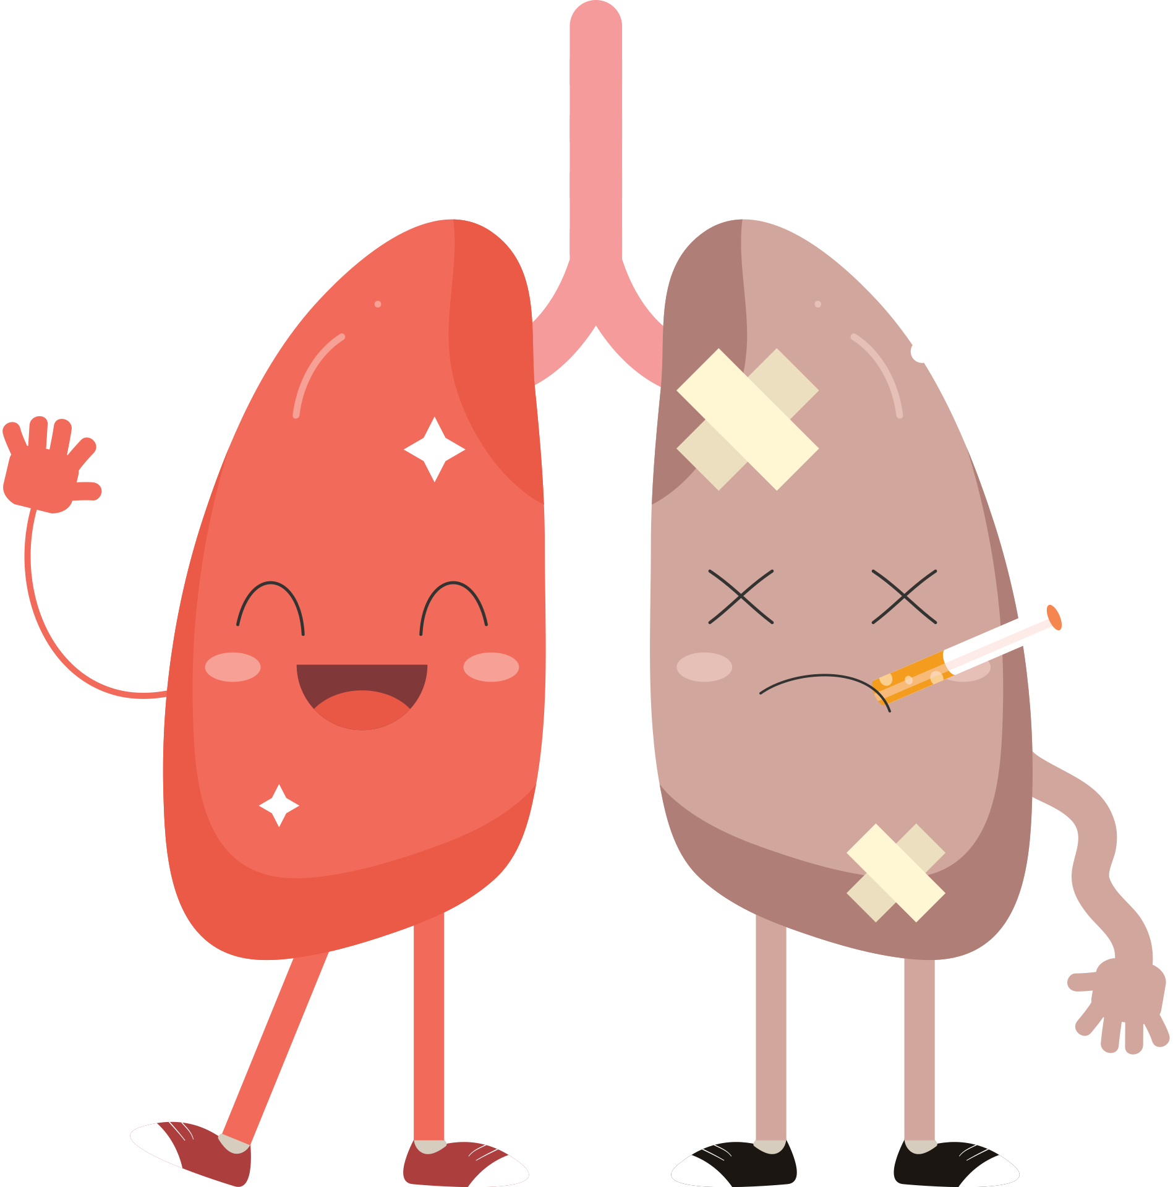
WHY WE SHOULD BE CONCERNED WITH ADOLESCENCE
  Young Americans between the ages of 13 and 24 are still contracting HIV at the rate of 2 per hour. Office of Natural AIDS Policy
  Every year 3 million teens--about 1 in 4 sexually active teens -- get a sexually transmitted disease (STD). American Social Health Administration
  One-third of all smokers had their first cigarette by the age of 14. Ninety percent of all smokers begin before the age of 21. American Lung Association
Notes:
Smoking- experience during high school years with cigarettes
Marihuana legalized in NJ Isaiah 5:20 Woe to those who call evil good, and good evil; who put dakness for ligh
Escuche al pastor Daniel Cabezas en su programacion matutina en Youtube acerca del suicidio de una joven.
Working at JCMC with many cases of suicide

Slide 17
WHY WE SHOULD BE CONCERNED WITH ADOLESCENCE
  Individuals who begin drinking before the age of 15 are four times more likely to become alcohol dependent than those who begin drinking at age 21. The National Center on Addiction and Substance Abuse at Columbia University
  Suicide is the third leading cause of death among youths ages 15 to 20. National Center for Health Statistics
Notes:
Smoking- experience during high school years with cigarettes
Marihuana legalized in NJ Isaiah 5:20 Woe to those who call evil good, and good evil; who put dakness for ligh
Escuche al pastor Daniel Cabezas en su programacion matutina en Youtube acerca del suicidio de una joven.
Working at JCMC with many cases of suicide

Slide 18
“WOE TO THOSE WHO CALL EVIL GOOD, AND GOOD EVIL; WHO PUT DARKNESS FOR LIGHT, AND LIGHT FOR DARKNESS; WHO PUT BITTER FOR SWEET, AND SWEET FOR BITTER”
ISAIAH 5:20 NKJV

Slide 19
Share at least 5 reasons why understanding adolescence
is important in working with Pathfinders
______________
______________
______________
______________
______________
Notes:
GROUP DISCUSSION - 1 - ADD OTHER CONCERNS, 2 - MENTION ANY INSTANCES WHERE PATHFINDER SHOW EMOTIONAL CARACTERISTICS PRESENTED HERE AND HOW WAS IT SOLVED. WHO DO YOU INVOLVED IN RESOLUCTION CONCERNING YOUR PATHFINDERS?

Slide 20

THE PURPOSE OF PATHFINDERS

Slide 21

THE PURPOSE OF PATHFINDERS
1- Build relationships with Christ
2 - Teach young Christians to witness
3 - Grow Responsible citizens
4 - Provide positive mentors
5 - Build community
6 - Create opportunities for fun and fellowship

Slide 22

BUILD RELATIONSHIPS WITH CHRIST
  Research shows that 70% of all Adventist children who eventually become church members make their decisions before age 14.
  Study of scripture
  Study of church history
  Study of God’s creation

Slide 23

“TRAIN A CHILD IN THE WAY HE SHOULD GO, AND WHEN HE IS OLD HE WILL NOT TURN FROM IT”
PROVERBS 22:6

Slide 24

TEACH YOUNG CHRISTIANS TO WITNESS
  Witnessing is a lifestyle
  Outreach activities
  Full participation in local church ministry programs
  Pathfinders as a ministry to member and non-member children

Slide 25


“THE ADVENT MESSAGE TO ALL THE WORLD IN THIS GENERATION”
PATHFINDER AIM

Slide 26

“BUT IN YOUR HEARTS REVERE CHRIST AS LORD. ALWAYS BE PREPARED TO GIVE AN ANSWER TO EVERYONE WHO ASKS YOU TO GIVE THE REASON FOR THE HOPE THAT YOU HAVE. BUT DO THIS WITH GENTLENESS AND RESPECT.”
1 Peter 3:15

Slide 27
GROW RESPONSIBLE CITIZENS
  Balanced growth (triangle)
  Growth in knowledge
  Training ground for leadership
  Principles of Christian citizenship

Slide 28

“JESUS GREW IN WISDOM AND STATURE, AND IN FAVOR WITH GOD AND MAN”
LUKE 2:52

Slide 29

PROVIDE POSITIVE MENTORS
  Help Pathfinders understand that their church loves, needs, and appreciates them.
  Christian role models
  Help them learn what God has planned for their lives
  Someone to listen
Notes:
Many believe by doing these attracts and keeps pathfinders in church

Slide 30

“GO THEREFORE AND MAKE DISCIPLES OF ALL THE NATIONS, BAPTIZING THEM IN THE NAME OF THE FATHER AND OF THE SON AND OF THE HOLY SPIRIT, TEACHING THEM TO OBSERVE ALL THINGS THAT I HAVE COMMANDED YOU”
MATHEW 28:19,20

Slide 31

BUILD COMMUNITY
  Learn to work with others to accomplish goals
  Understand that they are not alone
  Become part of the fabric of the club, church, and society

Slide 32

”I DO NOT PRAY FOR THESE ALONE, BUT ALSO FOR THOSE WHO WILL BELIEVE IN ME THROUGH THEIR WORD; THAT THEY ALL MAY BE ONE AS YOU, FATHER ARE IN ME, AND I IN YOU, THAT THEY ALSO MAY ONE IN US, THAT THE WORLD MAY BELIEVE THAT YOU SENT ME”
JOHN 17:20-21

Slide 33
CREATE OPPORTUNITIES FOR FUN AND FELLOWSHIP
  Provide a safe environment for getting to know others
  Have fun in a Christian context
  Lots of opportunities for fellowship with the greater Pathfinder community

Slide 34

CONNECTING THE DOTS
Share the 6 reasons for
the Purpose of Pathfinders
__________
__________
__________
__________
__________
__________

Slide 35

IN SUMMARY
  Pathfinders is a ministry which is designed to deal with many of the issues facing adolescent children.
  It provides for a structured fellowship with fellow Pathfinders and adults
  It helps foster the development of values which provide a good foundation in adult life

