Slide 1
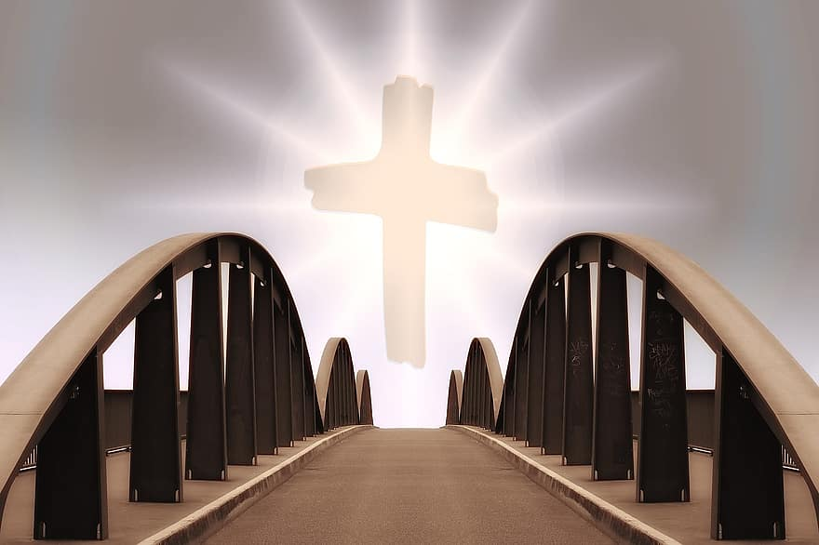
Planning Made Easy
The Bridge from What? To Why? Programs that really Matter
Karol Rivera
New Jersey Conference

Slide 2
BREAK OUT
WHY ARE YOUTH PROGRAMS SO IMPORTANT?
Notes:
Youth programs are very important because of the training it gives to the youth, because of the principles it establishes in their life moving forward, and because of the information that will be helpful in their spiritual life. It can help raise and inform many young groups, who will learn to comprehend what they are doing and why there are doing it.
3 minutes

Slide 3
10 Common reasons youth leaders do programs
Something-just fill the time that was given.
Nothing-we don’t do anything: we do nothing.
Anything-better than nothing: do anything.
Everything-Super busy, hyperactive, lots of activity.
One thing-focus on just one thing.
Best Thing-we only do high quality.
Same Thing-we’re in a rut, highly predictable.
New Thing-we only do the latest: we love fads.
Old Thing- stick with what the previous generation did.
My Thing-whatever I want, I don’t need a reason.
Break out
Choose one of the Common reasons that you think it’s more important and discuss it with your group.
Notes:
When a program has a clear purpose, it becomes a tool or galvanizing experience for spiritual growth. The types of programs we conduct are of great importance. We MUST know what we are doing and why we are doing it.
5 minutes

Slide 4
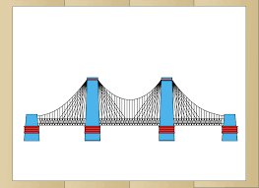
Point A: Program
Point B: Goal
What is the Goal you want to achieve with your program?
Having a goal is essential to provide direction for our programs. It must be a goal that motivates the youth group.
In order for you to know what you are doing you need a plan.
You need a plan to get from Point A to Point B.
Notes:
The illustration of the bridge represents (Point A) being your program to (Point B) being your overall goal
Each word that is spoken from Point A of your program to Point B is a measurement of how willingly you are perusing and desiring the objective to be.

Slide 5
BREAK OUT
Discuss what types of Youth Programs we do for our youth and
why do we do them/What's the purpose???
Notes:
5 minutes
Types of Youth Programs:
Youth groups (Bible Study)
Youth Day
Saturday Night Social/Recreational events
Prayer/Testimony
Camp Outs/ Youth Retreats
Etc.
Purposes:
Salvation/Heaven: “Save our youth”, “Get our kids to heaven”
Church attendance: “We need our young people in the pews each week”
Relationship: “Having a relationship with God is the only thing that matters”
Spreading the Gospel: “Preach the Advent message to all the world”
Serving the Community: “In the end, its about the sheep and the goats” – Matthew 25: 31-46
Entertainment: “Revive things now and they will stick around later”

Slide 6
PROGRAMS
Youth groups (Bible Study)
Youth Day
Saturday Night Social/Recreational events
Prayer/Testimony
Camp Outs/ Youth Retreats
GOAL
Christenlikeness
WHY???
HOW???
-Notice how the programs are big and appealing.
-Do you notice that the programs require ACTION?
If we do a program based on Jesus life and our Goal is to be like Christ it needs to lead into Action. It needs to be more specific.
You need something additional that relates to the goal and the program-something that links them together in a way useful for our purposes, plans, implementation, and evaluation.
You need a BRIDGE between your programs and your goal. You need a PHILOSOPHY.
Notes:
Lets consider the overall goal of “Christenlikeness”
What does Christenlikeness mean? More specific goals incorporated:
Accepting Christ as Savior
Accepting Christ as Lord
Relationship with God
Character development with the Fruits of the Spirit
Service through the gifts of the Spirit
Living + Spreading the kingdom of God
Joy and suffering

Slide 7
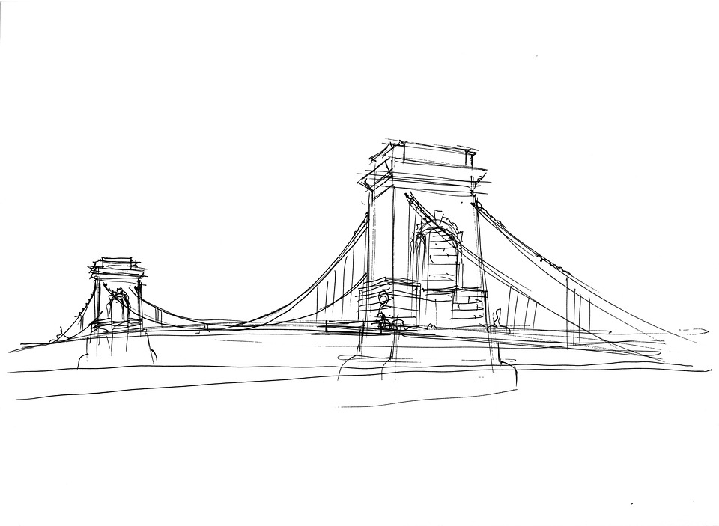
WHY?
WHY?
PROGRAMS
Youth groups (Bible Study)
Youth Day
Saturday Night Social/Recreational events
Prayer/Testimony
Camp Outs/ Youth Retreats
PHILOSOPHY
Fostering relationships that build responsible servant Leaders
GOAL
Christlikeness
HOW?
HOW?
THE BRIDGE: A statement of Philosophy
Notes:
Lets go from program to Philosophy, Why am I doing this program? Answer with Philosophy. You may use one or more parts of the philosophy, such as responsibility or service. Your goal should then answer the WHY of the philosophy. If these 3 parts do not complement each other, then you need to change your goal or your philosophy.
Now, lets go from the goal to the program and ask the HOW questions. “How can we experience the goal of christenlikeness? Answer using the philosophy. We then continue to program. How can we foster relationships that build responsible servant leaders?” We need to be able to answer the question with our actions in the Youth program.
One way of keeping a good and strong bridge is to record what you do each week and why you did it. As the year goes by, you can adjust what should keep happening and what needs to change. Ask the questions using the illustration above. “Did we foster relationships that build responsible servant leaders?”
The words in our philosophy are themes that guide the way we do ministry.
Why? Because it takes us to the goal!
How? By shaping everything we do in the youth ministry to implement a specific or several approaches!

Slide 8
Philosophy
Responsible
Freedom
Choices
Action
Servant
Received life; Give life
Don’t hoard
Look outside of Church
Leaders
Talents
Need one follower
Does not depend on Age
Empower others
Fostering
To influence things a certain direction
** Includes Planning ahead and being
proactive
Relationships
Bring people and God together/Closer
Although Sin causes separation, We find
Unity in Christ
That Build
Dynamic Part
Freshness and life

Slide 9
Notes:
8 minutes

Slide 10
Having a goal is essential to provide direction for our programs. It must be a goal that motivates the youth group.
“Suppose one of you wants to build a tower. Won’t you first sit down and estimate the cost to see if you have enough money to complete it?”
Luke 14:28
“Commit to the Lord whatever you do, and he will establish your plans.”
Proverbs 16:3

